Slide 1
1.Location
Australia is a country comprising the mainland of the Australian continent, the island of Tasmania, and numerous smaller islands.
It is located in the Southern Hemisphere, between the Indian Ocean and the Southern Pacific Ocean. Neighbouring countries include Indonesia and Papua New Guinea to the north; the Solomon Islands to the north-east; and New Zealand to the south-east.
Australia has an area of 7,7 mln square kilometers.

Slide 2
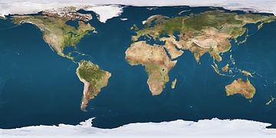

Slide 3
2. Government, currency and symbols
Australia is a constitutional monarchy a parliamentary system of government with Queen Elizabeth II at its apex as the Queen of Australia
The National Flag of Australia contains three elements: the British Union Flag, the Southern Cross - reflecting Australia's geographic position and six pointed star - representing the Federation of six states

Slide 4
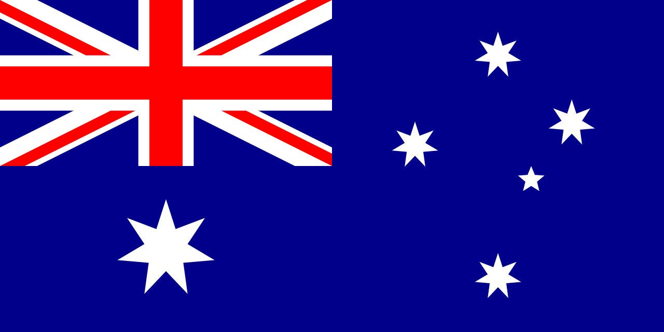

Slide 5
3. Australia’s Icons
In Australia there are many diffrent places, animals and monuments such as:
The Great Barrier Reef - the largest coral reef on Earth. It is home to many animals and plants

Slide 6
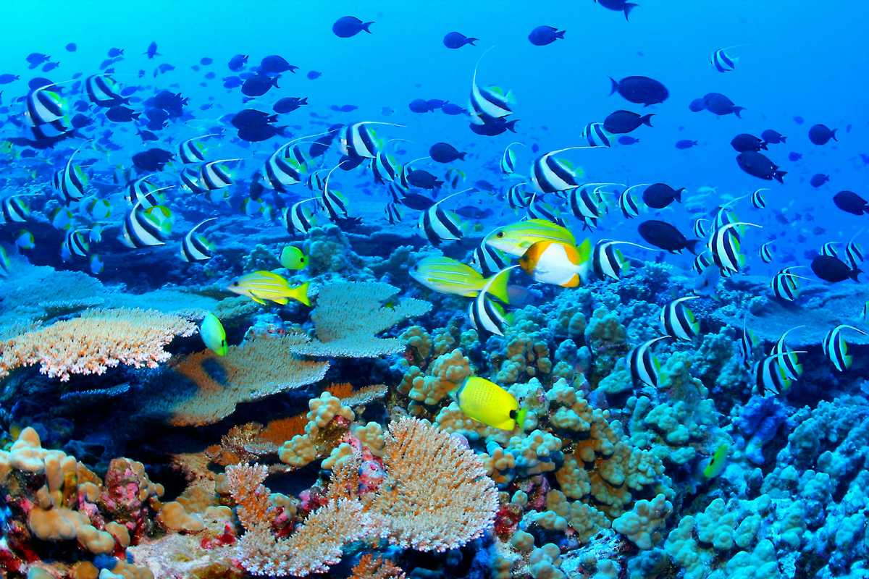

Slide 7
Famous animals:
Kangaroo – can hop and has a pouch

Slide 8
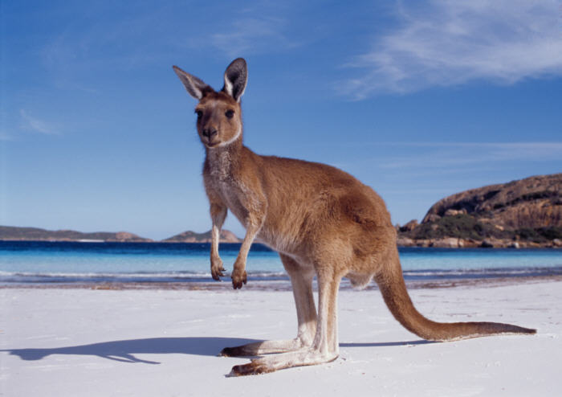

Slide 9
Koala - is an Australian marsupial ; it is not a bear

Slide 10
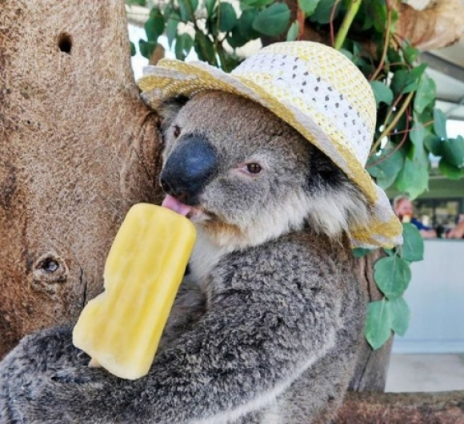

Slide 11
Emu and Kiwi - are the birds that cannot fly

Slide 12
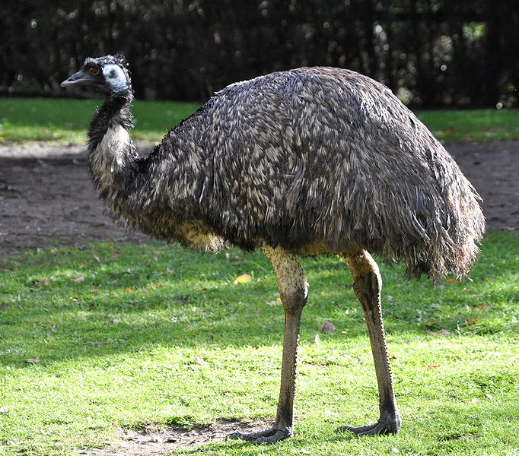
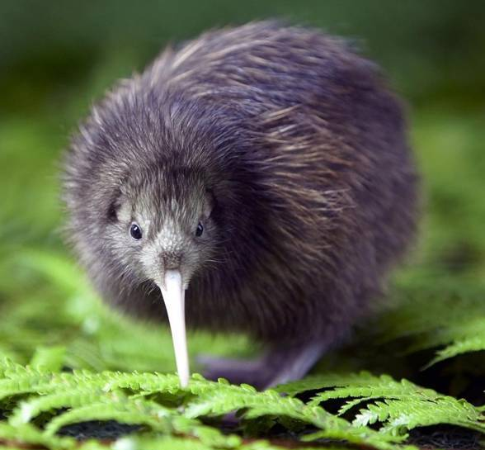

Slide 13
Blue Whale - is the biggest whale and the biggest animal that ever lived on Earth

Slide 14
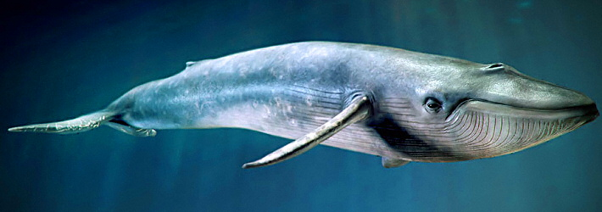

Slide 15
Famous monuments: Sydney Opera House and Sydney Harbour Bridge

Slide 16
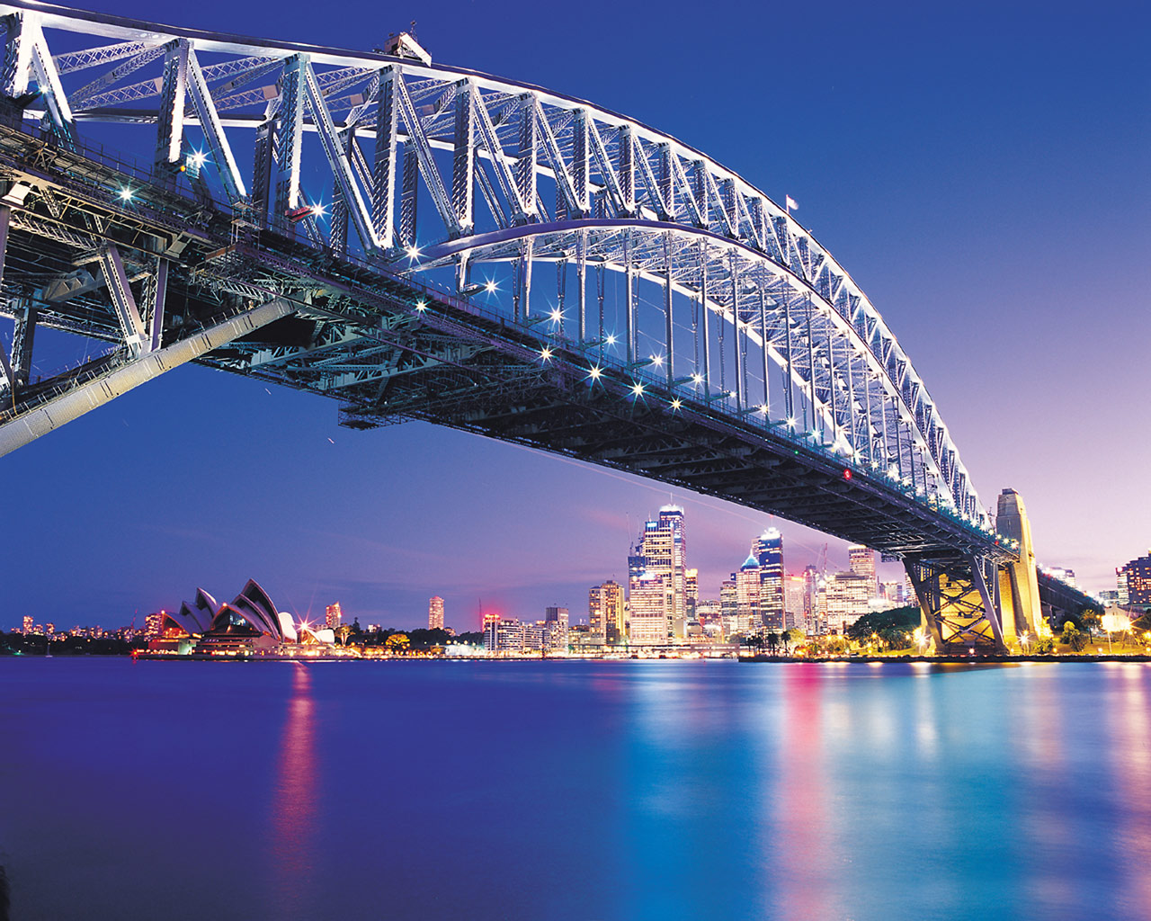
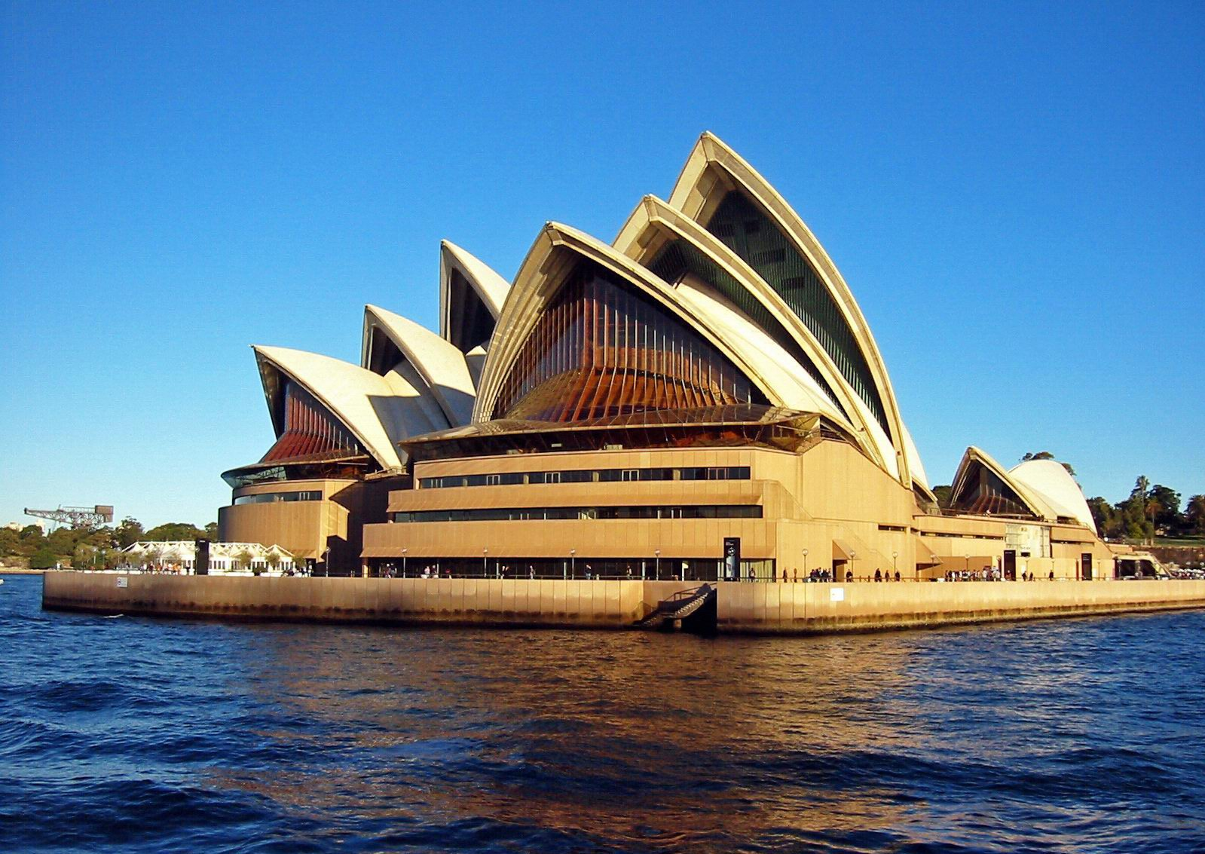

Slide 17
Aboriginal Australians - first Australians who lived in this continent 50,000 years ago.

Slide 18
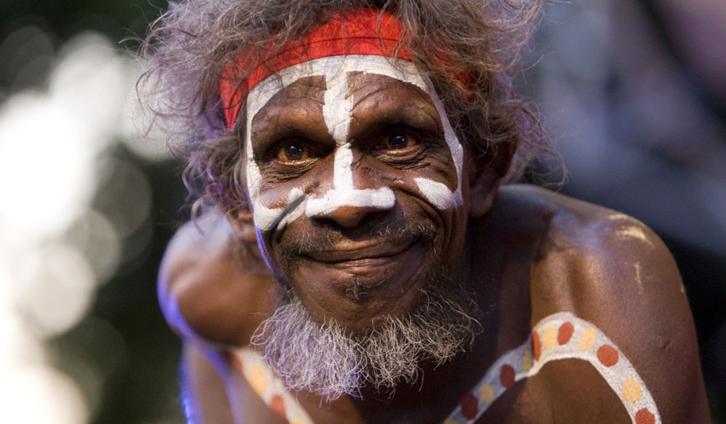

Slide 19
4. Famous people
Australia’s famous people include many actors (like Russell Crowe, Nicole Kidman), singers (like Kylie Minogue), sportspeople (like Cathy Freeman - Aborigen, who lit the Olympic flame at the 2000 Sydney Olympics Games) and writers (like Patrick White who won the 1973 Nobel Prize)

Slide 20
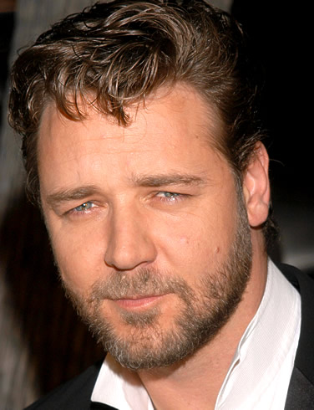
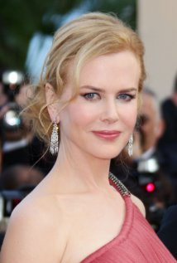
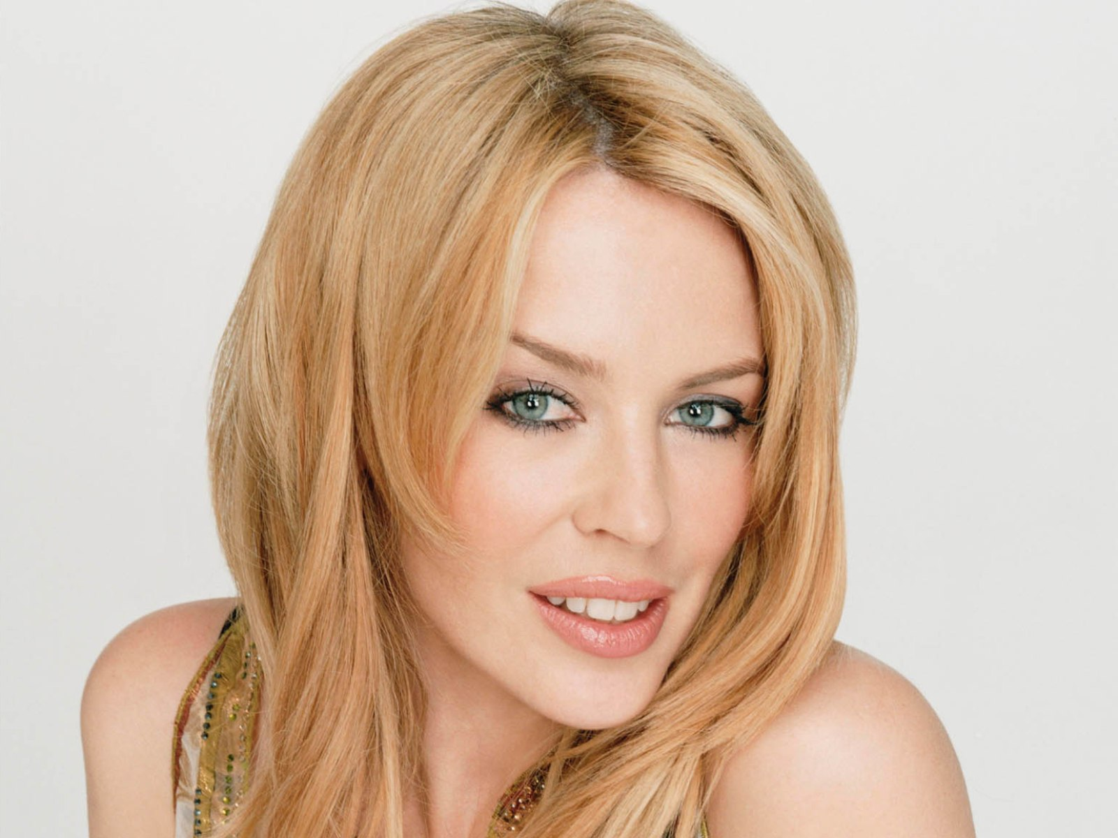
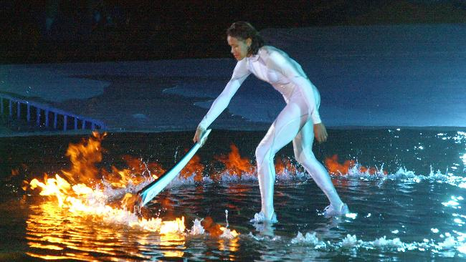
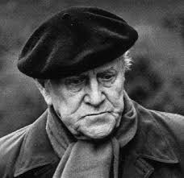

Slide 21
Australian kitchen
The most famous dish in Australia is Vegemite - food paste made from leftover brewers' yeast extract with various vegetable and spices

Slide 22
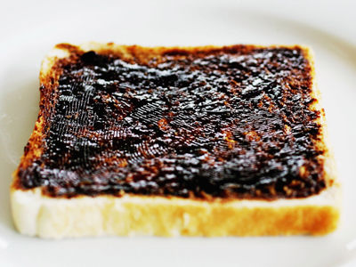

Slide 23
6. Trivia
It is the world's smallest continent and the sixth-largest country.
Australia has a population of about 20 million people.
Most of Australia's population lives on the fertile plains of the eastern and southeastern coasts.
The interior of Australia is dry with many deserts
Australia's tallest peak is Mount Kosciuszko, which is 2,228 m tall.

Slide 24
