Slide 1
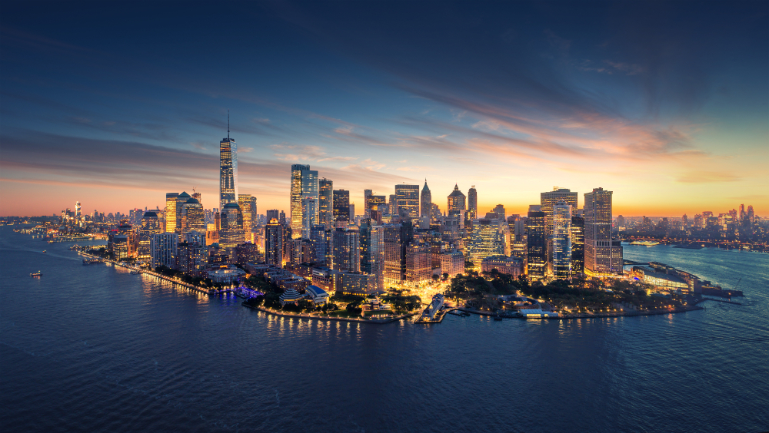
New York, New York…

Slide 2
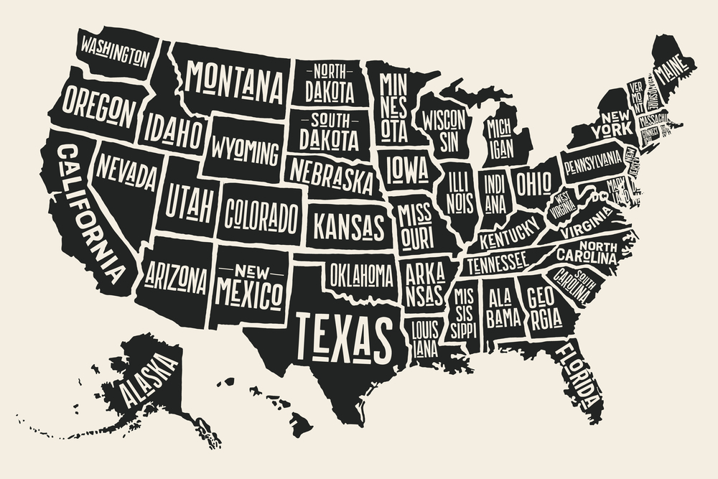
New York:
New York is a northeastern state with the 4th largest population in the United States.

Slide 3

Quick facts about New York…
- capital: Albany.
- population: 20 million people live across the state and 8 million live in New York City.
- nickname: The Empire State.
- key cities: New York City, Rochester, Albany, Buffalo, Syracuse, Yonkers
- postal Abbreviation: NY

Slide 4
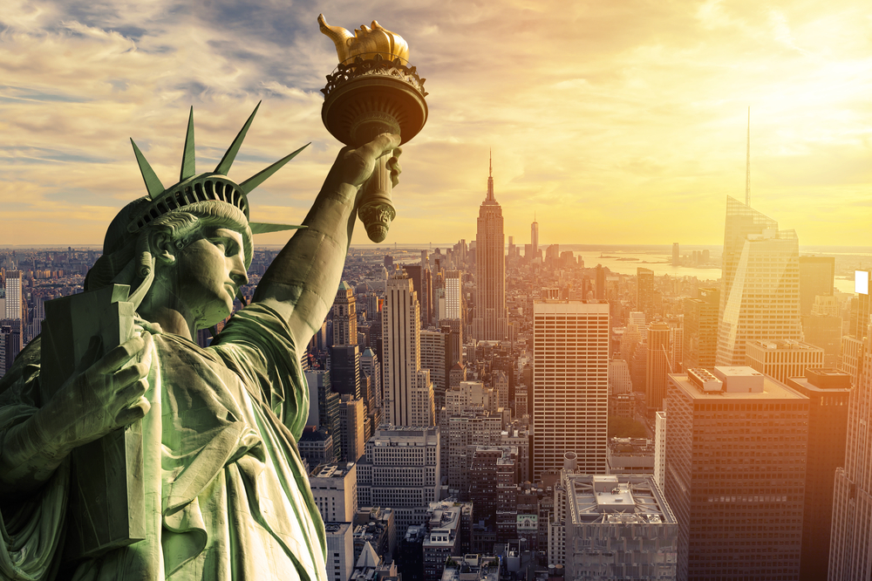
Statue of Liberty- a national symbol of the USA
Statue of Liberty

Slide 5
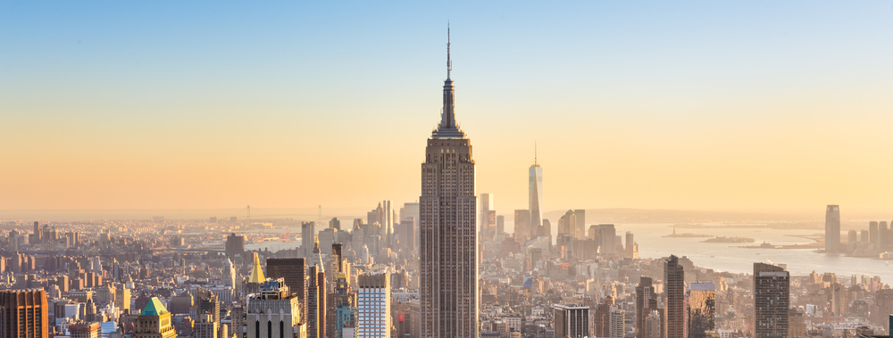
Empire State Building- the tallest building in New York

Slide 6
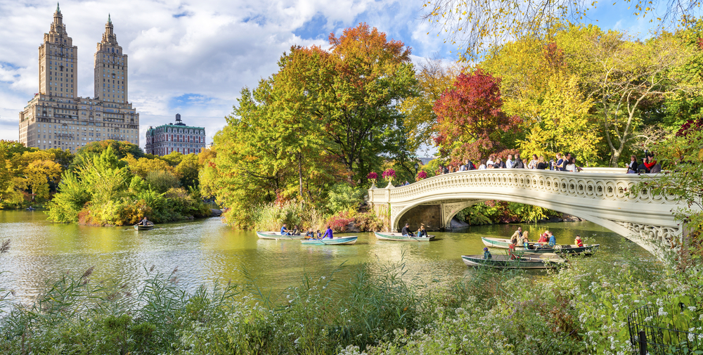
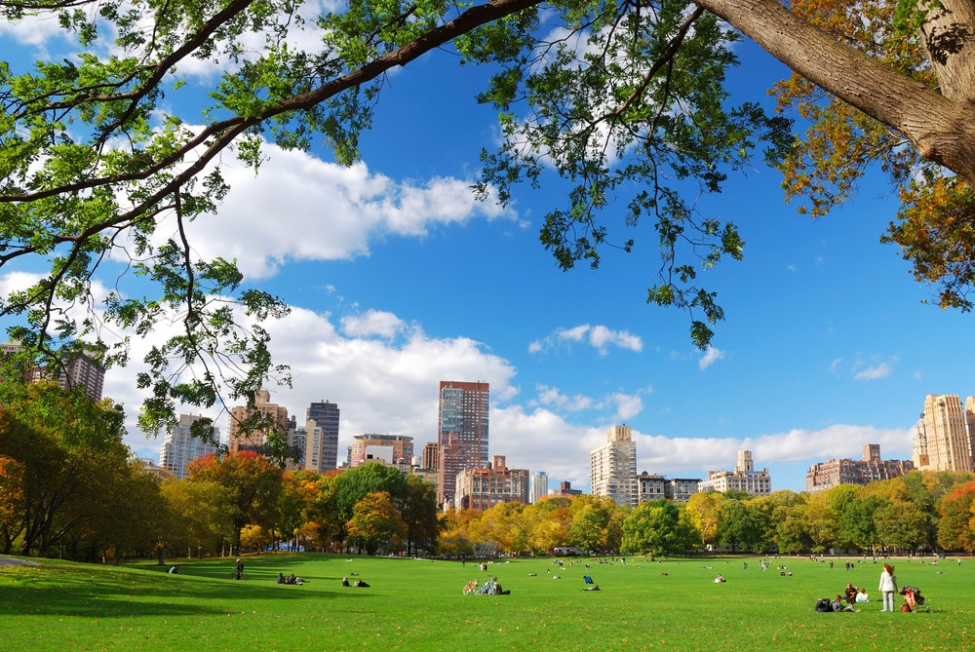
Central Park- the most visited urban park in the United States

Slide 7
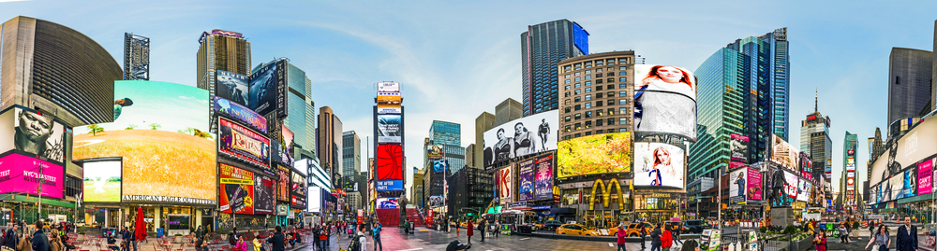
Times Square- an entertainment center of New York

Slide 8
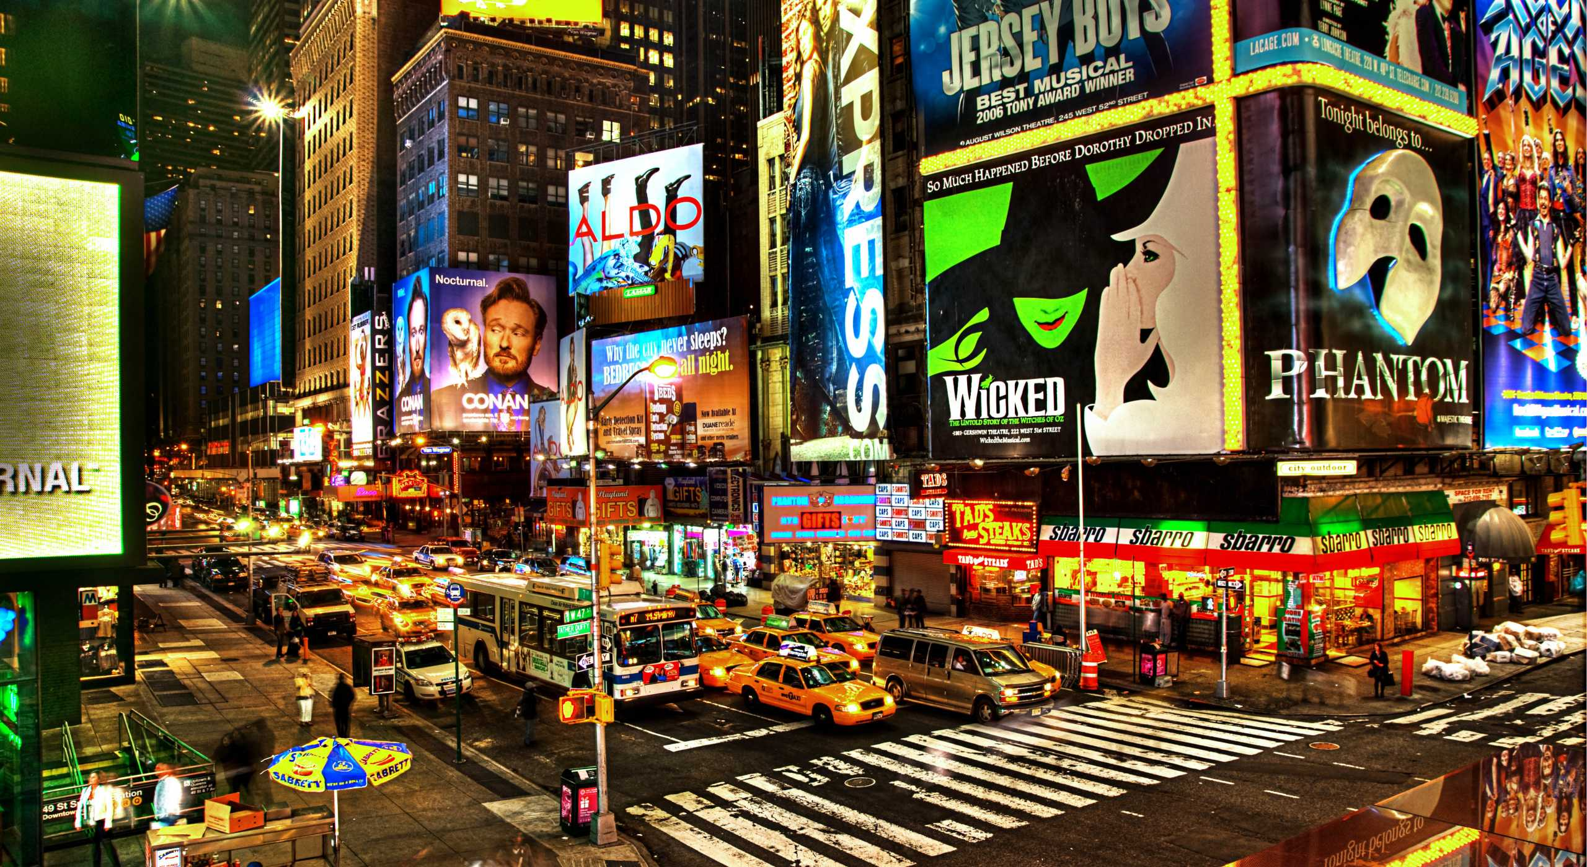
Broadway- 41 theatres, the longest road in the USA- 241 km

Slide 9
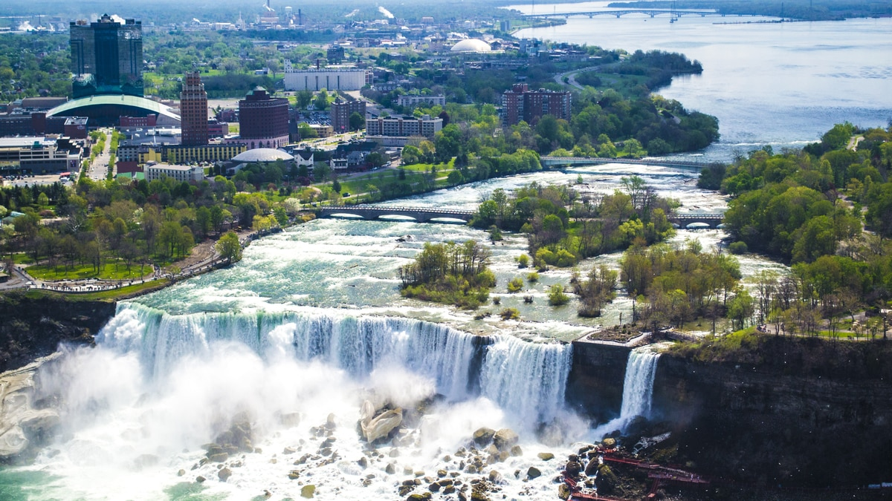
Niagara Falls

Slide 10


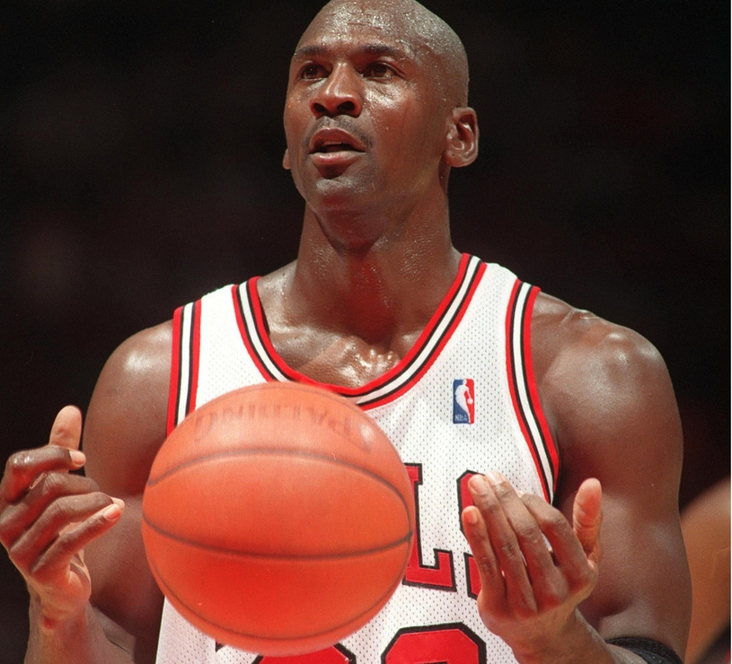

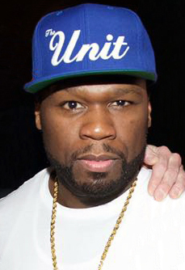
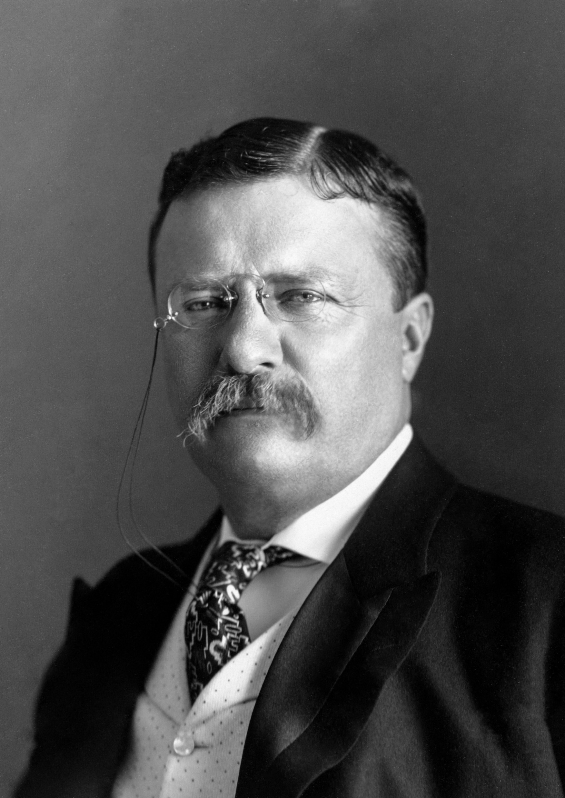

Famous New Yorkers
Alicia Keys- singer
Madonna- singer
Michael Jordan- basketball player
Anne Hathaway- actress
50 Cent- rap artist
Donald Trump- president
Theodore Roosevelt– 26th President

Slide 11
New York has over 70,000 miles of rivers and streams. It also has 722 miles of subway tracks!
New York City was the first capital of the United States. In 1789, George Washington took his presidential oath on the balcony of the city’s Federal Hall.
- With 8.5 million residents, New York City (NYC) is the most populated city in the United States. More people live in NYC than in Australia and Switzerland combined.
The state of New York is the third most populous in the United States, following behind California and Texas.
-There are over 800 languages spoken in New York City. Almost half of all families in New York City speak a language other than English at home.

Slide 12
https://www.coolkidfacts.com/new-york-facts/

