Slide 1
United Kingdom
the presentation

Slide 2
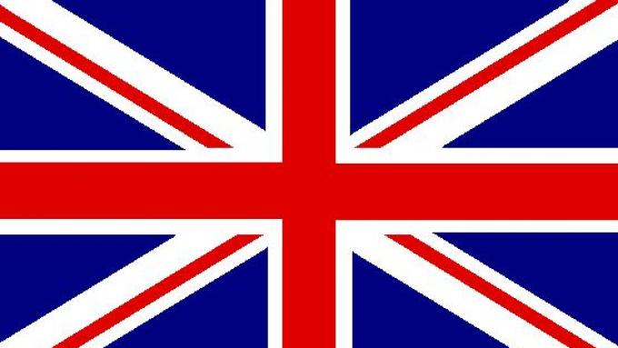

Slide 3
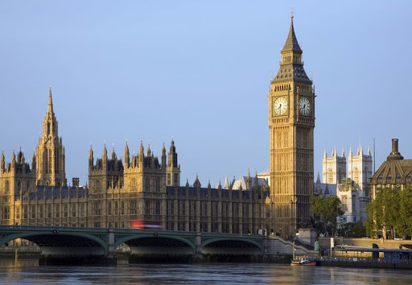
The weight of the famous bell is 13 tons. Big Ben is said to be named after the chief commissioner in charge of hanging the bell on the tower, Benjamin Hall. The clock tower is part of the Palace of Westminster. It was built after the fire of the Palace, which destroyed part of the building in 1834. At that time, it was known as the Tower of St. Stephen, but the popularity of the bell itself dominated the entire structure. Today, the neo-Gothic clock tower is known to everyone simply as Big Ben.

Slide 4
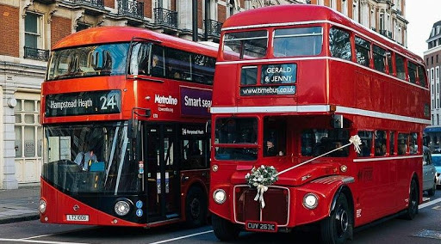
In 1954 the Associated Equipment Company (AEC) constructed "The AEC Routmaster" - a model of a double-decker bus produced from 1958 to 1968. Originally, these buses were front-engine with an open platform at the rear. A small number of these buses were produced with a door and / or front entrance. The bus was presented by London Transport in 1956. Until 2005, Routmaster continued to operate in London, and two Routes 9 and 15 now remain in central London. On July 24, 2014, Route 9 was withdrawn.

Slide 5
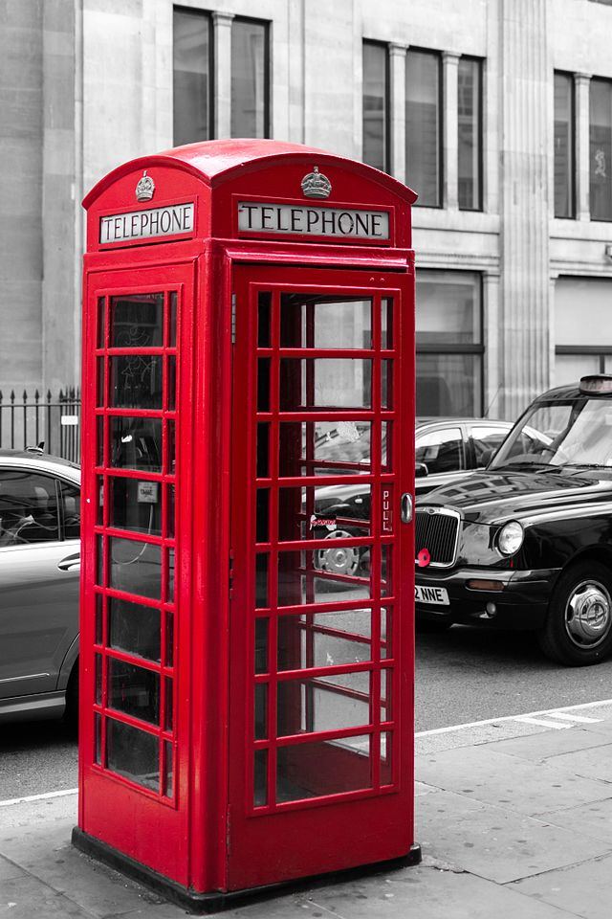
In May 1903 in central London, the first British telephone booth was put into operation at the Staple Inn in the High Holborn district. However, they received the characteristic red appearance only due to the introduction of the so-called standardized K1 telephone boxes in 1921 (red boxes marked K2 were introduced in 1925).

Slide 6
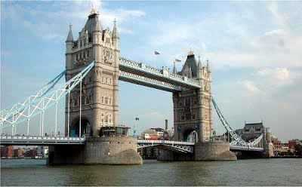
Tower Bridge - a drawbridge in London (sometimes confused with the neighboring London Bridge, crossing the Thames, near the Tower of London, from which it takes its name). One of the most famous landmarks in London, built in Victorian style. Its history began in 1872, when the English parliament considered a bill concerning the construction of a second bridge over the Thames. Despite objections raised by the management of the Tower of London castle, the act was passed. However, a condition was set that was met, the style of the bridge was to harmonize with the style of the castle. Its architect was Horace Jones, who used a structure that was fashionable at the time: a steel skeleton covered with stone in the neo-Gothic style. The bridge was completed in 1894. It is a drawbridge, allowing the passage of ocean-going vessels up to about 40.5 m high above the water level. During the first years, it was opened up to 6,000 times a year, now only 1,000 times a year.

Slide 7
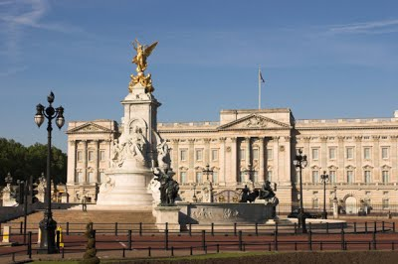
Buckingham Palace is the official residence of the British monarchs and at the same time, the world's largest royal palace, still serving its original function. The Queen's official London residence. A statue of Queen Victoria has been standing in the square in front of the palace since 1913.

Slide 8
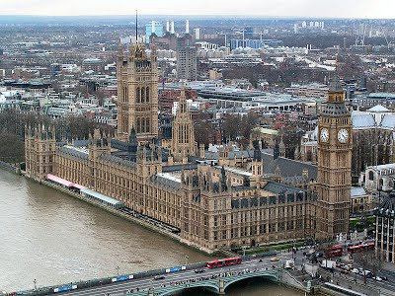
Palace of Westminster (also known in this language as Houses of Parliament) - the meeting place of both houses of the Parliament of the United Kingdom (House of Lords and House of Commons). The palace is located in London, in the City of Westminster, on the left bank of the River Thames. The oldest part of the palace today, Westminster Hall, was built in 1097. The palace initially served as the seat of the ruler, but no monarch has lived there since the 16th century. Most of the present structure of the palace dates back to the 19th century, when the palace was rebuilt after a fire in 1834. The architect responsible for the reconstruction was Sir Charles Barry, and the present appearance of the palace is an example of the neo-Gothic style. One of the most famous parts of the palace is the clock tower, which houses the famous tourist attraction, the clock and the Big Ben bell.

Slide 9
Koniec

