Slide 1
United Kingdom
Marika Radziemska

Slide 2
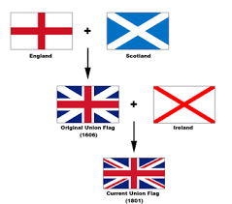
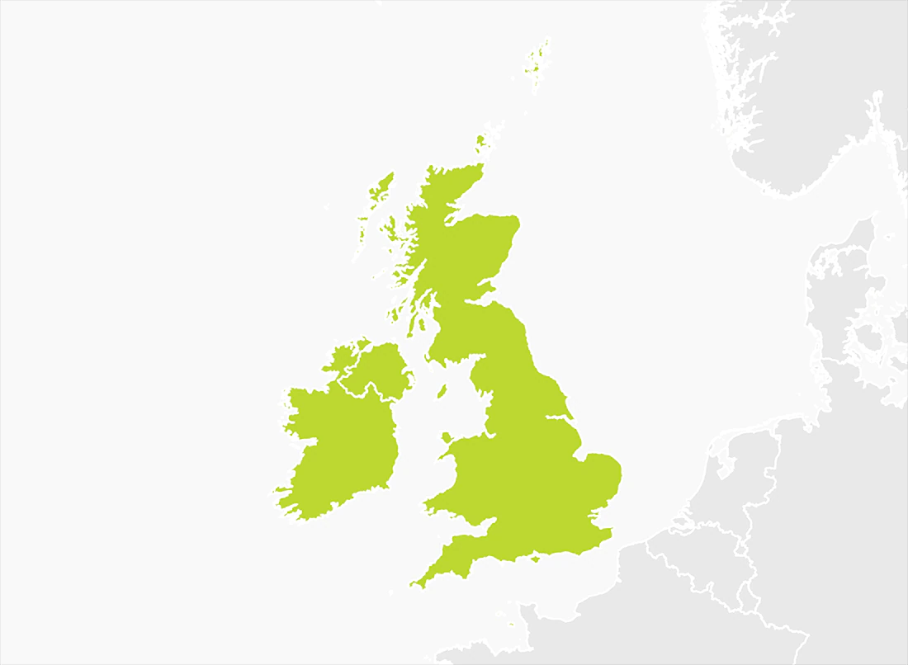
some interesting facts
Scotland, England and Wales are in the UK. Northern Ireland is next to Great Britain.
The Uk flag ,,Union Jack''. Union Jack is red, white and blue.

Slide 3
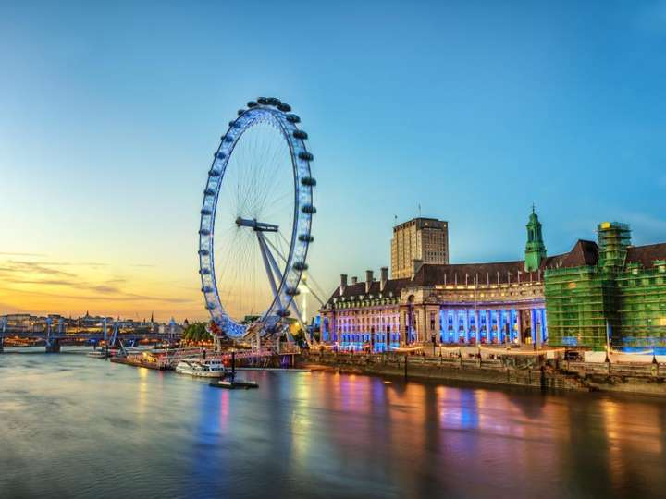
London eye

Slide 4
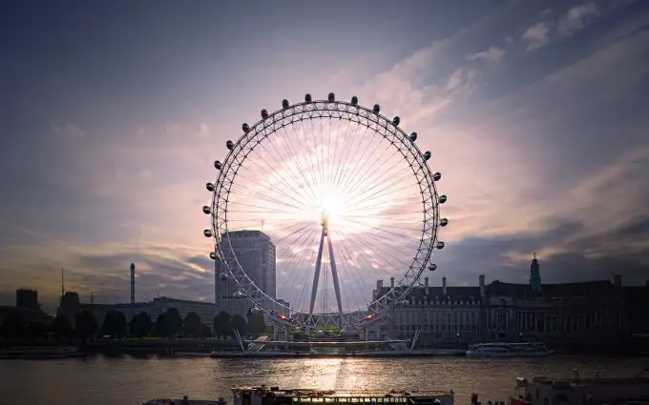
London Eye - it is a very big observation wheel. It has capsules that you can ride it to see an aerial view of London. It is on the banks of the Thames.

Slide 5
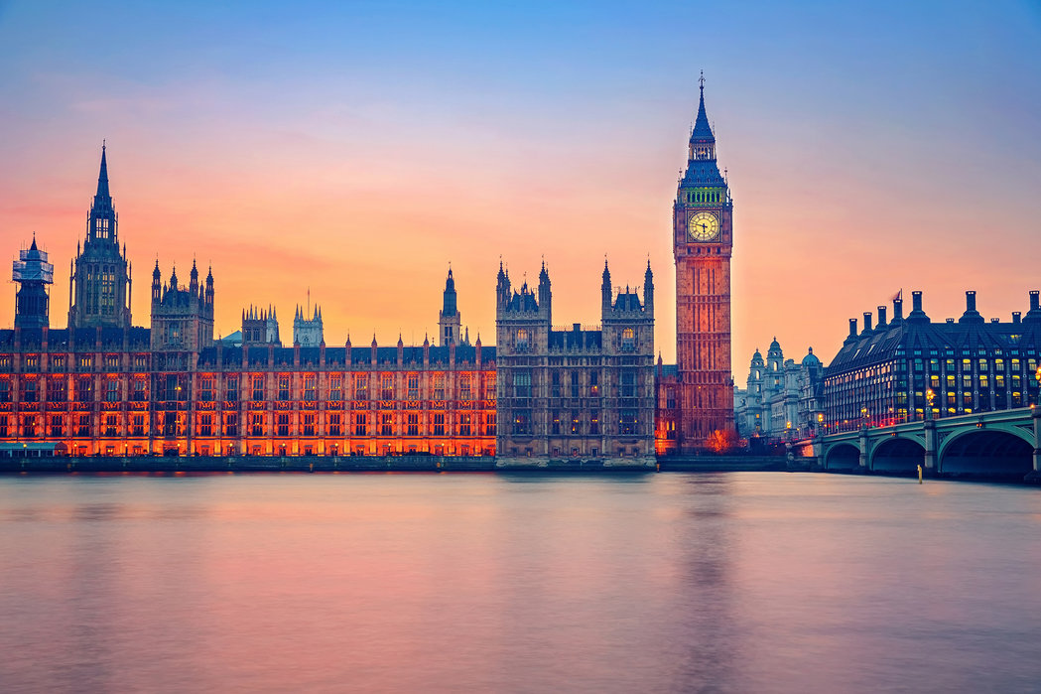
Big ben

Slide 6
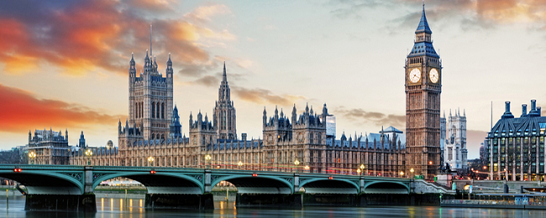
Big Ben - one of the best know things in London. The big bell is inside the tower with the big clock. The tower is called ,,St. Elizabeth Tower" and next to the Houses of Parliament on the banks of the river Thames.
Big Ben - one of the best know things in London. The big bell is inside the tower with the big clock. The tower is called ,,St. Elizabeth Tower" and next to the Houses of Parliament on the banks of the river Thames.

Slide 7
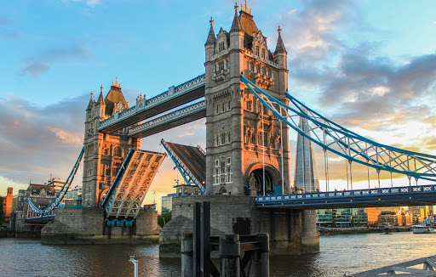
Tower Bridge

Slide 8
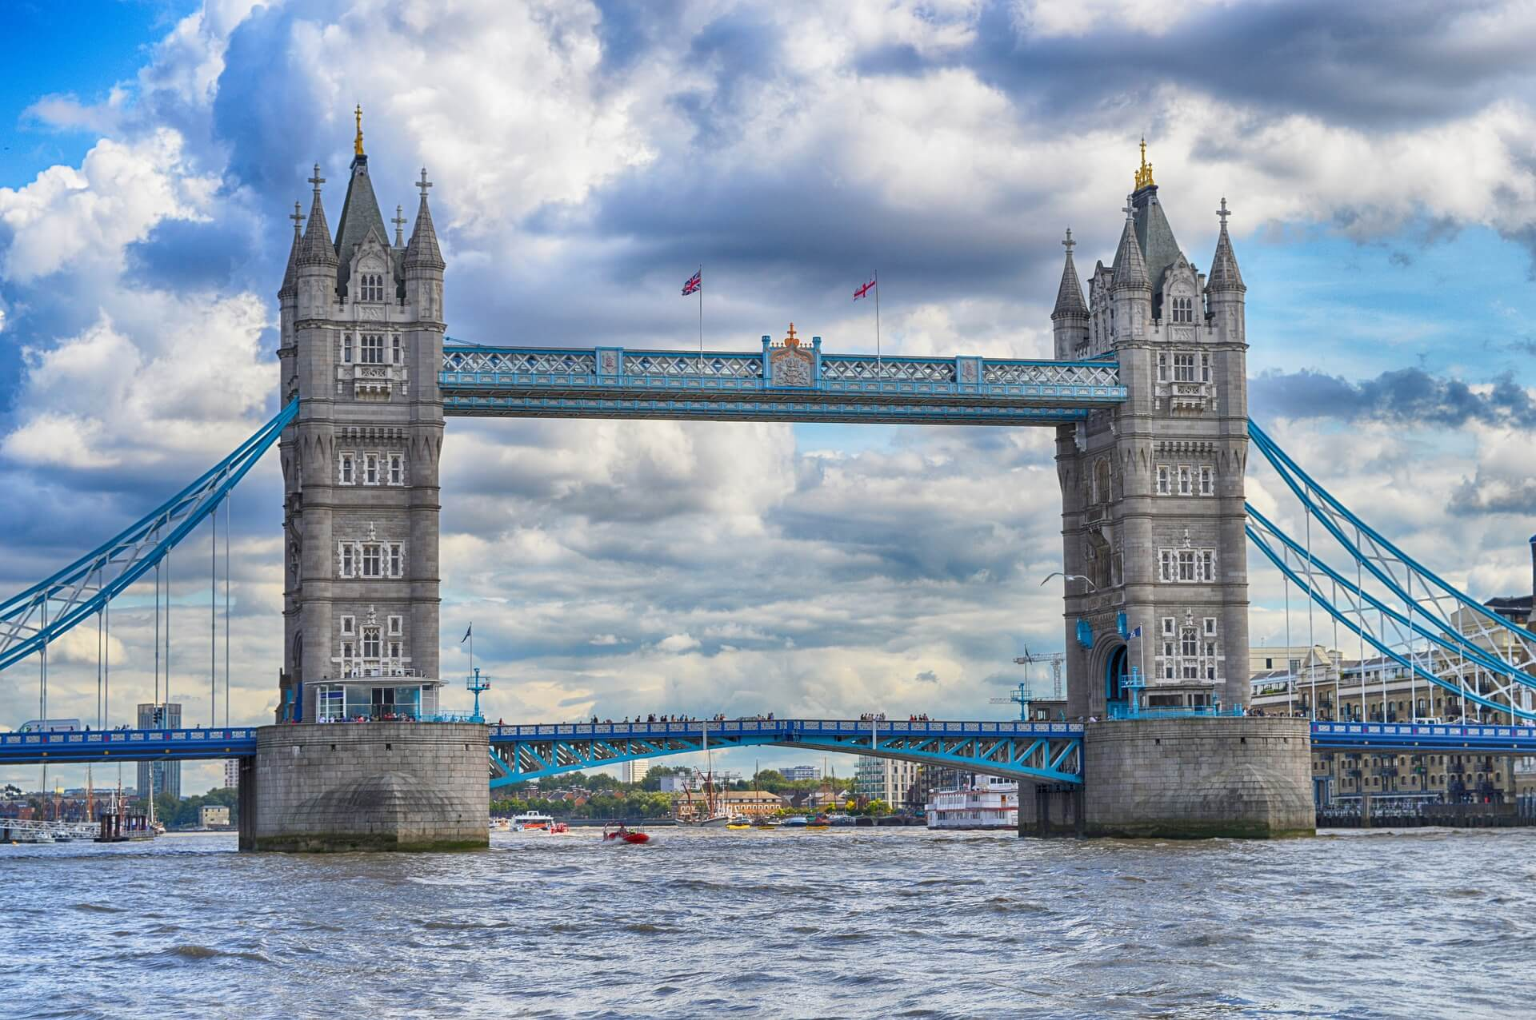
Tower Bridge - the most famous bridge in the UK. It is a suspension biridge that opens and closes to let large boats travel on the Thames. It was build in 1800s.

Slide 9
Thank’s for wathing

