Slide 1
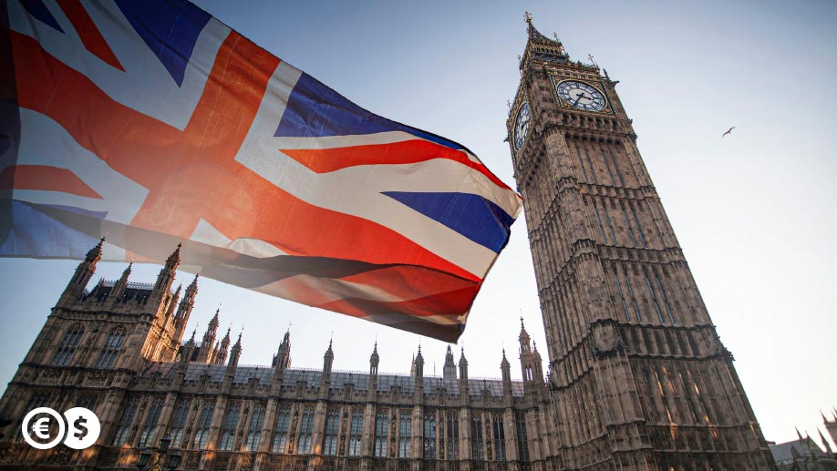
Welcome to the UK

Slide 2
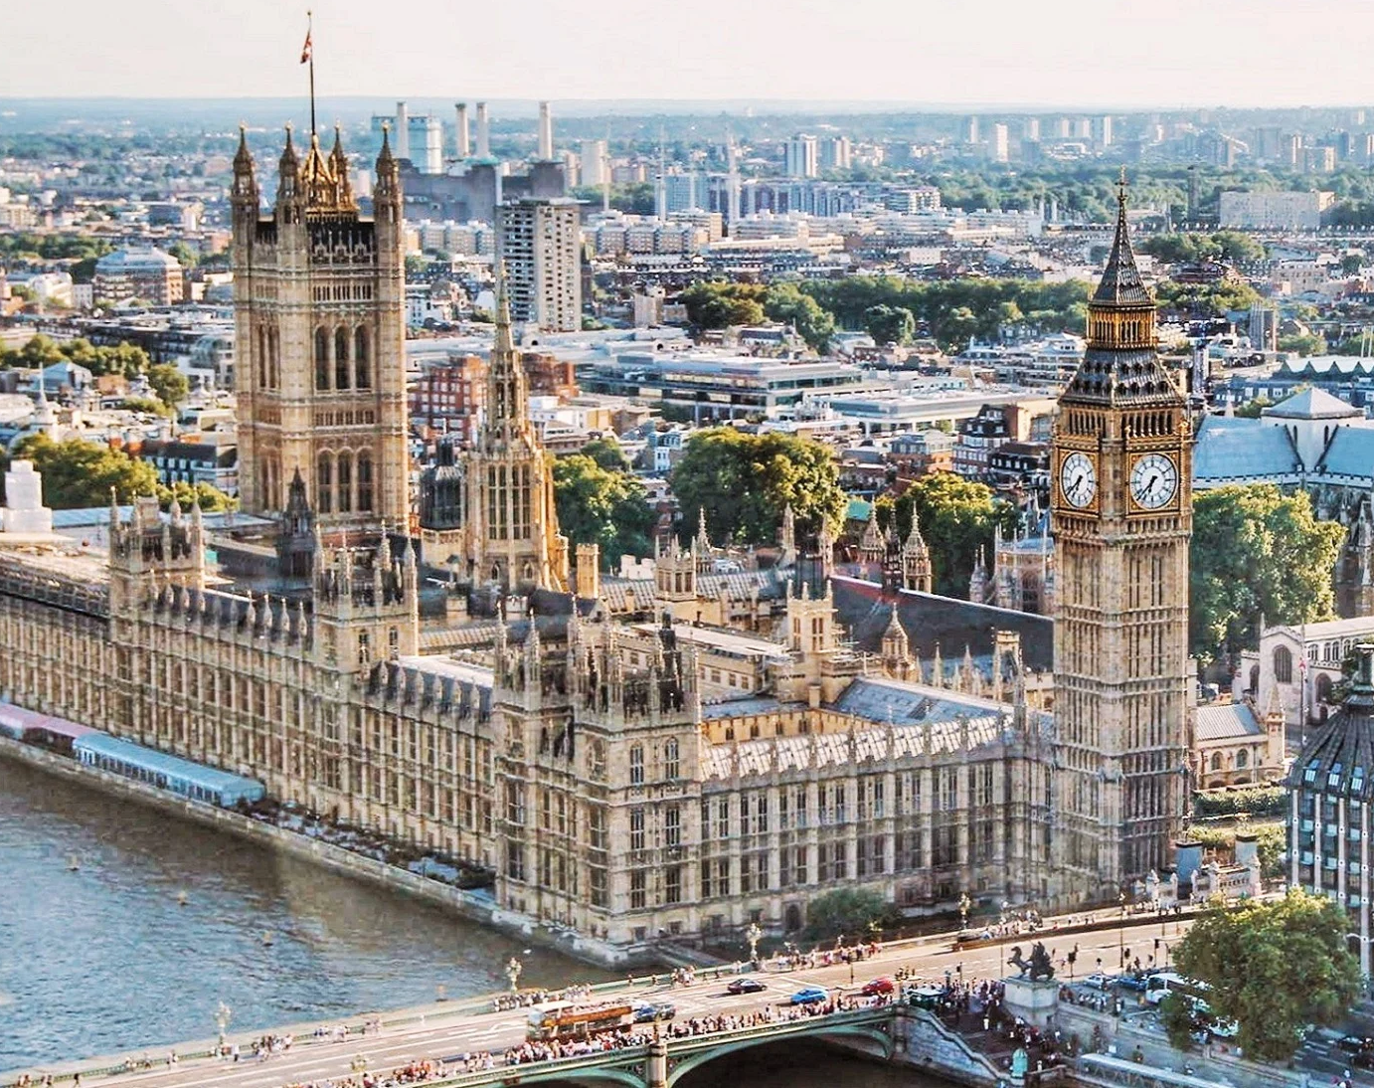
Big Ben believes the clock is 96.3 meters high, and each of the four clock dials is 7 meters in diameter. Please see the tower via a 334-degree spiral staircase.

Slide 3
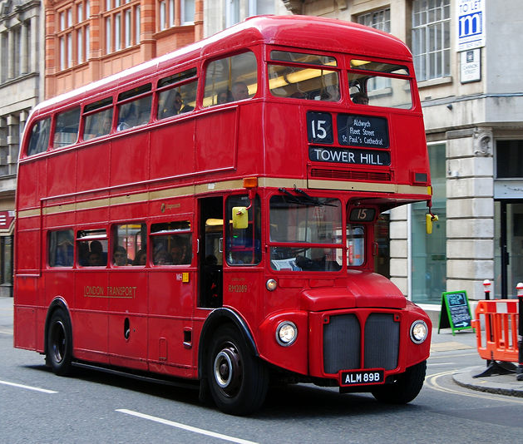
There are also red, funny double decker buses

Slide 4
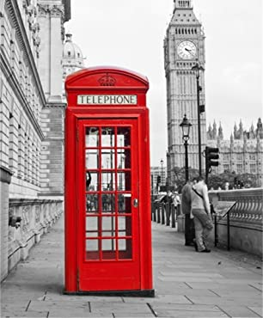
Red phone boots symbol of great Britain

Slide 5

Princess Diana queen of human hearts

Slide 6
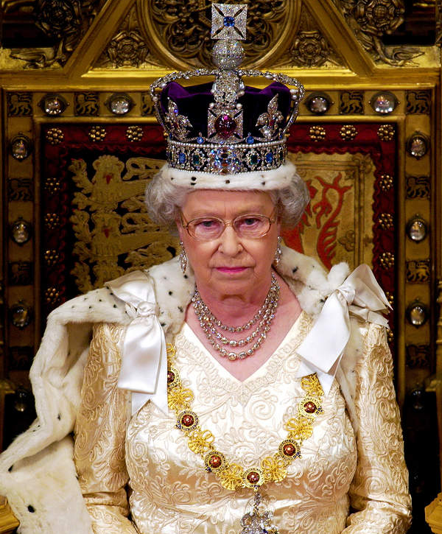
The Queen of Great Britain is Elizabeth 2

