Slide 1
MY FAVOURITE GAME
KLASA 2D

Slide 2
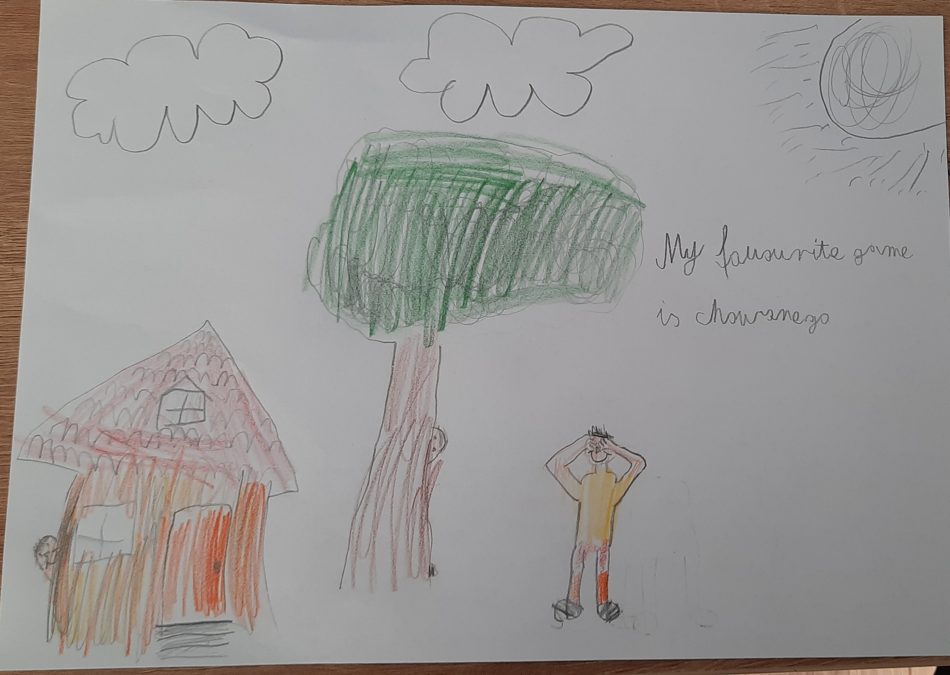
FILIP

Slide 3
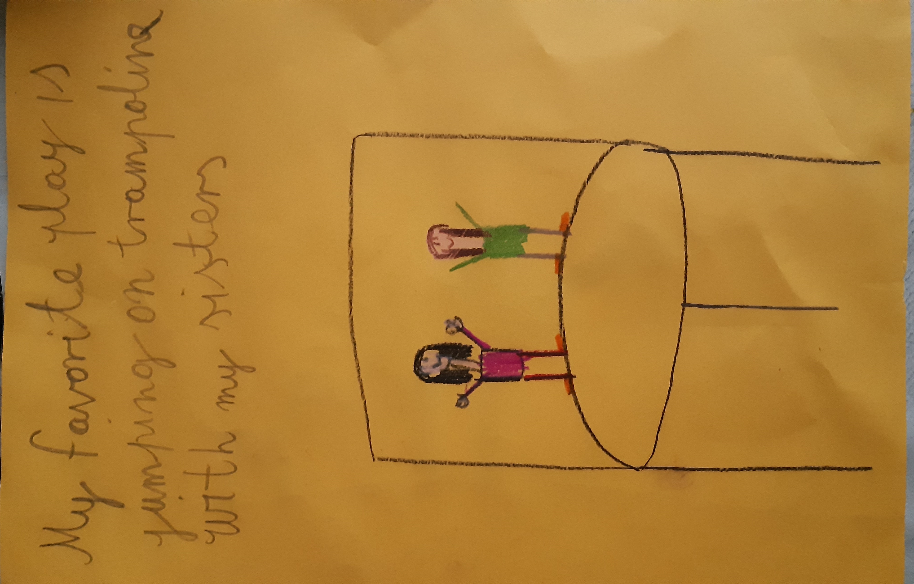
MAJA

Slide 4
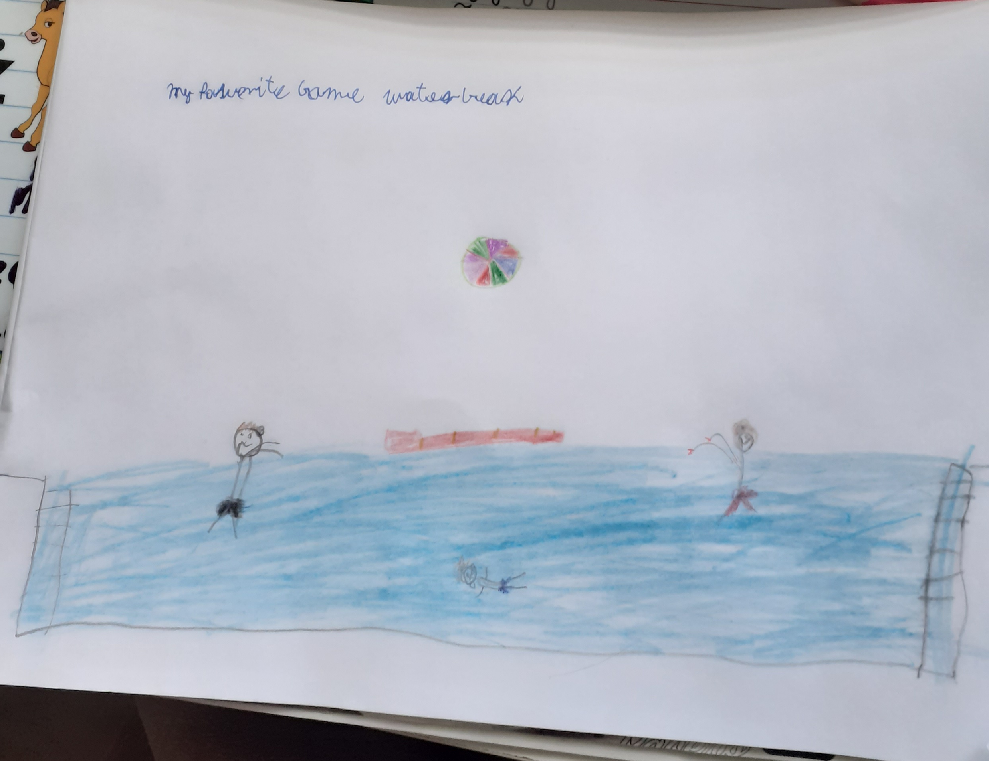
MARCEL

Slide 5
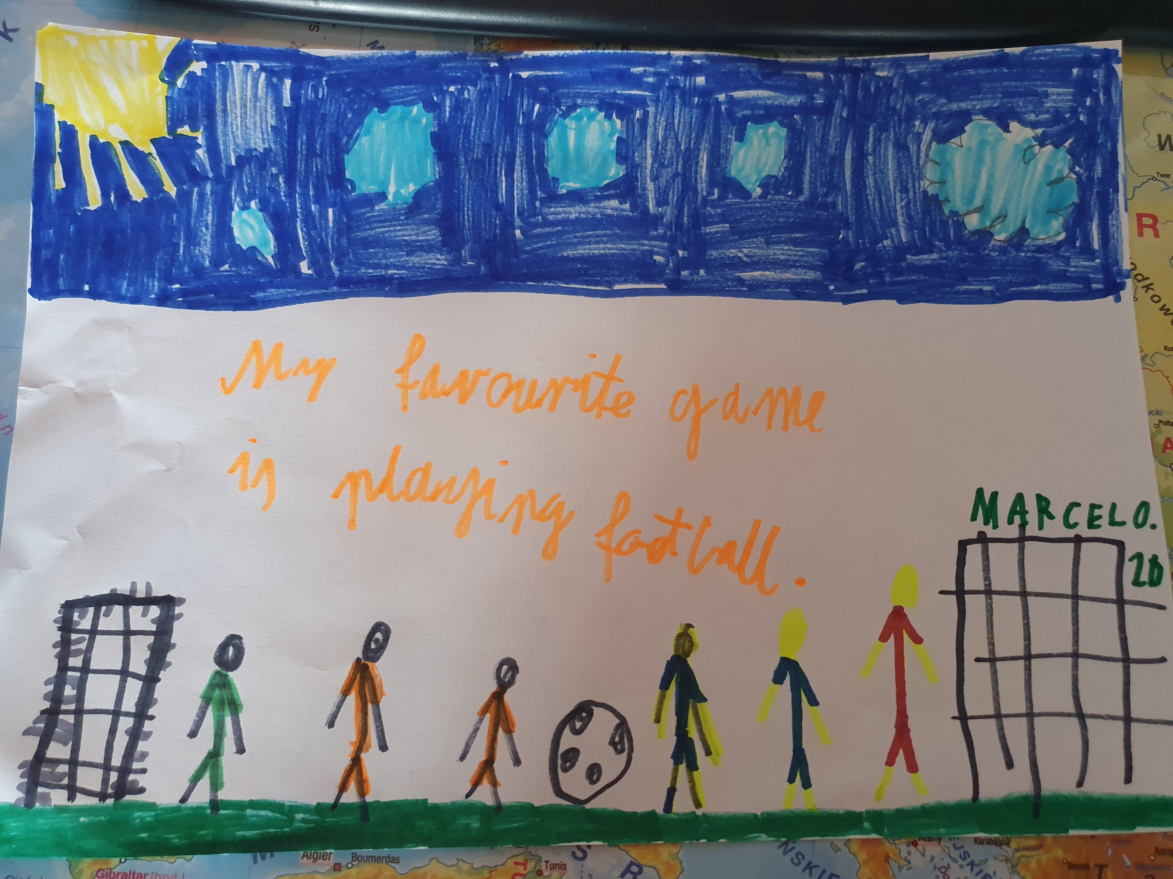
MARCEL

Slide 6
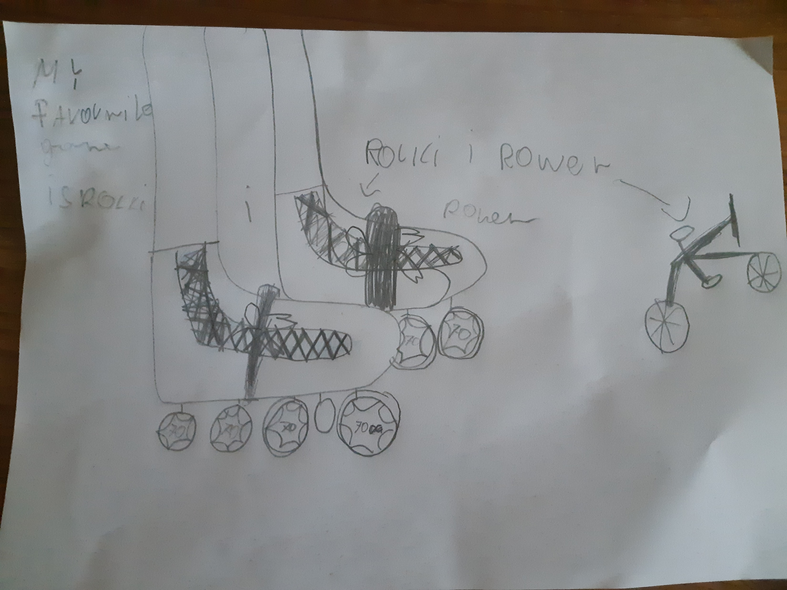
KAROLINA

Slide 7
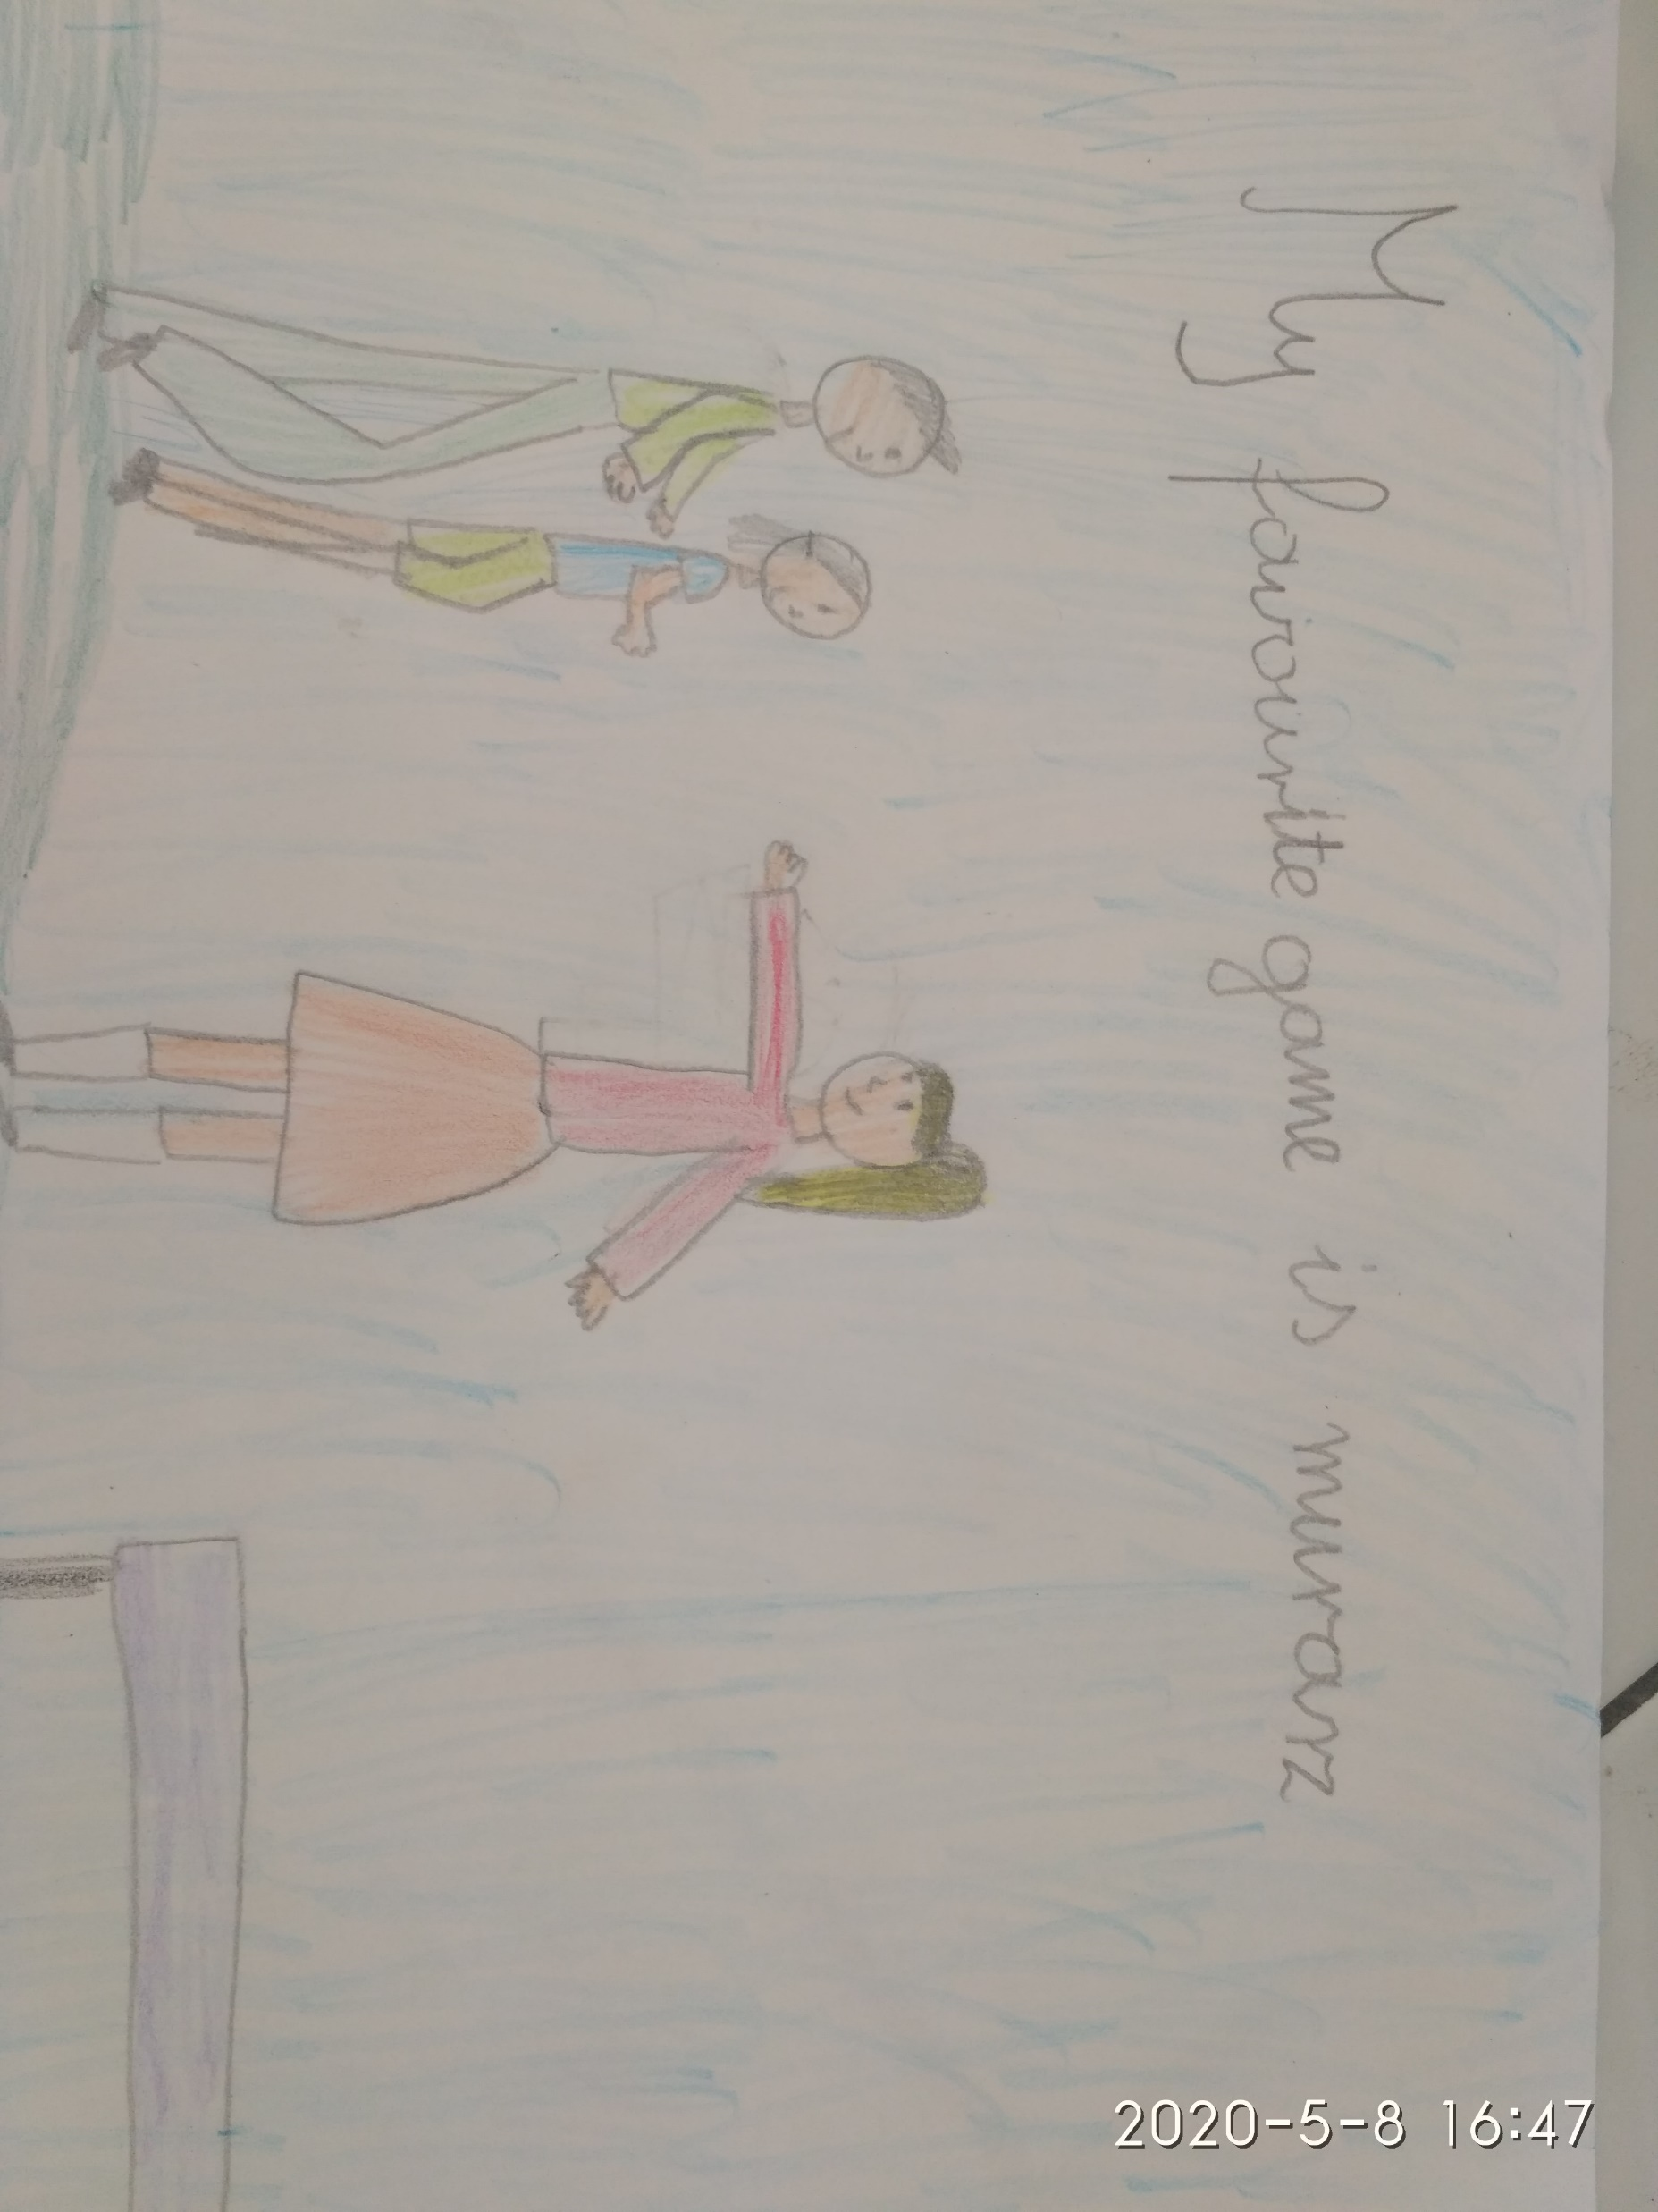
MARIA

Slide 8
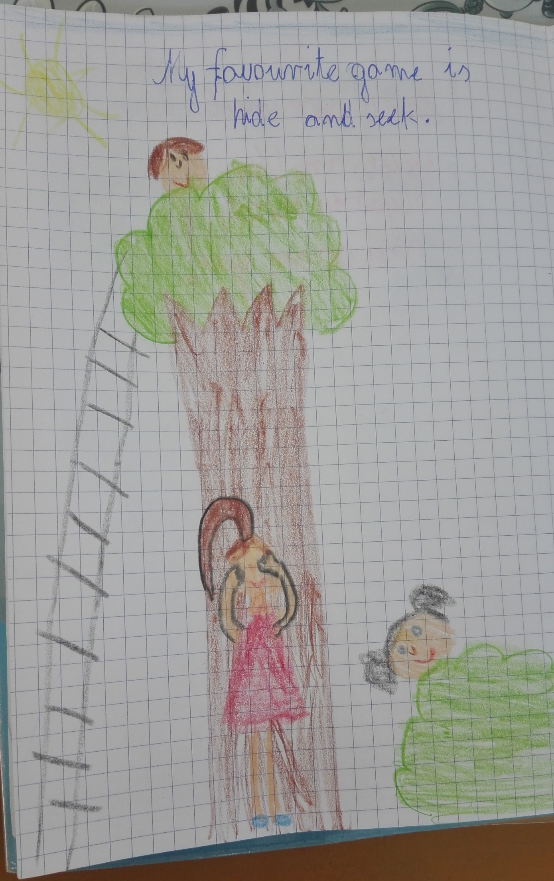
KAJA

Slide 9
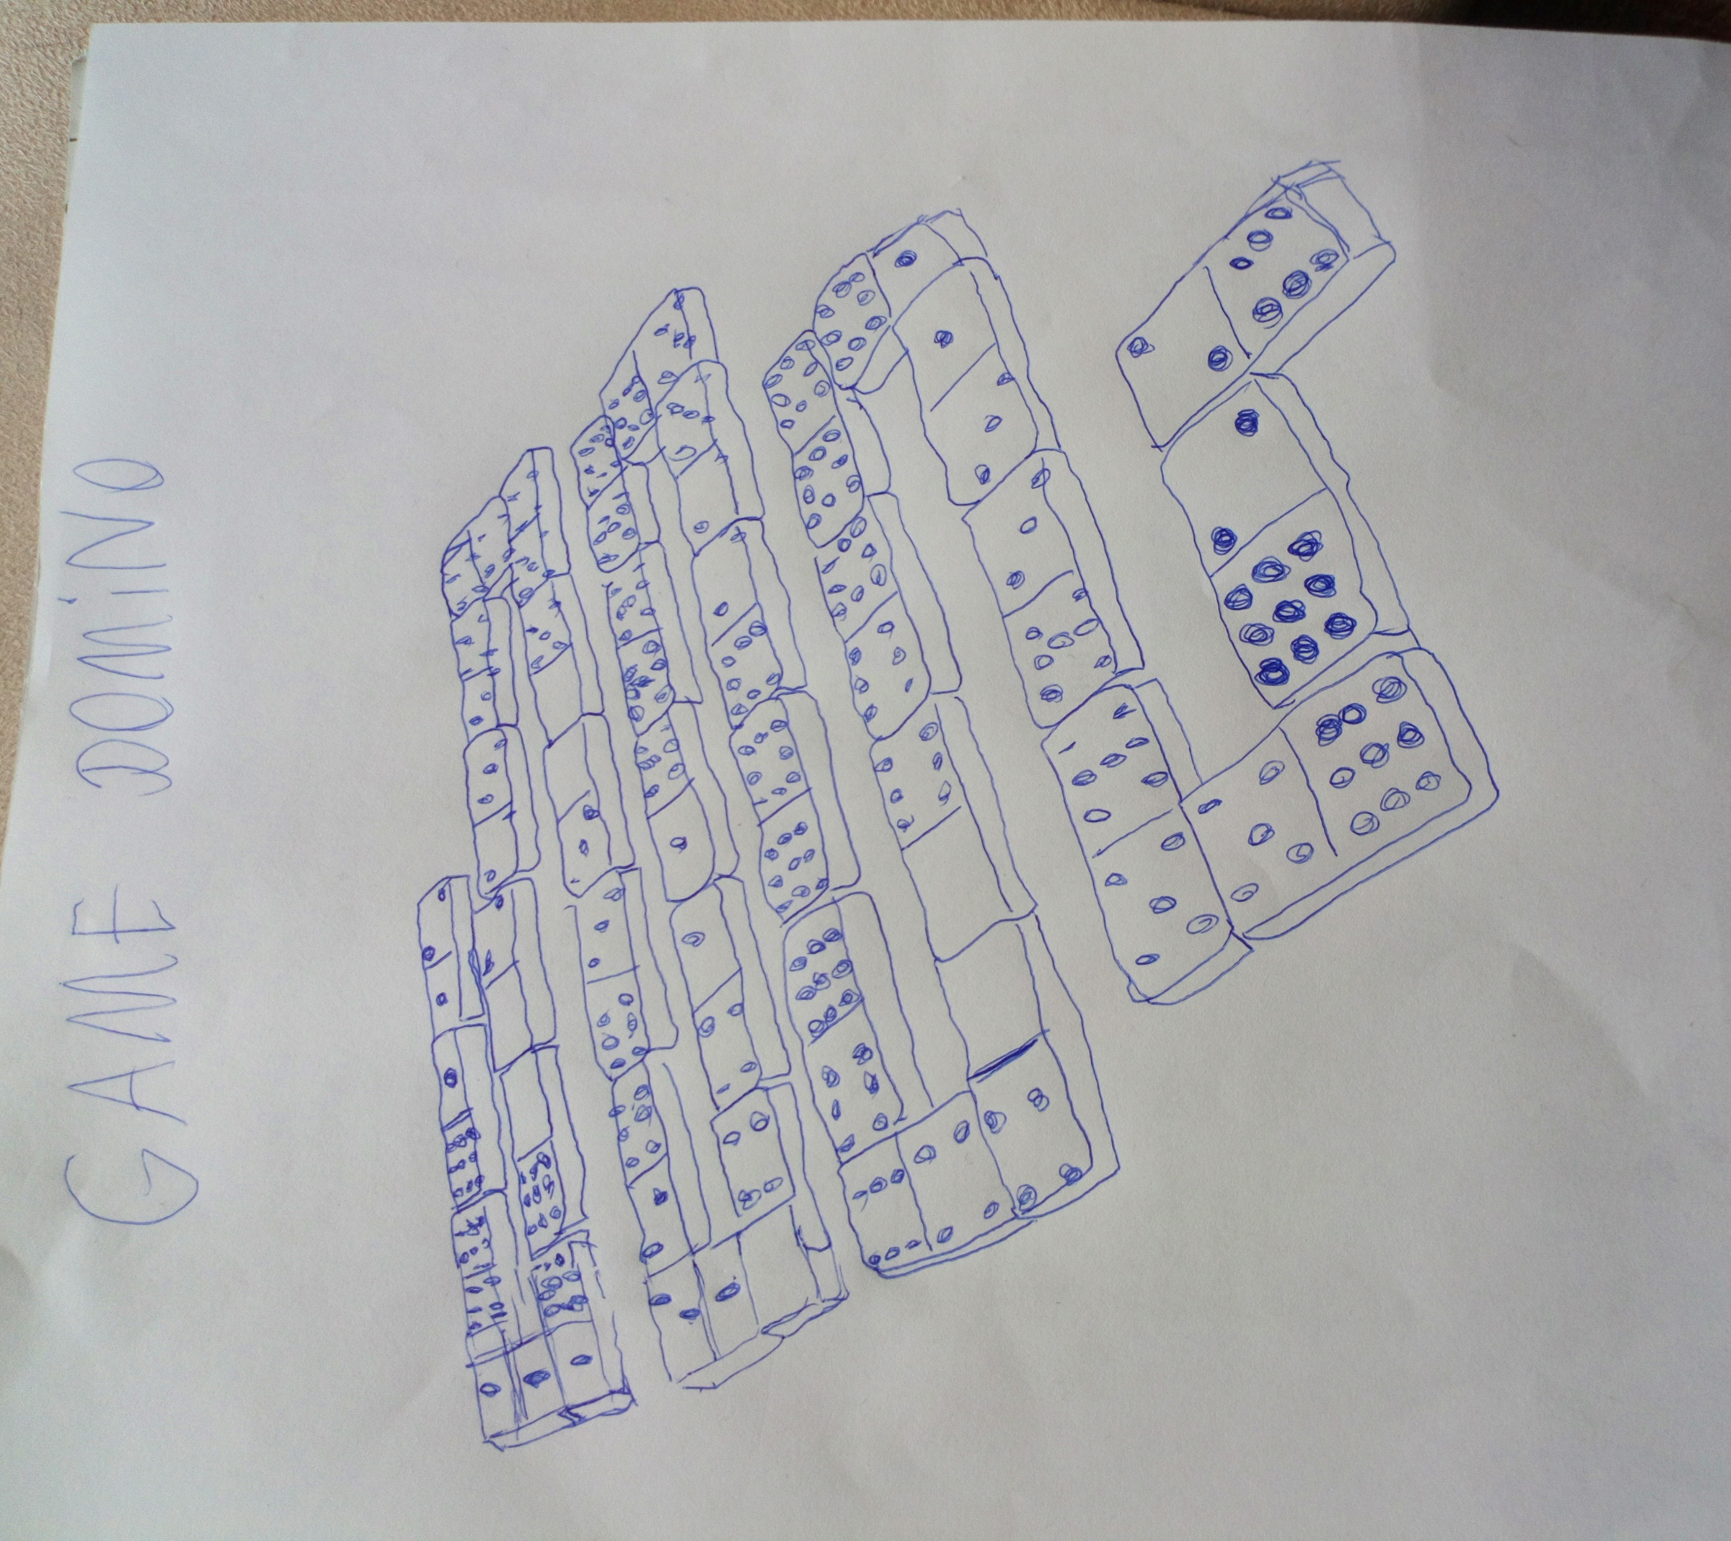
JAKUB

Slide 10
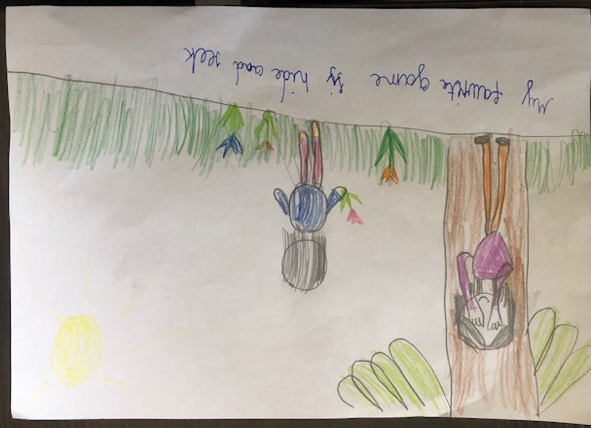
KINGA

Slide 11
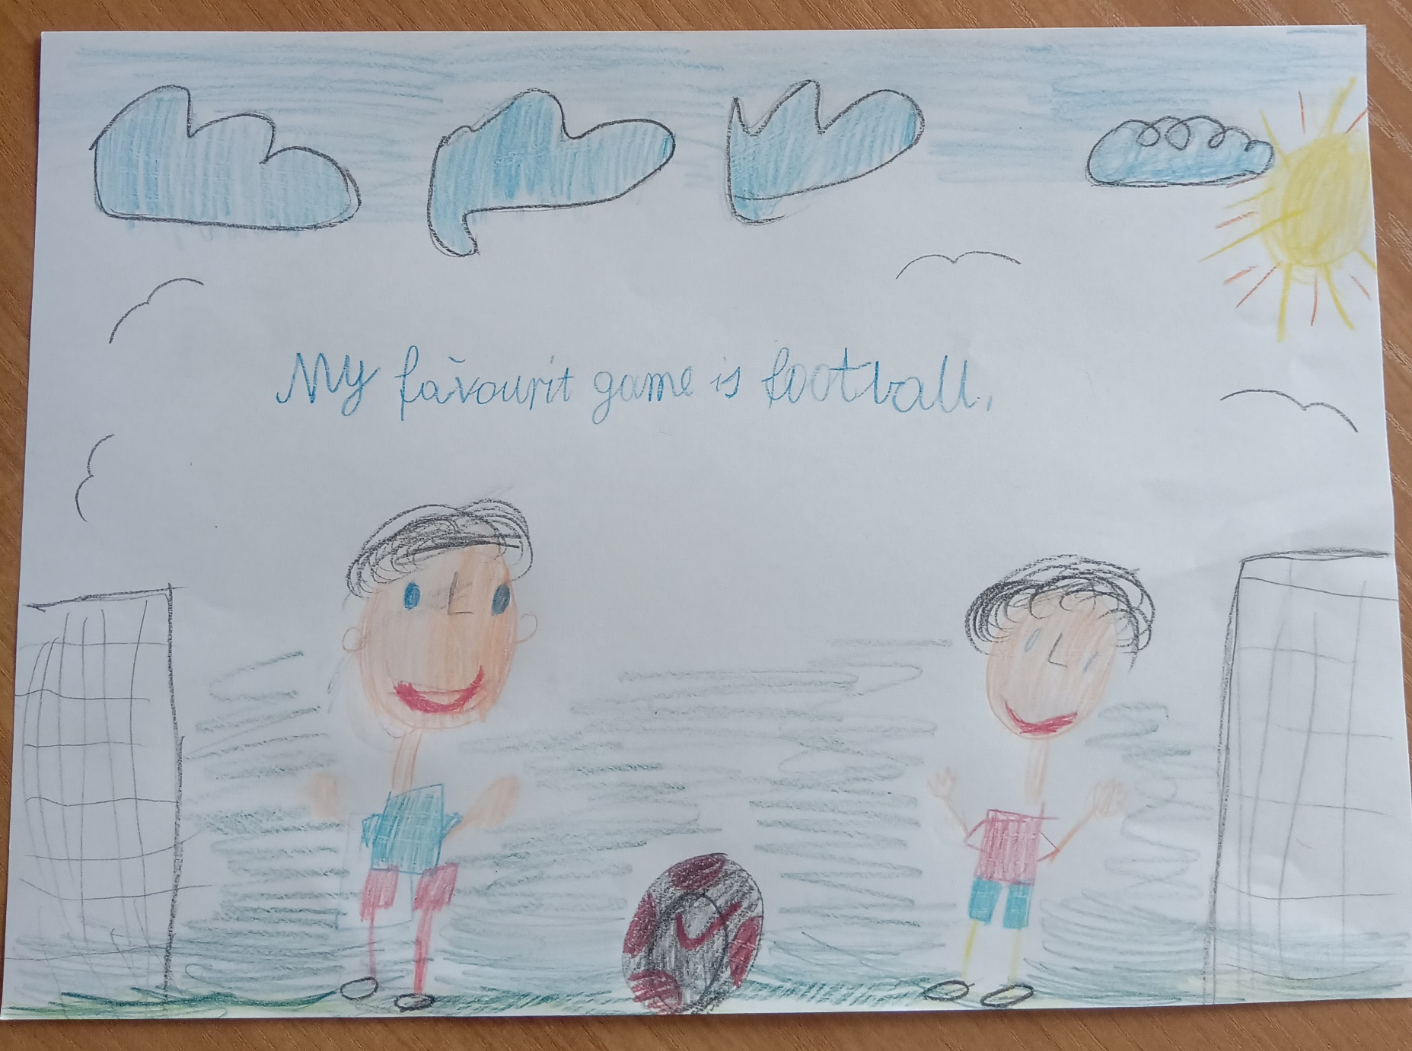
IGOR

Slide 12
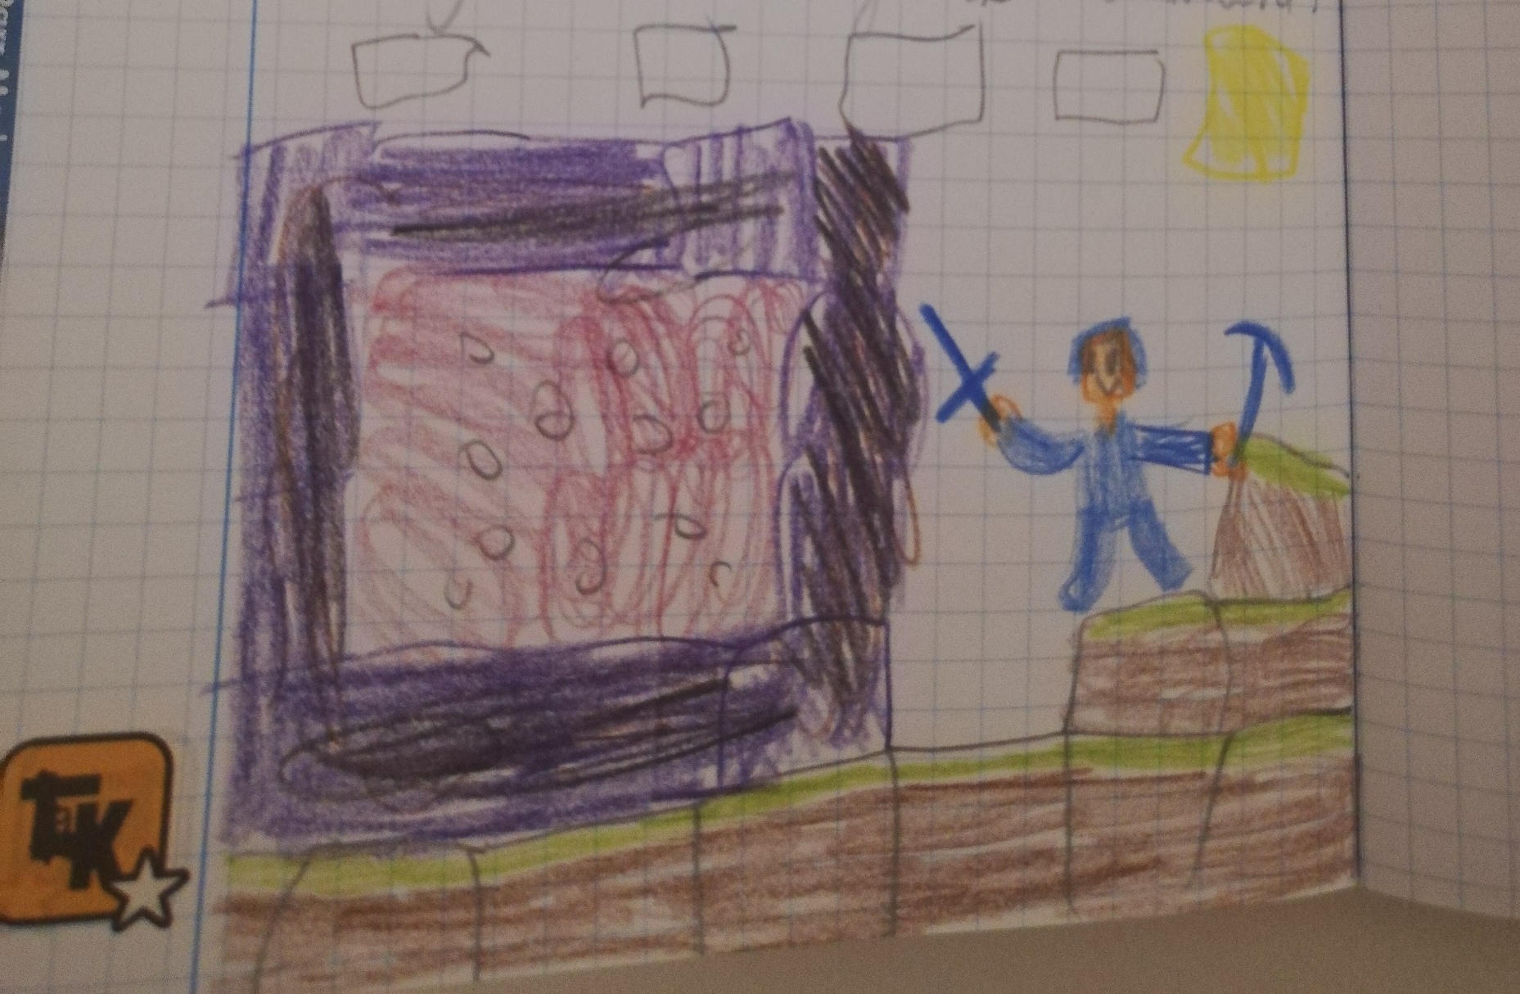
ALEKS

Slide 13
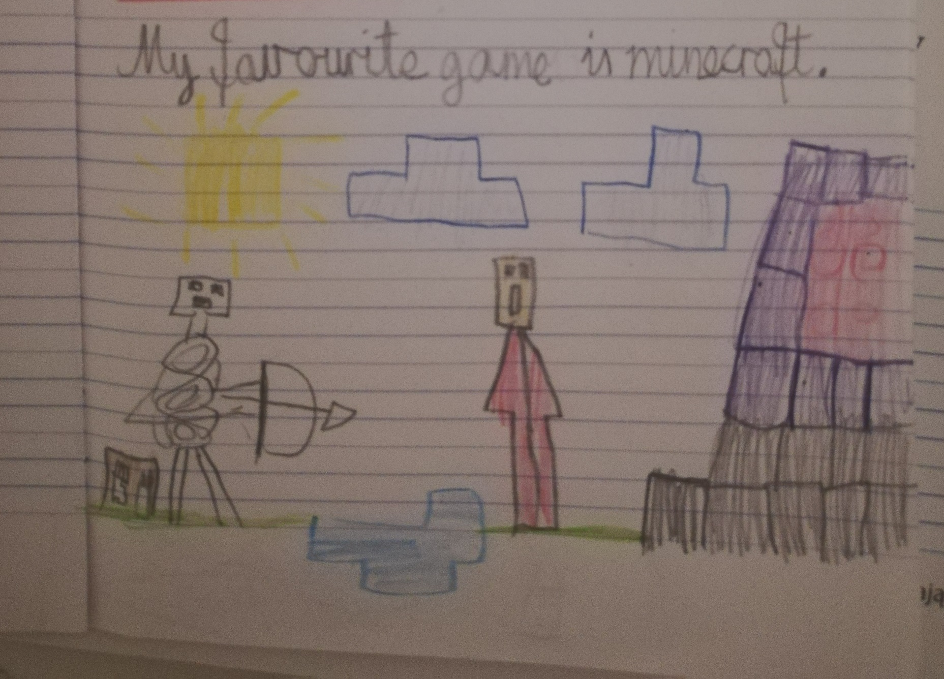
KACPER

Slide 14
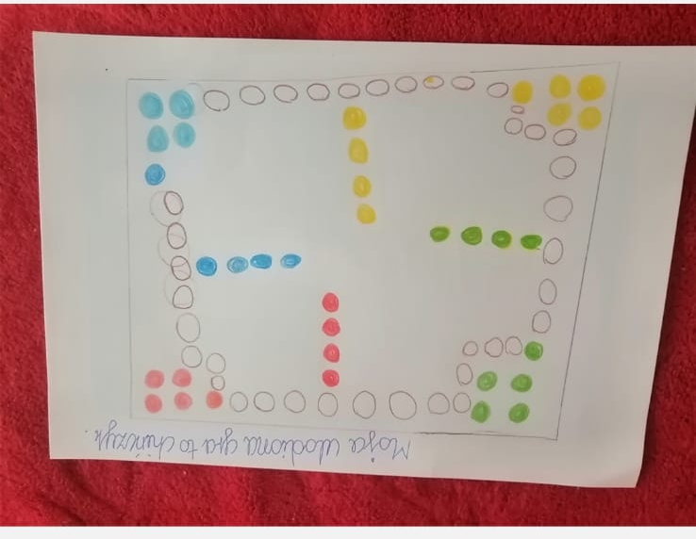
NIKOLA

Slide 15
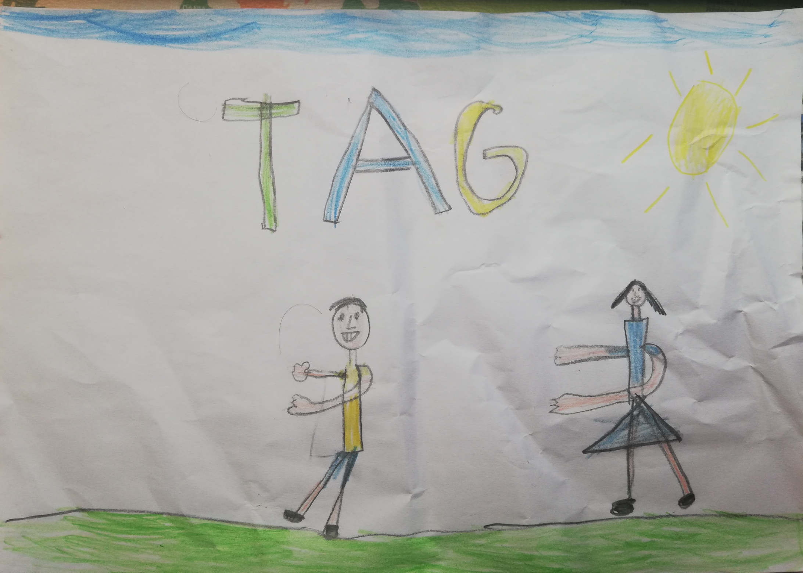
WIKTOR

Slide 16
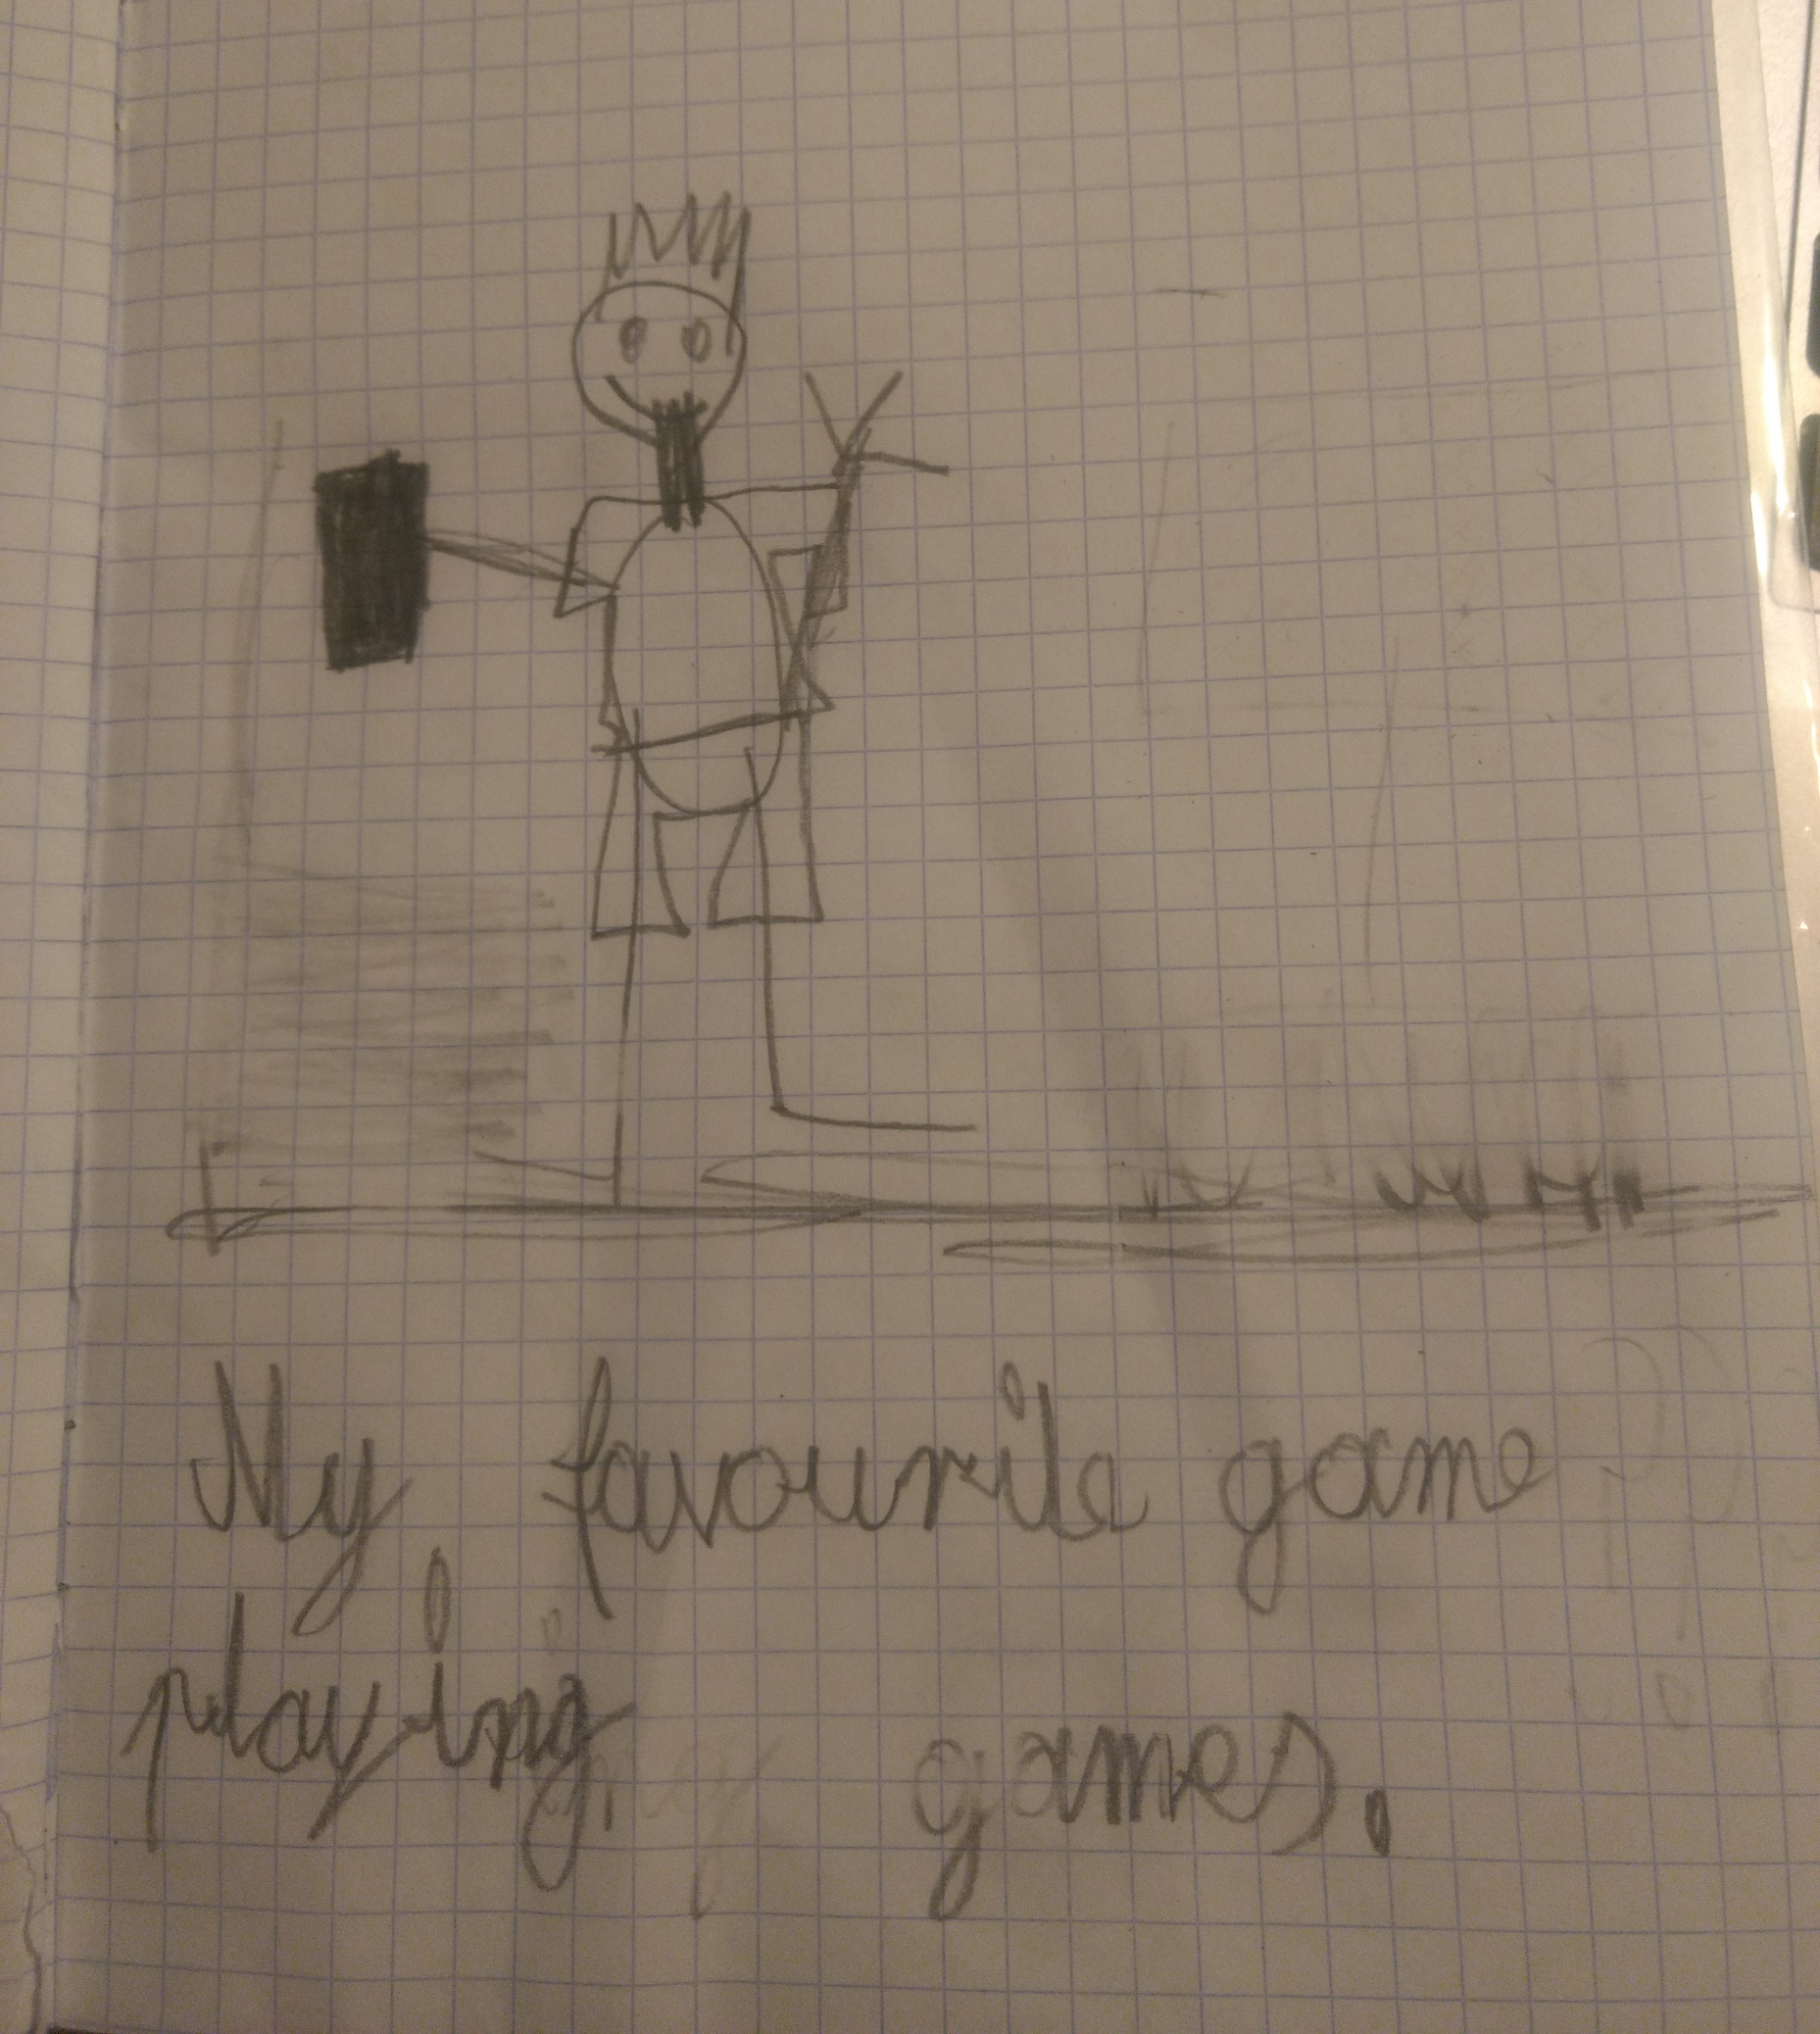
HUBERT

Slide 17
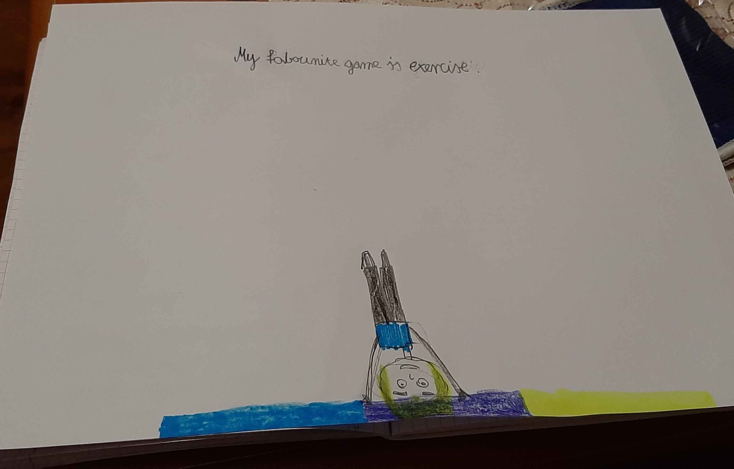
MARTA

Slide 18
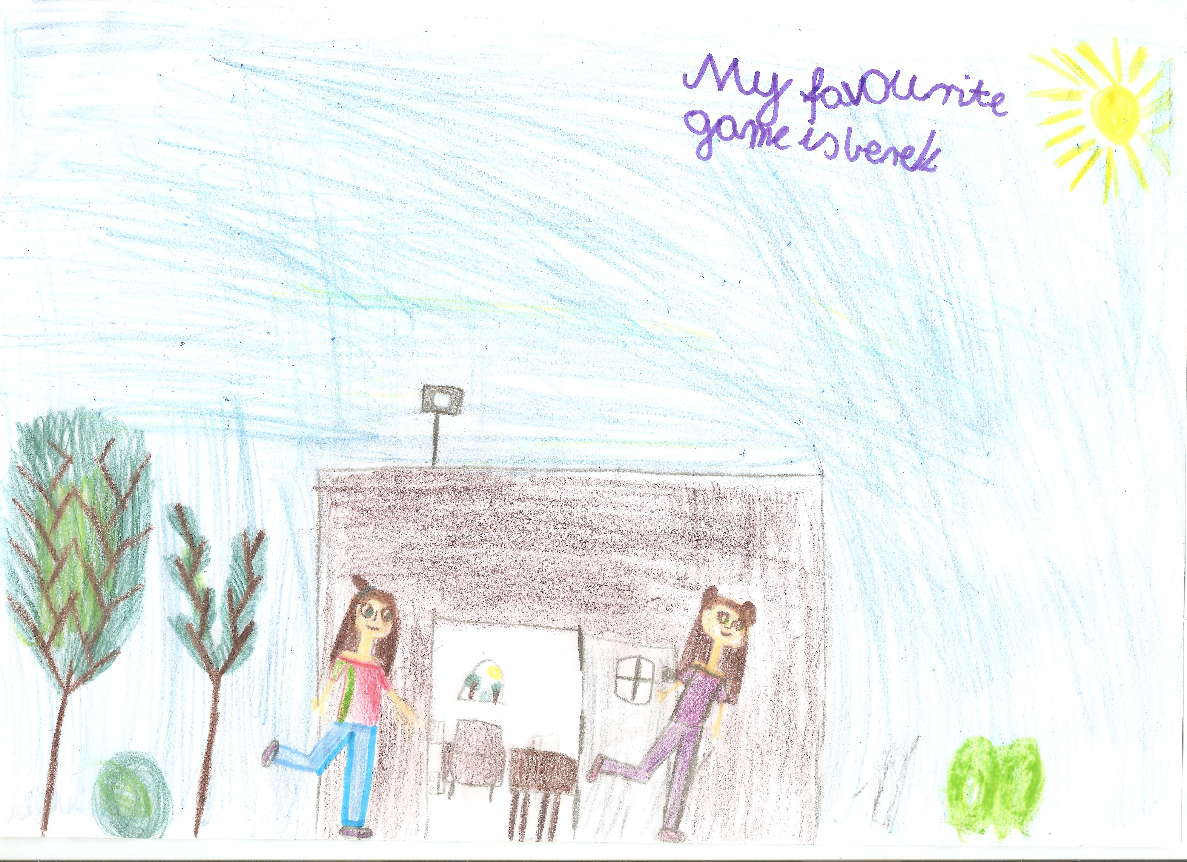
MAJA

Slide 19
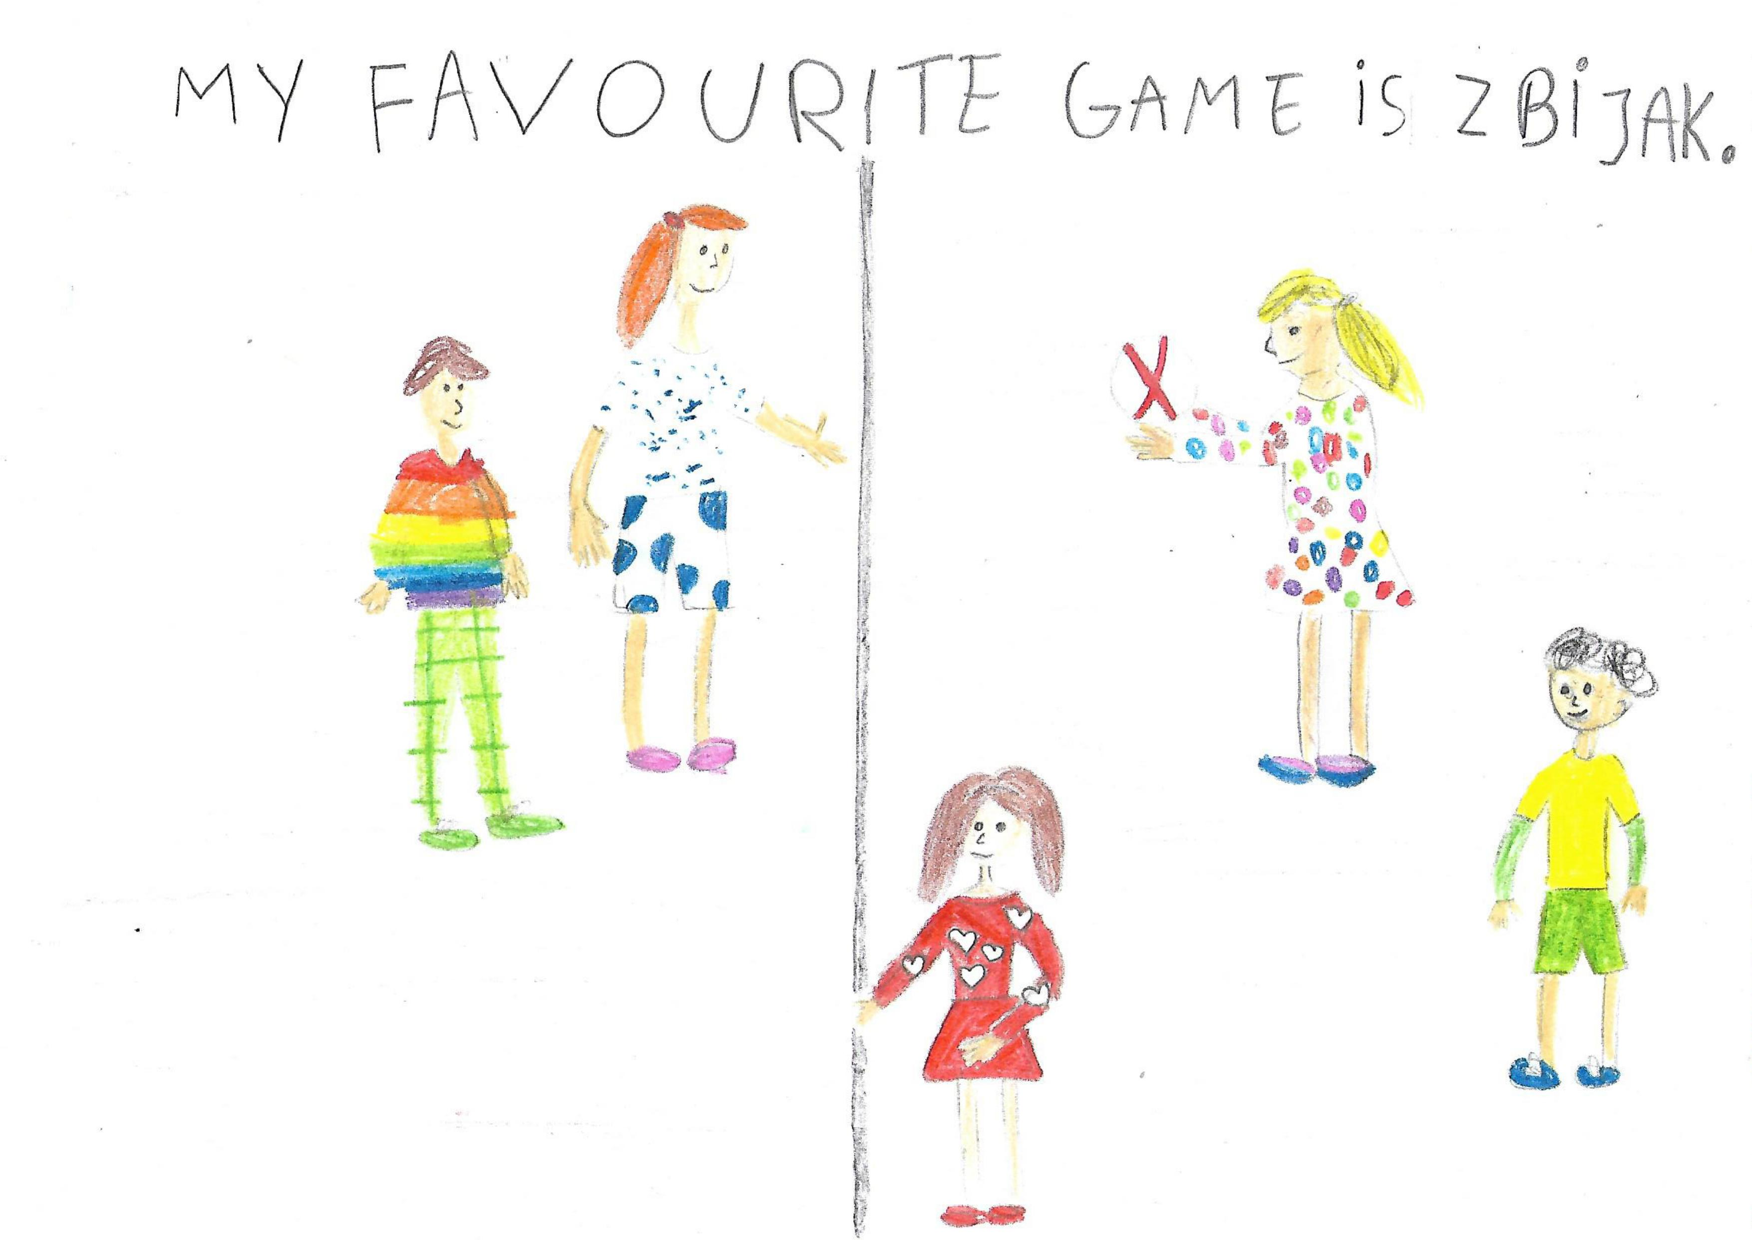
ALICJA

Slide 20
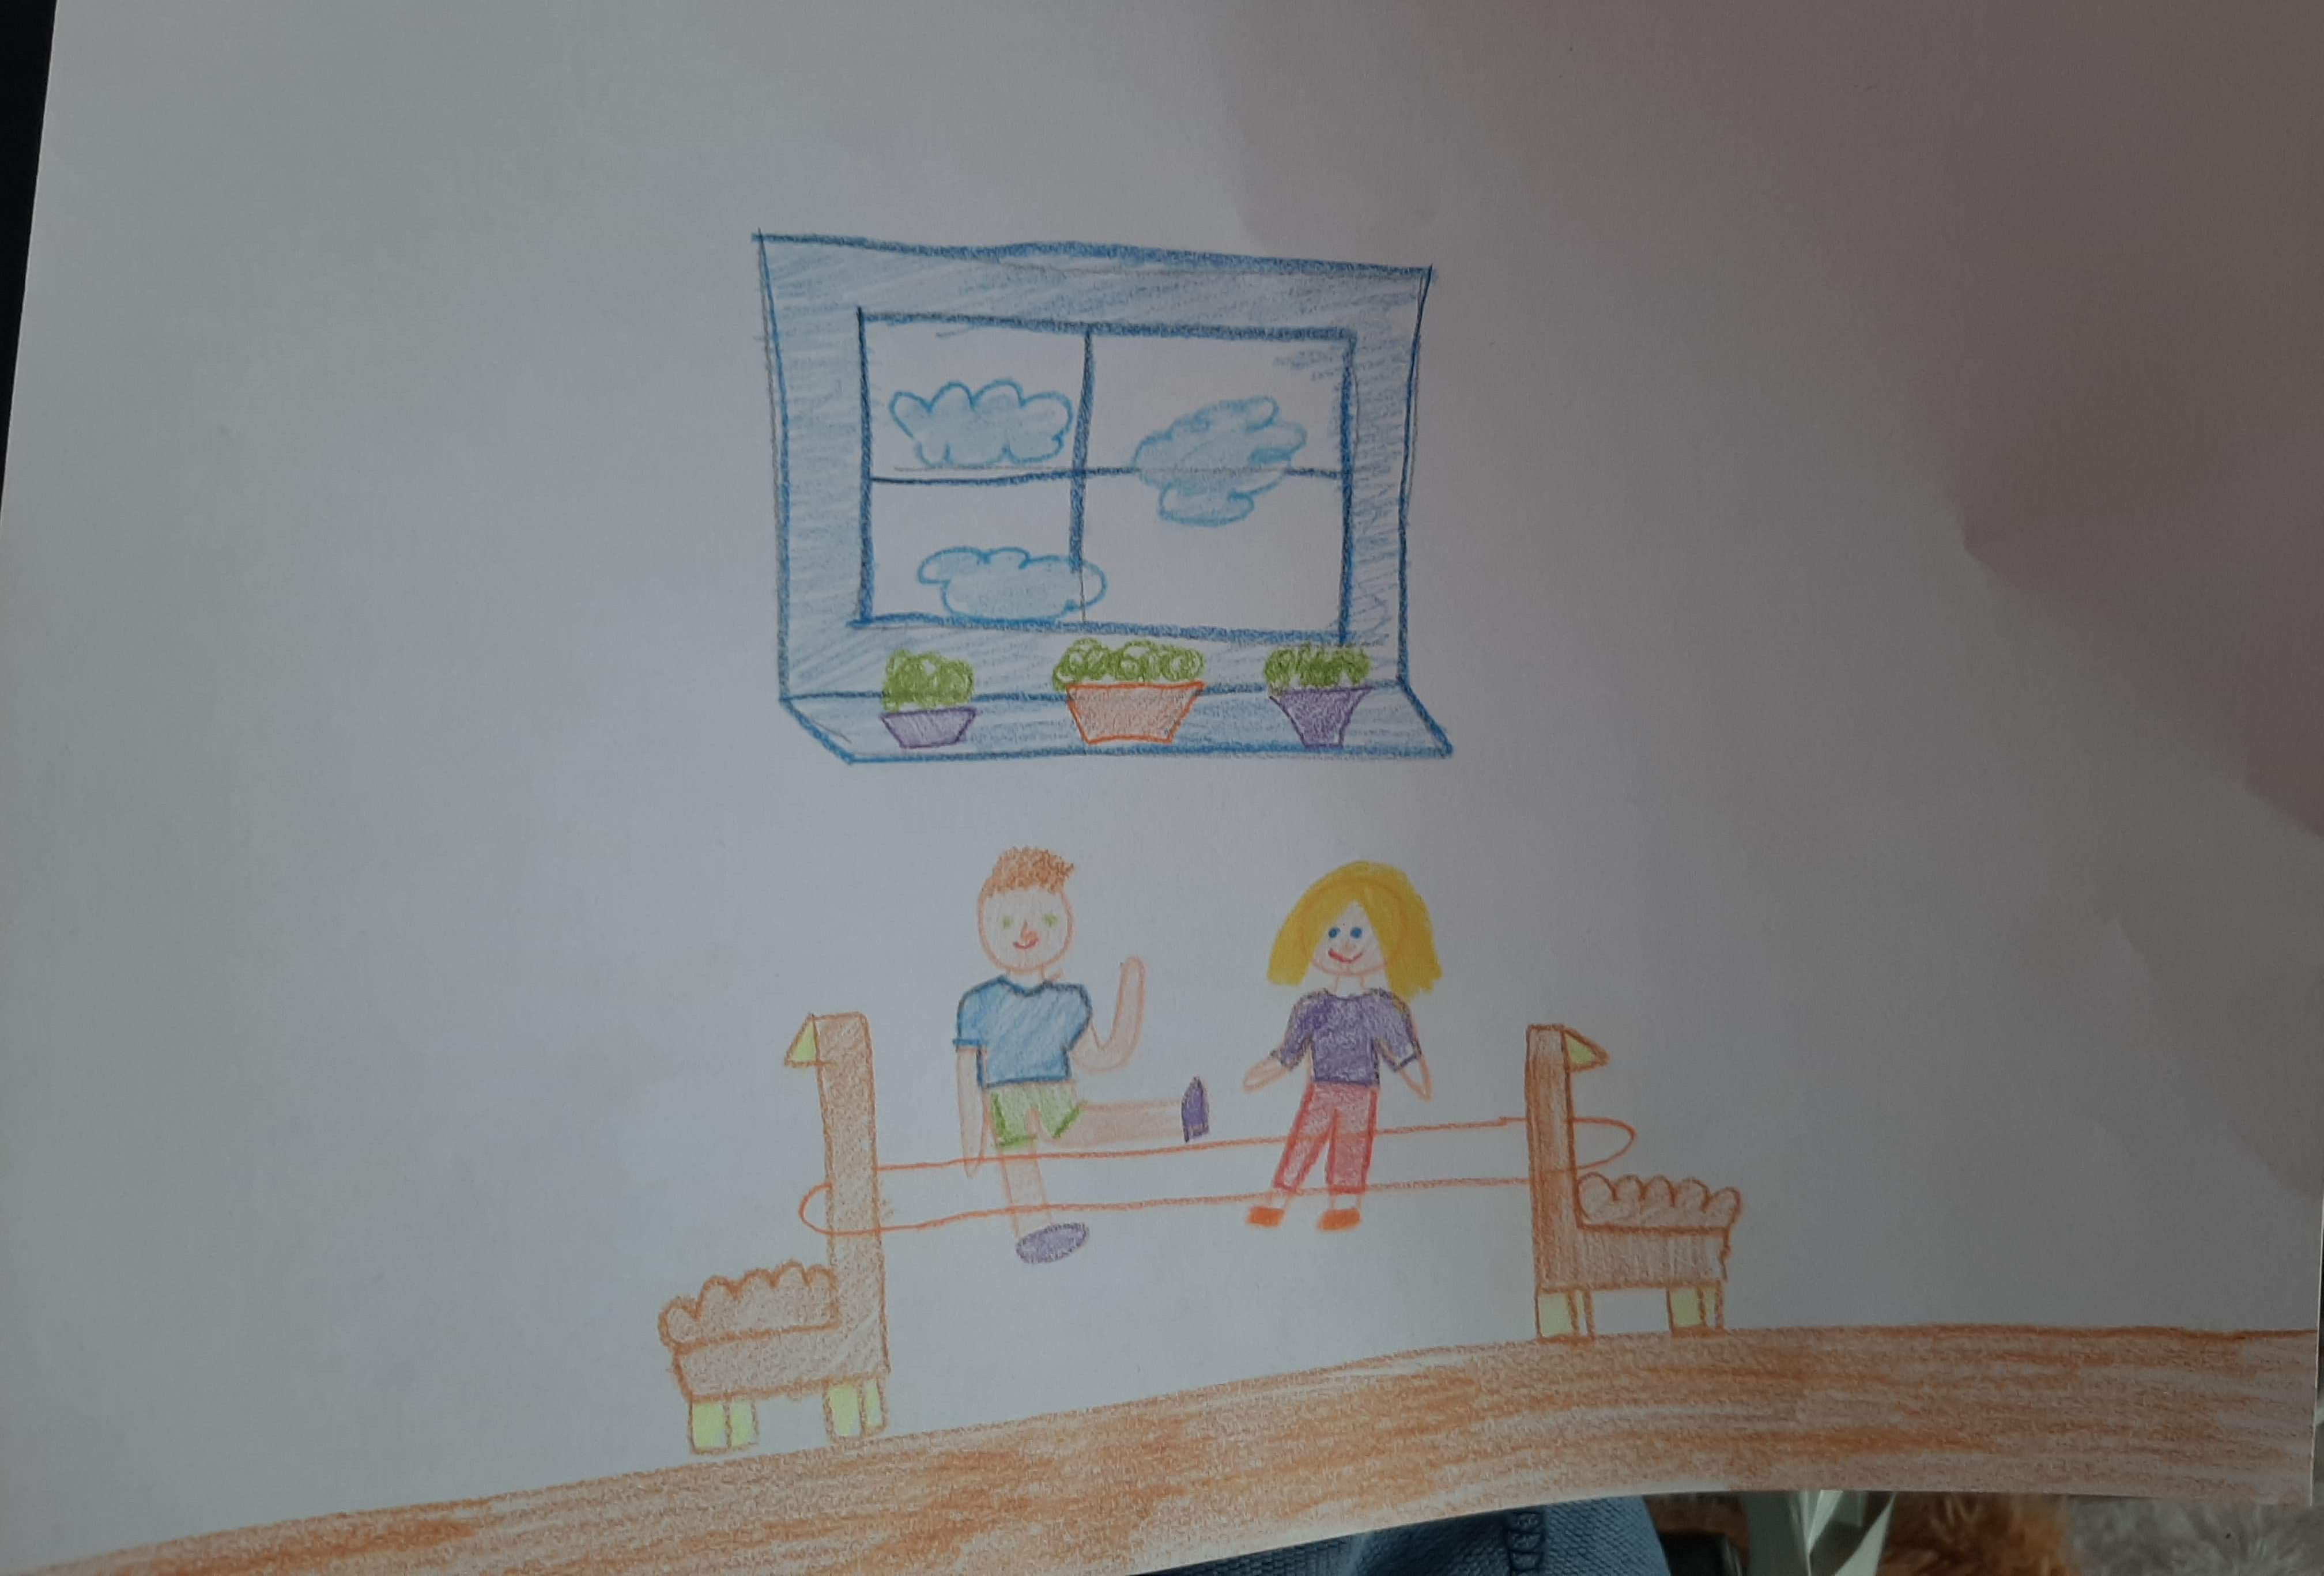
LAURA

Slide 21

OUR FAVOURITE GAMES
FOOTBALL
TAG
HIDE AND SEEK
COMPUTER GAMES
ROLLERBLADING
RIDING A BIKE
GYMNASTICS
DOMINO
WATERPOLO
LUDO

