Slide 1

Super school from Ciachcin
Teachers and Students

Slide 2
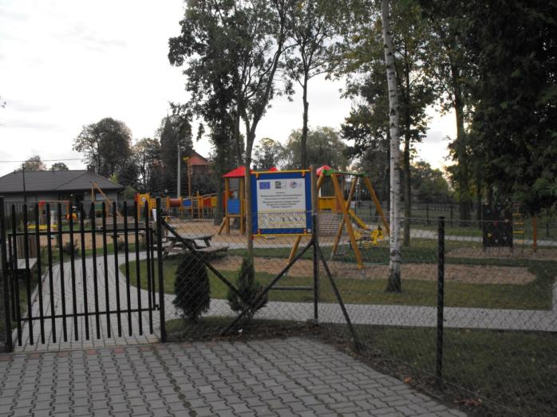
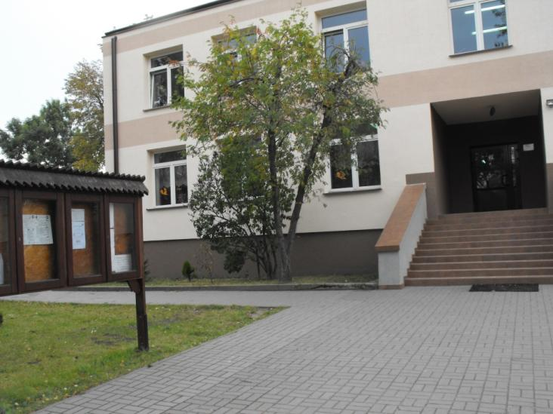
Photos of our school.

Slide 3
The place we meet!
Our school – Zespół Szkoł number 2 is in Ciachcin Nowy in Poland, about 100 km from Warsaw – the capital city.
Two years ago we chose the patron for our school – The Polish Nobel Prize winners (we have got 6 Nobel winners so far ☺)
Now, you are listening the school anthem: „We do know so much about ourselves as much as we were taught”. Our music teacher is playing the quitar.
There are more than two hundred students in our school and 27 teachers.

Slide 4
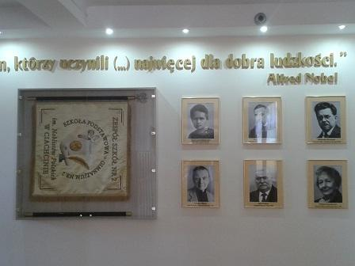
Polish Nobel Prize winners
There are six famous people: Maria Curie Skłodowska (1903 and 1911), Henryk Sienkiewicz (1905), Władysław Reymont (1924), Czesław Miłosz (1980), Lech Wałęsa (1983), Wisława Szymborska (1996).

Slide 5
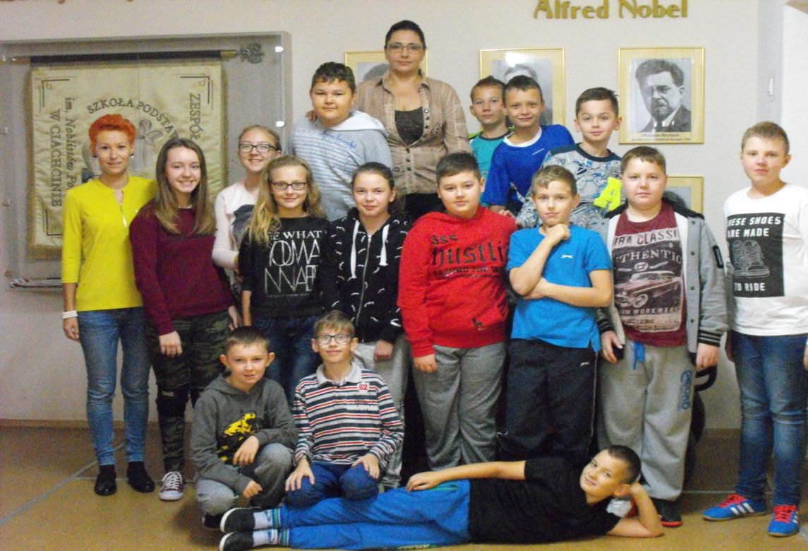
Here we are!!!

Slide 6
That is a photo of our e twinning group: two English teachers and fifteen crazy but hard working students. ☺

Slide 7
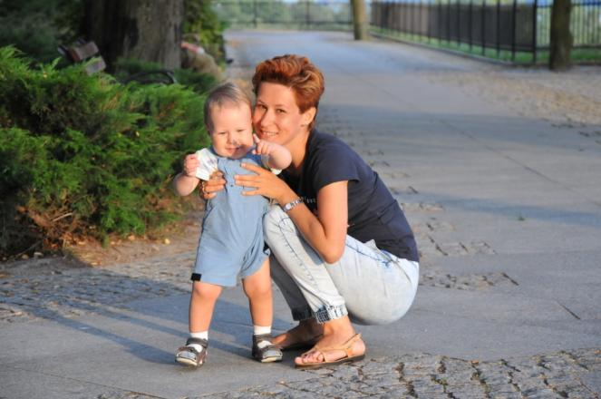
Teachers
Monika Topczewska
Hi! I’m a teacher of English in Ciachcin Nowy, where I’ve been working for 11 years.
I’ve always enjoyed teaching students and I’ve always tried to do everything to make my job FUN and easier.
I love reading books and watching old movies.
My pupils are really hard working, intelligent and curious about the world.
We start the project to:
Make new friends
Improve English
Have FUN of course ☺

Slide 8
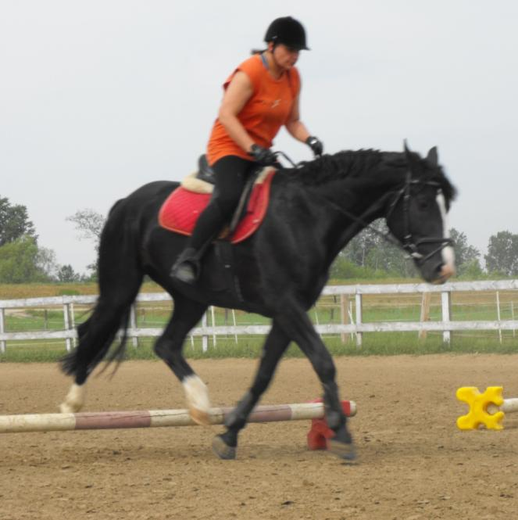
Edyta Sołtysiak – Mielcarek
Hi Everyone!!!!!!!!!!!!!
I am a teacher of English in a primary school and in a junior high school.
I am a little crazy so I love laughing.
I have two hobbies.
One of them is sailnig. I gained a patent many years ago and nowadays i sail every summer in the Masurian District – it is a geographical region of Polish beautiful lakes.
The second hobby is horse riding. I still learn but it is awesome. I ride every Saturday.

Slide 9
Kacper
Hi! My name is Casper and i’m 10 years old, i am in class 5 A.
My hobby is playing computer games, learning more from English language I really like doing this, fun with my friends their names are : Caroline, Victor, Nickolas, Piter, Michael and I love atletics.
This is my family: my mom, stepfather, sister and me. My mom is 30 years old, her name is Ana, My stepfather is 28 years old and his name's Matheus, My sister she is 7 months old, her name is Laura.We like watching Tv when Laura is slepping.

Slide 10
Michał
My name is Michael. I live in Ciachcin, in Poland. I am interested in football, my favourite player is Cristiano Ronaldo, he’s very good at it !
I’ve got a younger brother. His name is Krzysztof. He is seven years old and he goes to my school, too.

Slide 11
Adam
My name is Adam. I’m eleven years old.
I go to school in Ciachcin class 5b.
My interests are: architecture, music, sport and movies.
I live with my whole family: my mom’s name is Marta, she is 28 years old, great-grandmother’s name is Zofia, she is 78 years old, great-grandfather’s name is Adam, he’s 90 years old, grandmother’s name is Hanna, she is 53 years old, grandfather’s name is Jan, he is 55 years old, aunt’s name is Karolina, she is 22 years old, uncle name is Paweł, he is 24 years old, and uncle Darek is 23 years old.
In this way I introduced myself, my interests and my big family.

Slide 12
Katarzyna
My name is Kasia. I am ten years old. I'm from Ciachcin in Poland. I go to the class 5b.
I'm interested in singing and sport.
My favourite singer is Sylwia Grzeszczak.
My family is mum, dad and brother. My mum is thirty eight years old. Her name is Aneta. My dad is thirty seven years old. His name is Marcin. My brother is eighteen years old. His name is Kuba. My family isn't big but very happy.

Slide 13
Zuzanna
Hello! my name is Suzan. I am eleven years old and I go to school in Zespoł Szkół nr 2 in Ciachcin. I go to 5 class.
I’m Interested in music. I like the singer Alvaro Soler and I love his song: Sofia.
I have a brother he is seventeen years old, he’s interested in motorcycles . My mum’s name is Renata. She is keen on pupies, she is thirty eight years old. My dad’s name is Mariusz he’s forty one years old, he loves riding motorcycles.

Slide 14
Paweł
My name is Paweł. I'm 11 years old. I live in a small village near Płock Bronowo- Zalesie.
I'm in 5 year in primary school in Ciachcin.
I'm interested in football and Information Technology. In the future I want to be an informatician or footballer.
There are 4 people in my family. My mum, dad, sister and me. My sister's name is Kasia. She's 9 years old. She is in 3 year. She's got brown eyes and medium length hair. She's short. She doesn't like dresses. She wears jeans and tracksuit. She likes dolls and dancing. My mum's name is Teresa. She works in a supermarket. She's tall and beautiful. She's got dark and wavy hair. She's interested in cooking. My dad is Piotr. He is a mechanic. He's tall and slim. He's got blonde short hair and blue eyes. He likes animals and cars.
I like my school very much. I've got a lot of friends there. My best friend is Filip. He's a tall boy and he doesn't like doing his homework but he 's smart and intelligent.

Slide 15
Marcin
I'm Martin, I’m eleven years old and I live in Machcino.
I attend to primary school number 2 in Ciachcin Nowy.
My school has two floors and orange and yellow colours.
I have one, three years old sister.
My mother is thirty eight years old and my father is forty one years old.
In my free time I like playing games on my playstation.

Slide 16
Filip
Hi! I’m 11 years old. My name is Filip and I go to the fifth grade. My school is located in Ciachcin near Plock.
I'm interested in football. My favorite player is Zinedine Yazid Zidane. He is the coach of the Real Madrid club.
My family consists of four members. There is my dad, my mom, my brother and me.

Slide 17
Karolina
Hello!
My name is Karolina. I'm eleven years old. I go to the fifth grade of primary school - name of Noblistów Polskich in Ciachcin. My family consists of my mum, dad, grandma and me. My mum’s name's Agnieszka. She's thirty eight years old. My dad’s name is Artur. He's forty two years old. My grandma’s name's Jadwiga. She's seventy one years old. I'm an only child. I’m Interesed in music and sports. I like playing the guitar, singing, playing football, playing table tennis and drawing. My favourite animals are dog, cat and tortoise. My favourite fruits are stravberry, watermelon and apple.
Regards
Karolina ☺

Slide 18
Julia
My name is Julia. I'm eleven years old.
I am interested in painting and singing. I like playing football and table tennis. I like animals too. My favourite are cats.
My mother's name is Joanna and my father's name is Krzysztof. I have a sister too. Her name is Natalia. My grandma's name is Hanna and my grandad's name is Adam. They are my mother's parents. My second grandma's name is Krystyna and my second grandad's name is Bolesław. They are my father's parents.

Slide 19
Gabriel
Hi! I'm Gabriel and i’m 11 years old.
My Family Consists 6 memebers. My Mom’s name is Monika, she is 38. My dad’s name is Marek, he is 41. My brother’s name is Michael, he is 17. My grandmother’s name is Danusia, she is 63. My Grandfather’s name is Ryszard, he is 66. This is my Family.

Slide 20
Piotr
My name's Piotr, I'm 11 years old and I'm in class 5.
I go to school in Ciachcin.
I have got many friends, my favourite friend's name is Kuba.
My favourite subject at school is p.e.
I live in Goślice. It is 10 kilometers from Plock.
I have got a very big house: it has got five bedrooms, three bathrooms and two kitchens.
My grandparents are: Lucjan and Jadwiga. They live with us.
I have got one brother and his name is David. David is 18 years old.
My mum works in an office and my dad works at home.
I have got two dogs - Kora and Jack.
My hobbies are bike and football.

Slide 21
Patryk
Hi!
I'm Patryk. I'm eleven years old. I'm a student in clas five B in Ciachcin. I'm from Męczenino in Poland. I like pizza and apples.
I like geography and playing football. I'm an only child.
My school is big. My school is brown outside and yellow in the centre. Our teacher's are very nice.

Slide 22
Krystian
My name is Krystian. I’m 10 years old. I like playing computer games, my favorite are Minecraft and Paladins. I live in Ciachcin Nowy. I study in Szkoła Podstawowa im. Noblistów Polskich in Ciachicin.
My school is in the centre of town Ciachcin.
In this school there are many classes:
  IT class
  Sport class
  Day room
  Library
  And more classes to study

Slide 23
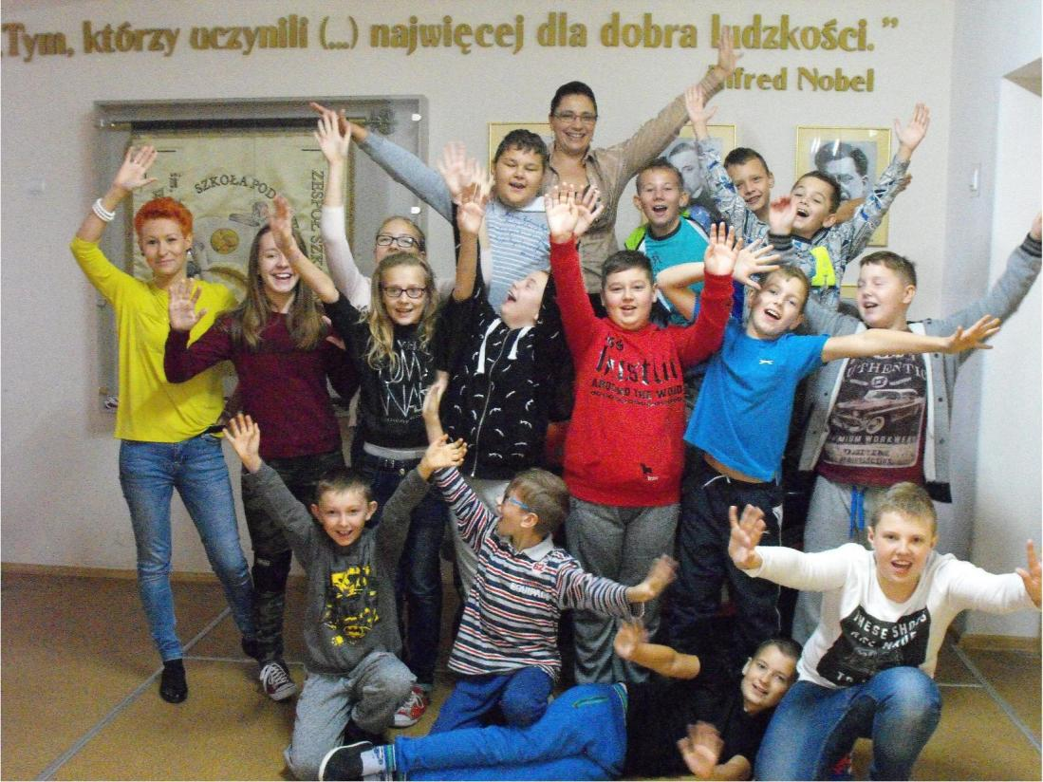
Thanks for watching!!!
Bye Bye ☺

