Slide 1
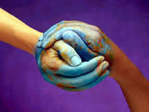

THE ETWINNING PROJECT:
ME – YOU – NICE TO MEET!

Slide 2

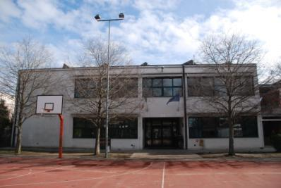
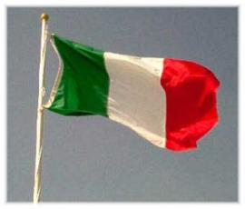
SCUOLA PRIMARIA g. RODARI
CALDERARA DI RENO
BOLOGNA
ITALY

Slide 3
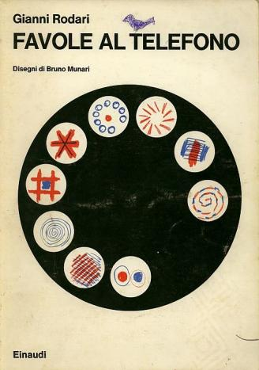
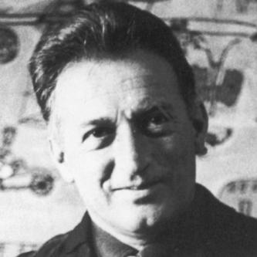
GIANNI RODARI WAS AN ITALIAN WRITER AND JOURNALIST FAMOUS FOR HIS CHILDREN’S BOOKS

Slide 4

HERE WE ARE….
LET’S TALK ABOUT some of US!

Slide 5
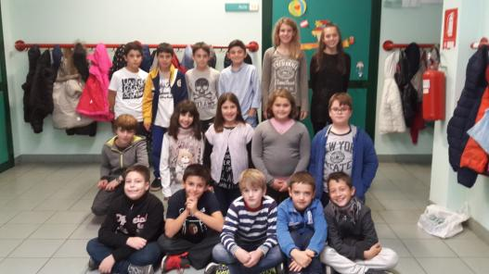
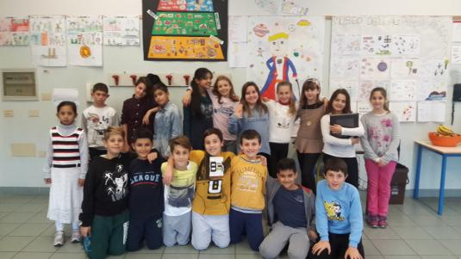
CLASS 5 D
CLASS 5E

Slide 6
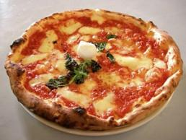
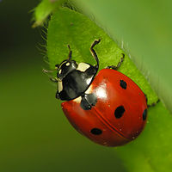
MY NAME IS SIMONE. MY SURNAME IS PISANU. I ’M 10. MY BIRTHDAY IN ON THE 3RD OF MARCH. I‘’VE GOT A SISTER. MY FAVOURITE COLOUR IS YELLOW. I LIKE PIZZA BUT I DON’T LIKE SALAD. I CAN SWIM BUT I CAN’T FLY. MY FAVOURITE SPORT IS SWIMMING. I LIVE IN CALDERARA. I’M FROM ITALY
My name is Marianna. My surname is Mioli.
I’m 10. I live in Calderara. I’m from Italy.
My favourite colour is red. My favourite animal is ladybird. My favourite hobby is dancing

Slide 7


HELLO! MY NAME’S MARCO. I’M 10, I LIVE IN CALDERARA IN ITALY. I’M A STUDENT. MY FAVOURITE SUBJECTS ARE: MATHS AND ENGLISH. MY FAVOURITE ANIMAL IS DOG.
MY FAVOURITE SPORT IS BASKETBALL. MY FAVOURITE FOOD IS MEAT AND SALAD. I HAVEN’T GOT ANY BROTHERS OR SISTERS
HELLO, MY NAME IS ANNA MARIA. I’M 11.
I’M FROM ROMANIA. I LIVE IN CALDERARA DI RENO. MY BIRTHDAY IS ON THE FIFTH OF MARCH.
I’VE GOT A LITTLE BROTHER. HIS NAME’S MARCO. MY FAVOURITE COLOUR IS PURPLE.
MY FAVOURITE SPORT IS VOLLEYBALL. MY FAVOURITE FOOD IS PIZZA.MY FAVOURITE ANIMAL IS CAT. MY FAVOURITE SUBJECTS IS MATHS.
I LOVE ARIANA GRANDE. I LOVE SCHOOL!

Slide 8
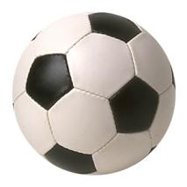
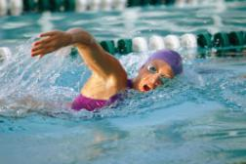
My name is Davide,
I’m ten . My birthday is on the 22nd of November.
I’ve got a sister. Her name is Marta. She’s 12.
I like football but I don’t like basketball.
I can run but I can’t swim.
MY NAME IS GIORGIA
I‘M FROM ITALY. I’M 10.
I LIVE IN CALDERARA DI RENO.
I HAVE GOT BLUE EYES AND BLOND HAIR
I HAVE GOT ONE BROTHER, HIS NAME’S MICHELANGELO.
MY FAVOURITE SPORT IS SWIMMING.
I CAN CLIMB BUT I CAN’T PLAY FOOTBALL.
MY FAVOURITE ANIMAL IS DOG.
I LIKE PIZZA BUT I DON’T LIKE FISH

Slide 9
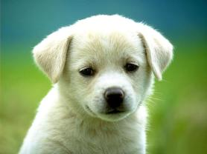
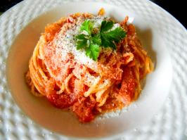
My name is Matteo. I'm 10. I'm from Italy.
I've got one sister Sara. She's 14.
I've got brown hair and brown eyes.
My favorite sport is football,
My favourite food is pizza .
My favourite animal is dog
My favourite colour is red
I can swim but I can't play baseball.
Hello! My name is Mattia. I'm 10. My surname is Bozzoli.
I Live in Calderara. I’m from Italy.
I’ve got a brother. His name is Mirko.
My birthday is on the 11th of August.
My favorite color is blue.
I like pasta but I don’t like fish.
I can swim but I can't play tennis

Slide 10

Hello! my name is Vincenzo Solimando.
I'm 10 years old . I'm from Italy and I live in Calderara Di Reno with my family.
I’ve got A brother, Francesco and A sister Anna. Francesco is 16 years old and Anna is 18 years old.
I love animals and my favourite animal is dog.
My birthday is on the 25th of July, in summer.
My favourite sport is football because I love running.
My favourite hobby is reading adventure books.
I like school and I' ve got a lot of friends. we love to play football.

Slide 11
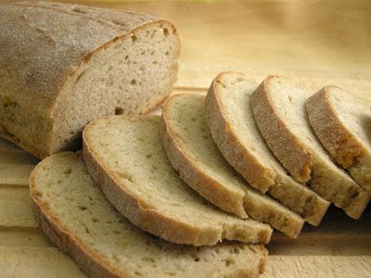
MY NAME IS FRANCESCO.
I’M 10. I’M FROM ITALY, I LIVE IN A VILLAGE, CALDERARA NEAR BOLOGNA.
I’VE GOT A BROTHER. HIS NAME’S MARCO.
MY FAVOURITE COLOUR IS GREEN. MY FAVOURITE ANIMAL IS DOG.
MY FAVOURITE SPORT IS FOOTBALL. I LIKE BREAD BUT I DON’T LIKE VEGETABLES.
I CAN SWIM BUT I CAN’T DANCE

Slide 12

THANKS FOR YOUR ATTENTION…
HOPE TO HEAR FROM YOU SOON!

