Slide 1
ITALIAN CUISINE

Slide 2
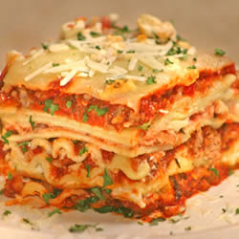
LASAGNA
INGREDIENTS
• 1 pound sweet Italian sausage
• 3/4 pound lean ground beef
• 1/2 cup minced onion
• 2 cloves garlic, crushed
• 1 (28 ounce) can crushed tomatoes
• 2 (6 ounce) cans tomato paste
• 2 (6.5 ounce) cans canned tomato sauce
• 1/2 cup water
• 2 tablespoons white sugar
• 1 1/2 teaspoons dried basil leaves
• 1/2 teaspoon fennel seeds
• 1 teaspoon Italian seasoning
• 1 tablespoon salt
• 1/4 teaspoon ground black pepper
• 4 tablespoons chopped fresh parsley
• 12 lasagna noodles
• 16 ounces ricotta cheese
• 1 egg
• 1/2 teaspoon salt
• 3/4 pound mozzarella cheese, sliced
• 3/4 cup grated Parmesan cheese
DIRECTIONS
In a Dutch oven, cook sausage, ground beef, onion, and garlic over medium heat until well browned. Stir in crushed tomatoes, tomato paste, tomato sauce, and water. Season with sugar, basil, fennel seeds, Italian seasoning, 1 tablespoon salt, pepper, and 2 tablespoons parsley. Simmer, covered, for about 1 1/2 hours, stirring occasionally.
Bring a large pot of lightly salted water to a boil. Cook lasagna noodles in boiling water for 8 to 10 minutes. Drain noodles, and rinse with cold water. In a mixing bowl, combine ricotta cheese with egg, remaining parsley, and 1/2 teaspoon salt.
Preheat oven to 375 degrees F (190 degrees C).
To assemble, spread 1 1/2 cups of meat sauce in the bottom of a 9x13 inch baking dish. Arrange 6 noodles lengthwise over meat sauce. Spread with one half of the ricotta cheese mixture. Top with a third of mozzarella cheese slices. Spoon 1 1/2 cups meat sauce over mozzarella, and sprinkle with 1/4 cup Parmesan cheese. Repeat layers, and top with remaining mozzarella and Parmesan cheese. Cover with foil: to prevent sticking, either spray foil with cooking spray, or make sure the foil does not touch the cheese.
Bake in preheated oven for 25 minutes. Remove foil, and bake an additional 25 minutes. Cool for 15 minutes before serving.
• PREP 30 mins
• COOK 2 hrs 30 mins
• READY IN 3 hrs 15 mins

Slide 3
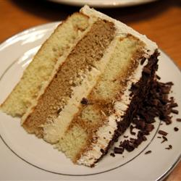
TIRAMISU
INGREDIENTS:
CAKE:
• 1 (18.25 ounce) package moist white cake mix
• 1 teaspoon instant coffee powder
• 1/4 cup coffee
• 1 tablespoon coffee flavored liqueur
FILLING:
• 1 (8 ounce) container mascarpone cheese
• 1/2 cup confectioners' sugar
• 2 tablespoons coffee flavored liqueur
FROSTING:
• 2 cups heavy cream
• 1/4 cup confectioners' sugar
• 2 tablespoons coffee flavored liqueur
GARNISH:
• 2 tablespoons unsweetened cocoa powder
• 1 (1 ounce) square semisweet chocolate
DIRECTIONS
Preheat oven to 350 degrees F (175 degrees C). Grease and flour 3 (9 inch) pans.
Prepare the cake mix according to package directions. Divide two thirds of batter between 2 pans. Stir instant coffee into remaining batter; pour into remaining pan.
Bake in the preheated oven for 20 to 25 minutes, or until a toothpick inserted into the center of the cake comes out clean. Let cool in pan for 10 minutes, then turn out onto a wire rack and cool completely. In a measuring cup, combine brewed coffee and 1 tablespoon coffee liqueur; set aside.
To make the filling: In a small bowl, using an electric mixer set on low speed, combine mascarpone, 1/2 cup confectioners' sugar and 2 tablespoons coffee liqueur; beat just until smooth. Cover with plastic wrap and refrigerate.
To make the frosting: In a medium bowl, using an electric mixer set on medium-high speed, beat the cream, 1/4 cup confectioners' sugar and 2 tablespoons coffee liqueur until stiff. Fold 1/2 cup of cream mixture into filling mixture.
To assemble the cake: Place one plain cake layer on a serving plate. Using a thin skewer, poke holes in cake, about 1 inch apart. Pour one third of reserved coffee mixture over cake, then spread with half of the filling mixture. Top with coffee-flavored cake layer; poke holes in cake. Pour another third of the coffee mixture over the second layer and spread with the remaining filling. Top with remaining cake layer; poke holes in cake. Pour remaining coffee mixture on top. Spread sides and top of cake with frosting. Place cocoa in a sieve and lightly dust top of cake. Garnish with chocolate curls. Refrigerate at least 30 minutes before serving.
To make the chocolate curls, use a vegetable peeler and run it down the edge of the chocolate bar.
• PREP 5 mins
• COOK 20 mins
• READY IN 2 hrs

Slide 4
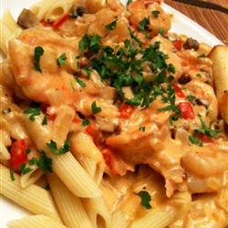
PEPPERED SHRIMP ALFREDO
INGREDIENTS
• 12 ounces penne pasta
• 1/4 cup butter
• 2 tablespoons extra-virgin olive oil
• 1 onion, diced
• 2 cloves garlic, minced
• 1 red bell pepper, diced
• 1/2 pound portobello mushrooms, diced
• 1 pound medium shrimp, peeled and deveined
• 1 (15 ounce) jar Alfredo sauce
• 1/2 cup grated Romano cheese
• 1/2 cup cream
• 1 teaspoon cayenne pepper, or more to taste
• salt and pepper to taste
• 1/4 cup chopped parsley
DIRECTIONS
Bring a large pot of lightly salted water to a boil. Add pasta and cook for 8 to 10 minutes or until al dente; drain.
Meanwhile, melt butter together with the olive oil in a saucepan over medium heat. Stir in onion, and cook until softened and translucent, about 2 minutes. Stir in garlic, red pepper, and mushroom; cook over medium-high heat until soft, about 2 minutes more.
Stir in the shrimp, and cook until firm and pink, then pour in Alfredo sauce, Romano cheese, and cream; bring to a simmer stirring constantly until thickened, about 5 minutes. Season with cayenne, salt, and pepper to taste. Stir drained pasta into the sauce, and serve sprinkled with chopped parsley.
• PREP 30 mins
• COOK 20 mins
• READY IN 50 mins

Slide 5
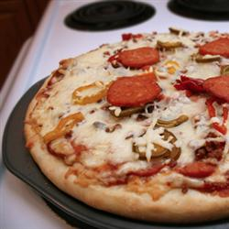
PIZZA DOUGH
INGREDIENTS
• 3 cups all-purpose flour
• 1 (.25 ounce) package active dry yeast
• 2 tablespoons vegetable oil
• 1 teaspoon salt
• 1 tablespoon white sugar
• 1 cup warm water (110 degrees F/45 degrees C)
DIRECTIONS
Combine flour, salt, sugar, and yeast in a large bowl. Mix in oil and warm water. Spread out on a large pizza pan. Top as desired.
Bake at 375 degrees C (190 degrees C) for 20 to 25 minutes.
PREP 10 mins
COOK 25 mins
READY IN 35 mins

Slide 6
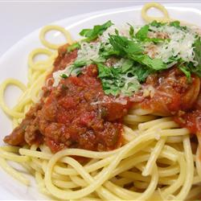
SPAGHETTI
INGREDIENTS
• 1 pound ground beef
• 1 onion, chopped
• 4 cloves garlic, minced
• 1 small green bell pepper, diced
• 1 (28 ounce) can diced tomatoes
• 1 (16 ounce) can tomato sauce
• 1 (6 ounce) can tomato paste
• 2 teaspoons dried oregano
• 2 teaspoons dried basil
• 1 teaspoon salt
• 1/2 teaspoon black pepper
DIRECTIONS
Combine ground beef, onion, garlic, and green pepper in a large saucepan. Cook and stir until meat is brown and vegetables are tender. Drain grease.
Stir diced tomatoes, tomato sauce, and tomato paste into the pan. Season with oregano, basil, salt, and pepper. Simmer spaghetti sauce for 1 hour, stirring occasionally.
• PREP 15 mins
• COOK 1 hr 10 mins
• READY IN 1 hr 25 mins

Slide 7
BRITISH CUISINE

Slide 8
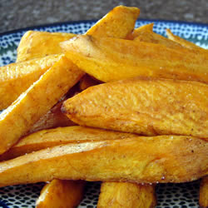
BAKED SWEET POTATO STICKS
INGREDIENTS
• 1 tablespoon olive oil
• 1/2 teaspoon paprika
• 8 sweet potatoes, sliced lengthwise into quarters
DIRECTIONS
Preheat oven to 400 degrees F (200 degrees C). Spray a baking sheet with cooking spay or vegetable oil.
In a large bowl, mix oil and paprika. Add potato sticks, and stir by hand to coat. Place on the prepared baking sheet.
Bake 40 minutes in the preheated oven. Best eaten at room temperature.
• PREP 15 mins
• COOK 40 mins
• READY IN 55 mins

Slide 9
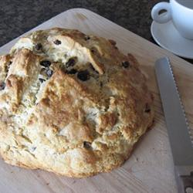
AMAZINGLY EASY IRISH SODA BREAD
INGREDIENTS
• 4 cups all-purpose flour
• 4 tablespoons white sugar
• 1 teaspoon baking soda
• 1 tablespoon baking powder
• 1/2 teaspoon salt
• 1/2 cup margarine, softened
• 1 cup buttermilk
• 1 egg
• 1/4 cup butter, melted
• 1/4 cup buttermilk
DIRECTIONS
Preheat oven to 375 degrees F (190 degrees C). Lightly grease a large baking sheet.
In a large bowl, mix together flour, sugar, baking soda, baking powder, salt and margarine. Stir in 1 cup of buttermilk and egg. Turn dough out onto a lightly floured surface and knead slightly. Form dough into a round and place on prepared baking sheet. In a small bowl, combine melted butter with 1/4 cup buttermilk; brush loaf with this mixture. Use a sharp knife to cut an 'X' into the top of the loaf.
Bake in preheated oven until a toothpick inserted into the center of the loaf comes out clean, 45 to 50 minutes. Check for doneness after 30 minutes. You may continue to brush the loaf with the butter mixture while it bakes.
• PREP 15 mins
• COOK 50 mins
• READY IN 1 hr 5 mins

Slide 10
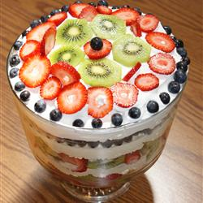
PRIZEWINNING TRIFLE
INGREDIENTS
• 1 (12 ounce) container frozen whipped topping, thawed
• 1 (8 ounce) container sour cream
• 1 (9 inch) angel food cake
• 1 (3.4 ounce) package instant vanilla pudding mix
• 3 kiwis, peeled and sliced
• 1 pint fresh strawberries, sliced
• 3 bananas, peeled and sliced
• 1 (15 ounce) can crushed pineapple, drained
• 1 sprig fresh mint
DIRECTIONS
In a medium bowl, fold sour cream and unprepared pudding mix into the whipped topping.
Cut the cake into thirds, horizontally.
Line a large trifle or other glass serving bowl with kiwi and strawberry slices, reserving two whole strawberries and two kiwi slices. Place one layer of cake in bottom of bowl, top with 1/3 of bananas and pineapple, and 1/3 of whipped topping mixture. Repeat layering until all ingredients are used.
Make fan garnishes of whole strawberries by slicing from just below the stem. Garnish assembled trifle with fanned strawberries, reserved kiwi slices, and a sprig of mint. Refrigerate until serving.
• PREP 30 mins
• READY IN 30 mins

Slide 11
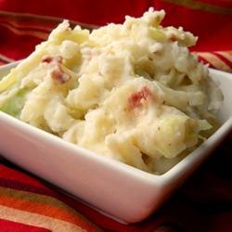
COLCANNON
INGREDIENTS
• 2 1/2 pounds potatoes, peeled and cubed
• 4 slices bacon
• 1/2 small head cabbage, chopped
• 1 large onion, chopped
• 1/2 cup milk
• salt and pepper to taste
• 1/4 cup butter, melted
DIRECTIONS
Place potatoes in a saucepan with enough water to cover. Bring to a boil, and cook for 15 to 20 minutes, until tender.
Place bacon in a large, deep skillet. Cook over medium high heat until evenly brown. Drain, reserving drippings, crumble and set aside. In the reserved drippings, saute the cabbage and onion until soft and translucent. Putting a lid on the pan helps the vegetables cook faster.
Drain the cooked potatoes, mash with milk and season with salt and pepper. Fold in the bacon, cabbage, and onions, then transfer the mixture to a large serving bowl. Make a well in the center, and pour in the melted butter. Serve immediately.
• PREP 20 mins
• COOK 20 mins
• READY IN 40 mins

Slide 12
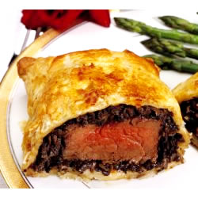
BEEF WELLINGTON
INGREDIENTS
• 2 1/2 pounds beef tenderloin
• 2 tablespoons butter, softened
• 2 tablespoons butter
• 1 onion, chopped
• 1/2 cup sliced fresh mushrooms
• 2 ounces liver pate
• 2 tablespoons butter, softened
• salt and pepper to taste
• 1 (17.5 ounce) package frozen puff pastry, thawed
• 1 egg yolk, beaten
• 1 (10.5 ounce) can beef broth
• 2 tablespoons red wine
DIRECTIONS
Preheat oven to 425 degrees F (220 degrees C). Place beef in a small baking dish, and spread with 2 tablespoons softened butter. Bake for 10 to 15 minutes, or until browned. Remove from pan, and allow to cool completely. Reserve pan juices.
Melt 2 tablespoons butter in a skillet over medium heat. Saute onion and mushrooms in butter for 5 minutes. Remove from heat, and let cool.
Mix together pate and 2 tablespoons softened butter, and season with salt and pepper. Spread pate over beef. Top with onion and mushroom mixture.
Roll out the puff pastry dough, and place beef in the center. Fold up, and seal all the edges, making sure the seams are not too thick. Place beef in a 9x13 inch baking dish, cut a few slits in the top of the dough, and brush with egg yolk.
Bake at 450 degrees F (230 degrees C) for 10 minutes, then reduce heat to 425 degrees F (220 degrees C) for 10 to 15 more minutes, or until pastry is a rich, golden brown. Set aside, and keep warm.
Place all reserved juices in a small saucepan over high heat. Stir in beef stock and red wine; boil for 10 to 15 minutes, or until slightly reduced. Strain, and serve with beef.
• PREP 30 mins
• COOK 30 mins
• READY IN 1 hr

Slide 13
JAPANESE CUISINE

Slide 14
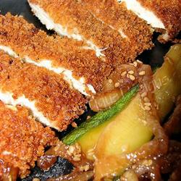
CHICKEN KATSU
INGREDIENTS
• 4 skinless, boneless chicken breast halves - pounded to 1/2 inch thickness
• salt and pepper to taste
• 2 tablespoons all-purpose flour
• 1 egg, beaten
• 1 cup panko bread crumbs
• 1 cup oil for frying, or as needed
DIRECTIONS
Season the chicken breasts on both sides with salt and pepper. Place the flour, egg and panko crumbs into separate shallow dishes. Coat the chicken breasts in flour, shaking off any excess. Dip them into the egg, and then press into the panko crumbs until well coated on both sides.
Heat 1/4 inch of oil in a large skillet over medium-high heat. Place chicken in the hot oil, and cook 3 or 4 minutes per side, or until golden brown.
• PREP 10 mins
• COOK 10 mins
• READY IN 20 mins

Slide 15
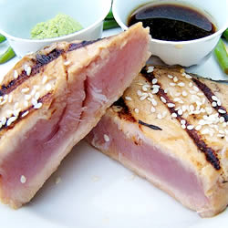
SESAME SEARED TUNA
INGREDIENTS
• 1/4 cup soy sauce
• 1 tablespoon mirin (Japanese sweet wine)
• 1 tablespoon honey
• 2 tablespoons sesame oil
• 1 tablespoon rice wine vinegar
• 4 (6 ounce) tuna steaks
• 1/2 cup sesame seeds
• wasabi paste
• 1 tablespoon olive oil
DIRECTIONS
In a small bowl, stir together the soy sauce, mirin, honey and sesame oil. Divide into two equal parts. Stir the rice vinegar into one part and set aside as a dipping sauce.
Spread the sesame seeds out on a plate. Coat the tuna steaks with the remaining soy sauce mixture, then press into the sesame seeds to coat.
Heat olive oil in a cast iron skillet over high heat until very hot. Place steaks in the pan, and sear for about 30 seconds on each side. Serve with the dipping sauce and wasabi paste.
• PREP 10 mins
• COOK 10 mins
• READY IN 20 mins

Slide 16
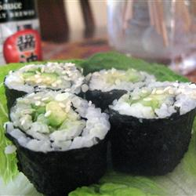
SUSHI
INGREDIENTS
• 2/3 cup uncooked short-grain white rice
• 3 tablespoons rice vinegar
• 3 tablespoons white sugar
• 1 1/2 teaspoons salt
• 4 sheets nori seaweed sheets
• 2 tablespoons pickled ginger
• 1 avocado
• 1/2 pound imitation crabmeat, flaked
DIRECTIONS
In a medium saucepan, bring 1 1/3 cups water to a boil. Add rice, and stir. Reduce heat, cover, and simmer for 20 minutes. In a small bowl, mix the rice vinegar, sugar ,and salt. Blend the mixture into the rice.
Preheat oven to 300 degrees F (150 degrees C). On a medium baking sheet, heat nori in the preheated oven 1 to 2 minutes, until warm.
Center one sheet nori on a bamboo sushi mat. Wet your hands. Using your hands, spread a thin layer of rice on the sheet of nori, and press into a thin layer. Arrange 1/4 of the cucumber, ginger, avocado, and imitation crabmeat in a line down the center of the rice. Lift the end of the mat, and gently roll it over the ingredients, pressing gently. Roll it forward to make a complete roll. Repeat with remaining ingredients.
Cut each roll into 4 to 6 slices using a wet, sharp knife.
• PREP 45 mins
• READY IN 45 mins

Slide 17
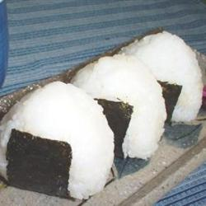
ONIGIRI
INGREDIENTS
• 4 cups uncooked short-grain white rice
• 4 1/2 cups water
• 1 cup water
• 1/4 teaspoon salt
• 1/4 cup bonito shavings (dry fish flakes)
• 2 sheets nori (dry seaweed), cut into 1/2-inch strips
• 2 tablespoons sesame seeds
DIRECTIONS
Wash the rice in a mesh strainer until the water runs clear. Combine washed rice and 4 1/2 cups water in a saucepan. Bring to a boil over high heat, stirring occasionally. Reduce heat to low; cover. Simmer rice until the water is absorbed, 15 to 20 minutes. Let rice rest, for 15 minutes to allow the rice to continue to steam and become tender. Allow cooked rice to cool.
Combine 1 cup water with the salt in a small bowl. Use this water to dampen hands before handling the rice. Divide the cooked rice into 8 equal portions. Use one portion of rice for each onigiri.
Divide one portion of rice in two. Create a dimple in the rice and fill with a heaping teaspoon of bonito flakes. Cover with the remaining portion of rice and press lightly to enclose filling inside rice ball. Gently press the rice to shape into a triangle. Wrap shaped onigiri with a strip of nori. Sprinkle with sesame seeds. Repeat to make a total of 8 onigiri.
• PREP 20 mins
• COOK 30 mins
• READY IN 1 hr 10 mins

Slide 18
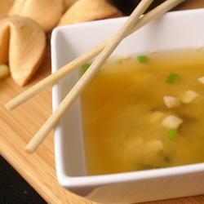
MISO SOUP
INGREDIENTS
• 2 teaspoons dashi granules
• 4 cups water
• 3 tablespoons miso paste
• 1 (8 ounce) package silken tofu, diced
• 2 green onions, sliced diagonally into 1/2 inch pieces
DIRECTIONS
1. In a medium saucepan over medium-high heat, combine dashi granules and water; bring to a boil. Reduce heat to medium, and whisk in the miso paste. Stir in tofu. Separate the layers of the green onions, and add them to the soup. Simmer gently for 2 to 3 minutes before serving.
• PREP 5 mins
• COOK 15 mins
• READY IN 20 mins

Slide 19
FRENCH CUISINE

Slide 20
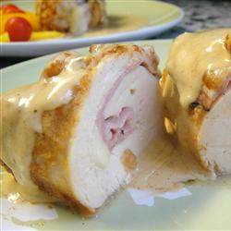
CHICKEN CORDON BLEU
INGREDIENTS
6 skinless, boneless chicken breast halves
6 slices Swiss cheese
6 slices ham
3 tablespoons all-purpose flour
1 teaspoon paprika
6 tablespoons butter
1/2 cup dry white wine
1 teaspoon chicken bouillon granules
1 tablespoon cornstarch
1 cup heavy whipping cream
DIRECTIONS
Pound chicken breasts if they are too thick. Place a cheese and ham slice on each breast within 1/2 inch of the edges. Fold the edges of the chicken over the filling, and secure with toothpicks. Mix the flour and paprika in a small bowl, and coat the chicken pieces.
Heat the butter in a large skillet over medium-high heat, and cook the chicken until browned on all sides. Add the wine and bouillon. Reduce heat to low, cover, and simmer for 30 minutes, until chicken is no longer pink and juices run clear.
Remove the toothpicks, and transfer the breasts to a warm platter. Blend the cornstarch with the cream in a small bowl, and whisk slowly into the skillet. Cook, stirring until thickened, and pour over the chicken. Serve warm.
• PREP 15 mins
• COOK 45 mins
• READY IN 1 hr

Slide 21
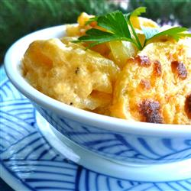
CREAMY AU GRATIN POTATOES
INGREDIENTS
• 4 russet potatoes, sliced into 1/4 inch slices
• 1 onion, sliced into rings
• salt and pepper to taste
• 3 tablespoons butter
• 3 tablespoons all-purpose flour
• 1/2 teaspoon salt
• 2 cups milk
• 1 1/2 cups shredded Cheddar cheese
DIRECTIONS
Preheat oven to 400 degrees F (200 degrees C). Butter a 1 quart casserole dish.
Layer 1/2 of the potatoes into bottom of the prepared casserole dish. Top with the onion slices, and add the remaining potatoes. Season with salt and pepper to taste.
In a medium-size saucepan, melt butter over medium heat. Mix in the flour and salt, and stir constantly with a whisk for one minute. Stir in milk. Cook until mixture has thickened. Stir in cheese all at once, and continue stirring until melted, about 30 to 60 seconds. Pour cheese over the potatoes, and cover the dish with aluminum foil.
Bake 1 1/2 hours in the preheated oven.
• PREP 30 mins
• COOK 1 hr 30 mins
• READY IN 2 hrs

Slide 22
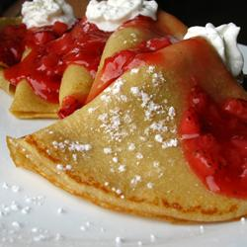
BASIC CREPES
INGREDIENTS
1 cup all-purpose flour
2 eggs
1/2 cup milk
1/2 cup water
1/4 teaspoon salt
2 tablespoons butter, melted
DIRECTIONS
In a large mixing bowl, whisk together the flour and the eggs. Gradually add in the milk and water, stirring to combine. Add the salt and butter; beat until smooth.
Heat a lightly oiled griddle or frying pan over medium high heat. Pour or scoop the batter onto the griddle, using approximately 1/4 cup for each crepe. Tilt the pan with a circular motion so that the batter coats the surface evenly.
Cook the crepe for about 2 minutes, until the bottom is light brown. Loosen with a spatula, turn and cook the other side. Serve hot.
• PREP 10 mins
• COOK 20 mins
• READY IN 30 mins

Slide 23
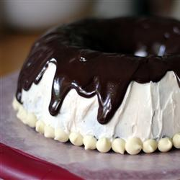
CHOCOLATE GANACHE
INGREDIENTS
9 ounces bittersweet chocolate, chopped
1 cup heavy cream
1 tablespoon dark rum (optional)
DIRECTIONS
Place the chocolate into a medium bowl. Heat the cream in a small sauce pan over medium heat. Bring just to a boil, watching very carefully because if it boils for a few seconds, it will boil out of the pot. When the cream has come to a boil, pour over the chopped chocolate, and whisk until smooth. Stir in the rum if desired.
Allow the ganache to cool slightly before pouring over a cake. Start at the center of the cake and work outward. For a fluffy frosting or chocolate filling, allow it to cool until thick, then whip with a whisk until light and fluffy.
• PREP 10 mins
• COOK 10 mins
• READY IN 20 mins

Slide 24
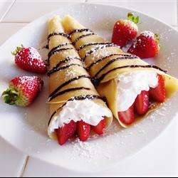
CREPES
INGREDIENTS
• 2 eggs
• 1 cup milk
• 2/3 cup all-purpose flour
• 1 pinch salt
• 1 1/2 teaspoons vegetable oil
DIRECTIONS
In a blender combine eggs, milk, flour, salt and oil. Process until smooth. Cover and refrigerate 1 hour.
Heat a skillet over medium-high heat and brush with oil. Pour 1/4 cup of crepe batter into pan, tilting to completely coat the surface of the pan. Cook 2 to 5 minutes, turning once, until golden. Repeat with remaining batter.
• PREP 5 mins
• COOK 15 mins
• READY IN 1 hr 20 mins

Slide 25
INDIAN CUISINE

Slide 26
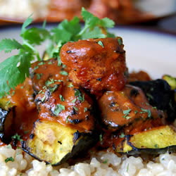
CHICKEN TIKKA MASALA
INGREDIENTS
1 cup yogurt
1 tablespoon lemon juice
2 teaspoons ground cumin
1 teaspoon ground cinnamon
2 teaspoons cayenne pepper
2 teaspoons freshly ground black pepper
1 tablespoon minced fresh ginger
4 teaspoons salt, or to taste
3 boneless skinless chicken breasts, cut into bite-size pieces
4 long skewers
1 tablespoon butter
1 clove garlic, minced
1 jalapeno pepper, finely chopped
2 teaspoons ground cumin
2 teaspoons paprika
3 teaspoons salt, or to taste
1 (8 ounce) can tomato sauce
1 cup heavy cream
1/4 cup chopped fresh cilantro
DIRECTIONS
In a large bowl, combine yogurt, lemon juice, 2 teaspoons cumin, cinnamon, cayenne, black pepper, ginger, and 4 teaspoons salt. Stir in chicken, cover, and refrigerate for 1 hour.
Preheat a grill for high heat.
Lightly oil the grill grate. Thread chicken onto skewers, and discard marinade. Grill until juices run clear, about 5 minutes on each side.
Melt butter in a large heavy skillet over medium heat. Saute garlic and jalapeno for 1 minute. Season with 2 teaspoons cumin, paprika, and 3 teaspoons salt. Stir in tomato sauce and cream. Simmer on low heat until sauce thickens, about 20 minutes. Add grilled chicken, and simmer for 10 minutes. Transfer to a serving platter, and garnish with fresh cilantro.
• PREP 30 mins
• COOK 50 mins
• READY IN 2 hrs 20 mins

Slide 27
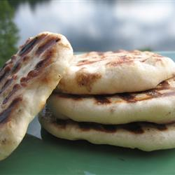
NAAN
INGREDIENTS
• 1 (.25 ounce) package active dry yeast
• 1 cup warm water
• 1/4 cup white sugar
• 3 tablespoons milk
• 1 egg, beaten
• 2 teaspoons salt
• 4 1/2 cups bread flour
• 2 teaspoons minced garlic (optional)
• 1/4 cup butter, melted
DIRECTIONS
In a large bowl, dissolve yeast in warm water. Let stand about 10 minutes, until frothy. Stir in sugar, milk, egg, salt, and enough flour to make a soft dough. Knead for 6 to 8 minutes on a lightly floured surface, or until smooth. Place dough in a well oiled bowl, cover with a damp cloth, and set aside to rise. Let it rise 1 hour, until the dough has doubled in volume.
Punch down dough, and knead in garlic. Pinch off small handfuls of dough about the size of a golf ball. Roll into balls, and place on a tray. Cover with a towel, and allow to rise until doubled in size, about 30 minutes.
During the second rising, preheat grill to high heat.
At grill side, roll one ball of dough out into a thin circle. Lightly oil grill. Place dough on grill, and cook for 2 to 3 minutes, or until puffy and lightly browned. Brush uncooked side with butter, and turn over. Brush cooked side with butter, and cook until browned, another 2 to 4 minutes. Remove from grill, and continue the process until all the naan has been prepared.
• PREP 30 mins
• COOK 7 mins
• READY IN 3 hrs

Slide 28
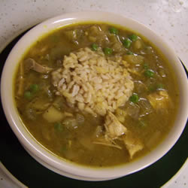
MULLIGATAWNY SOUP
INGREDIENTS
• 1/2 cup chopped onion
• 2 stalks celery, chopped
• 1 carrot, diced
• 1/4 cup butter
• 1 1/2 tablespoons all-purpose flour
• 1 1/2 teaspoons curry powder
• 4 cups chicken broth
• 1/2 apple, cored and chopped
• 1/4 cup white rice
• 1 skinless, boneless chicken breast half - cut into cubes
• salt to taste
• ground black pepper to taste
• 1 pinch dried thyme
• 1/2 cup heavy cream, heated
DIRECTIONS
Saute onions, celery, carrot, and butter in a large soup pot. Add flour and curry, and cook 5 more minutes. Add chicken stock, mix well, and bring to a boil. Simmer about 1/2 hour.
Add apple, rice, chicken, salt, pepper, and thyme. Simmer 15-20 minutes, or until rice is done.
When serving, add hot cream.
• PREP 20 mins
• COOK 1 hr
• READY IN 1 hr 20 mins

Slide 29
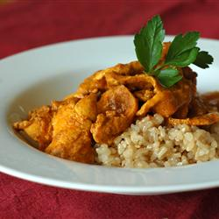
INDIAN CHICKEN CURRY
INGREDIENTS
• 3 tablespoons olive oil
• 1 small onion, chopped
• 2 cloves garlic, minced
• 3 tablespoons curry powder
• 1 teaspoon ground cinnamon
• 1 teaspoon paprika
• 1 bay leaf
• 1/2 teaspoon grated fresh ginger root
• 1/2 teaspoon white sugar
• salt to taste
• 2 skinless, boneless chicken breast halves - cut into bite-size pieces
• 1 tablespoon tomato paste
• 1 cup plain yogurt
• 3/4 cup coconut milk
• 1/2 lemon, juiced
• 1/2 teaspoon cayenne pepper
DIRECTIONS
Heat olive oil in a skillet over medium heat. Saute onion until lightly browned. Stir in garlic, curry powder, cinnamon, paprika, bay leaf, ginger, sugar and salt. Continue stirring for 2 minutes. Add chicken pieces, tomato paste, yogurt, and coconut milk. Bring to a boil, reduce heat, and simmer for 20 to 25 minutes.
Remove bay leaf, and stir in lemon juice and cayenne pepper. Simmer 5 more minutes.
• PREP 20 mins
• COOK 25 mins
• READY IN 45 mins

Slide 30
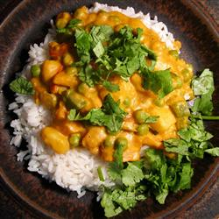
VEGETARIAN KORMA
INGREDIENTS
• 1 1/2 tablespoons vegetable oil
• 1 small onion, diced
• 1 teaspoon minced fresh ginger root
• 4 cloves garlic, minced
• 2 potatoes, cubed
• 4 carrots, cubed
• 1 fresh jalapeno pepper, seeded and sliced
• 3 tablespoons ground unsalted cashews
• 1 (4 ounce) can tomato sauce
• 2 teaspoons salt
• 1 1/2 tablespoons curry powder
• 1 cup frozen green peas
• 1/2 green bell pepper, chopped
• 1/2 red bell pepper, chopped
• 1 cup heavy cream
• 1 bunch fresh cilantro for garnish
DIRECTIONS
Heat the oil in a skillet over medium heat. Stir in the onion, and cook until tender. Mix in ginger and garlic, and continue cooking 1 minute. Mix potatoes, carrots, jalapeno, cashews, and tomato sauce. Season with salt and curry powder. Cook and stir 10 minutes, or until potatoes are tender.
Stir peas, green bell pepper, red bell pepper, and cream into the skillet. Reduce heat to low, cover, and simmer 10 minutes. Garnish with cilantro to serve.
• PREP 25 mins
• COOK 30 mins
• READY IN 55 mins

Slide 31
US CUISINE

Slide 32
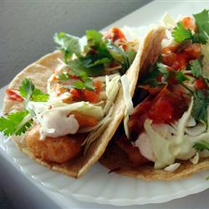
FISH TACOS
INGREDIENTS
• 1 cup all-purpose flour
• 2 tablespoons cornstarch
• 1 teaspoon baking powder
• 1/2 teaspoon salt
• 1 egg
• 1 cup beer
• 1/2 cup plain yogurt
• 1/2 cup mayonnaise
• 1 lime, juiced
• 1 jalapeno pepper, minced
• 1 teaspoon minced capers
• 1/2 teaspoon dried oregano
• 1/2 teaspoon ground cumin
• 1/2 teaspoon dried dill weed
• 1 teaspoon ground cayenne pepper
• 1 quart oil for frying
• 1 pound cod fillets, cut into 2 to 3 ounce portions
• 1 (12 ounce) package corn tortillas
• 1/2 medium head cabbage, finely shredded
DIRECTIONS
To make beer batter: In a large bowl, combine flour, cornstarch, baking powder, and salt. Blend egg and beer, then quickly stir into the flour mixture (don't worry about a few lumps).
To make white sauce: In a medium bowl, mix together yogurt and mayonnaise. Gradually stir in fresh lime juice until consistency is slightly runny. Season with jalapeno, capers, oregano, cumin, dill, and cayenne.
Heat oil in deep-fryer to 375 degrees F (190 degrees C).
Dust fish pieces lightly with flour. Dip into beer batter, and fry until crisp and golden brown. Drain on paper towels. Lightly fry tortillas; not too crisp. To serve, place fried fish in a tortilla, and top with shredded cabbage, and white sauce.
• PREP 40 mins
• COOK 20 mins
• READY IN 1 hr

Slide 33
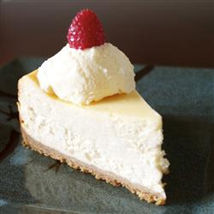
CHANTAL’S NEW YORK CHEESECAKE
INGREDIENTS
• 15 graham crackers, crushed
• 2 tablespoons butter, melted
• 4 (8 ounce) packages cream cheese
• 1 1/2 cups white sugar
• 3/4 cup milk
• 4 eggs
• 1 cup sour cream
• 1 tablespoon vanilla extract
• 1/4 cup all-purpose flour
DIRECTIONS
Preheat oven to 350 degrees F (175 degrees C). Grease a 9 inch springform pan.
In a medium bowl, mix graham cracker crumbs with melted butter. Press onto bottom of springform pan.
In a large bowl, mix cream cheese with sugar until smooth. Blend in milk, and then mix in the eggs one at a time, mixing just enough to incorporate. Mix in sour cream, vanilla and flour until smooth. Pour filling into prepared crust.
Bake in preheated oven for 1 hour. Turn the oven off, and let cake cool in oven with the door closed for 5 to 6 hours; this prevents cracking. Chill in refrigerator until serving.
• PREP 30 mins
• COOK 1 hr
• READY IN 7 hrs 30 mins

Slide 34
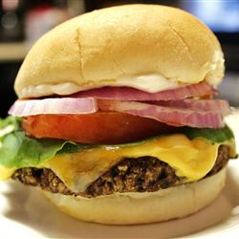
VEGGIE BURGERS
INGREDIENTS
• 1 (16 ounce) can black beans, drained and rinsed
• 1/2 green bell pepper, cut into 2 inch pieces
• 1/2 onion, cut into wedges
• 3 cloves garlic, peeled
• 1 egg
• 1 tablespoon chili powder
• 1 tablespoon cumin
• 1 teaspoon Thai chili sauce or hot sauce
• 1/2 cup bread crumbs
DIRECTIONS
If grilling, preheat an outdoor grill for high heat, and lightly oil a sheet of aluminum foil. If baking, preheat oven to 375 degrees F (190 degrees C), and lightly oil a baking sheet.
In a medium bowl, mash black beans with a fork until thick and pasty.
In a food processor, finely chop bell pepper, onion, and garlic. Then stir into mashed beans.
In a small bowl, stir together egg, chili powder, cumin, and chili sauce.
Stir the egg mixture into the mashed beans. Mix in bread crumbs until the mixture is sticky and holds together. Divide mixture into four patties.
If grilling, place patties on foil, and grill about 8 minutes on each side. If baking, place patties on baking sheet, and bake about 10 minutes on each side.
• PREP 15 mins
• COOK 20 mins
• READY IN 35 mins

Slide 35
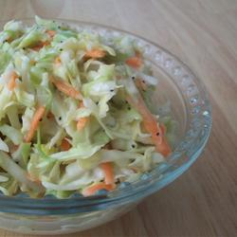
SWEET RESTAURANT SLAW
INGREDIENTS
• 1 (16 ounce) bag coleslaw mix
• 2 tablespoons diced onion
• 2/3 cup creamy salad dressing (such as Miracle Whip™)
• 3 tablespoons vegetable oil
• 1/2 cup white sugar
• 1 tablespoon white vinegar
• 1/4 teaspoon salt
• 1/2 teaspoon poppy seeds
DIRECTIONS
Combine the coleslaw mix and onion in a large bowl.
Whisk together the salad dressing, vegetable oil, sugar, vinegar, salt, and poppy seeds in a medium bowl; blend thoroughly. Pour dressing mixture over coleslaw mix and toss to coat. Chill at least 2 hours before serving.
• PREP 15 mins
• READY IN 2 hrs 15 mins

Slide 36
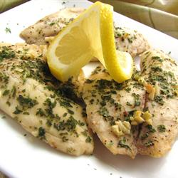
LEMON GARLIC TILAPIA
INGREDIENTS
• 4 tilapia fillets
• 3 tablespoons fresh lemon juice
• 1 tablespoon butter, melted
• 1 clove garlic, finely chopped
• 1 teaspoon dried parsley flakes
• pepper to taste
DIRECTIONS
Preheat oven to 375 degrees F (190 degrees C). Spray a baking dish with non-stick cooking spray.
Rinse tilapia fillets under cool water, and pat dry with paper towels.
Place fillets in baking dish. Pour lemon juice over fillets, then drizzle butter on top. Sprinkle with garlic, parsley, and pepper.
Bake in preheated oven until the fish is white and flakes when pulled apart with a fork, about 30 minutes.
• PREP 10 mins
• COOK 30 mins
• READY IN 40 mins

Slide 37
PREZENTACJĘ WYKONAŁA AGNIESZKA STECYK
Z KLASY DRUGIEJ GIMNAZJUM ZESPOŁU SZKÓŁ W KALNIKOWIE

