Slide 1
GREEK CUISINE

Slide 2
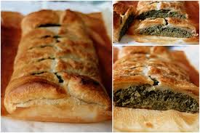
SPINACH STRUDELS
INGREDIENTS
• 1/2 cup olive oil
• 1 bunch green onions, chopped
• 2 (10 ounce) packages frozen chopped spinach, thawed, well drained
• 2 tablespoons chopped fresh dill
• 3 extra large eggs, lightly beaten
• 7 ounces feta cheese, crumbled
• 1/4 teaspoon salt
• 1/4 teaspoon freshly ground black pepper
• 40 sheets frozen phyllo pastry, thawed in refrigerator
• 1 cup unsalted butter, melted
• 1/2 cup plain bread crumbs
DIRECTIONS
Preheat oven to 400 degrees F (200 degrees C).
In a medium skillet, heat olive oil over a medium heat. Stir in green onions and cook until soft, about 5 minutes. Set aside.
Meanwhile in a large bowl, combine spinach, dill, eggs, feta, salt and pepper. Add reserved green onions, and mix well.
Unfold 1 sheet of the phyllo pastry, brush with melted butter, and sprinkle lightly with breadcrumbs. Lay another sheet directly on top of the first sheet; repeat butter and breadcrumb steps. Continue to do this until you have 10 layers.
Spoon 3/4 cup of spinach mixture (in a sausage-like shape) along longer edge of the top sheet. Roll it up, place on baking sheet, and brush lightly with butter. Score off 1-inch rounds by marking with a knife for easier cutting later. Repeat process with the remaining pastry sheets. You will have 4 rolls total when finished.
Bake in a preheated oven for 12 minutes or until edges are lightly brown. Cut into individual servings where you have marked. Serve immediately.
PREP 30 mins
COOK 18 mins
READY IN 48 mins

Slide 3
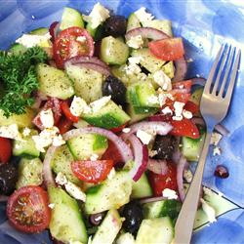
GREEK SALAD
INGREDIENTS
• 3 large ripe tomatoes, chopped
• 2 cucumbers, peeled and chopped
• 1 small red onion, chopped
• 1/4 cup olive oil
• 4 teaspoons lemon juice
• 1 1/2 teaspoons dried oregano
• salt and pepper to taste
• 1 cup crumbled feta cheese
• 6 black Greek olives, pitted and sliced
DIRECTIONS
In shallow salad bowl, or on serving platter, combine tomatoes, cucumber, and onion. Sprinkle with oil, lemon juice, oregano, and salt and pepper to taste. Sprinkle feta cheese and olives over salad. Serve.
• PREP 15 mins
• READY IN15 mins

Slide 4
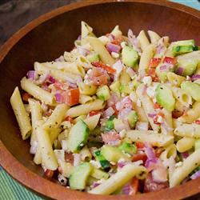
GREEK PASTA SALAD
INGREDIENTS
• 1 (16 ounce) package penne pasta
• 1/4 cup vegetable oil
• 1 teaspoon lemon juice
• 1 teaspoon dried basil
• 1 teaspoon ground black pepper
• 1 teaspoon garlic salt
• 2 tomatoes, chopped
• 1 green bell pepper, chopped
• 1 sweet onion, chopped
• 1 cucumber, coarsely chopped
• 1 cup black olives, chopped
DIRECTIONS
Cook pasta in a large pot of boiling water until al dente. Drain, and rinse in cold water.
In a small bowl, mix together oil, lemon juice, basil, garlic salt, and black pepper.
In a large bowl, combine pasta, tomatoes, green pepper, onion, cucumber, and black olives. Add dressing, and toss to coat. Chill in the refrigerator for 30 minutes.
• PREP 15 mins
• COOK 15 mins
• READY IN 1 hr

Slide 5
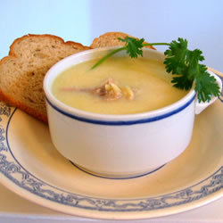
AVGOLEMONO
INGREDIENTS
• 1 3/4 quarts chicken broth
• 1/2 cup uncooked orzo pasta
• 3 eggs
• 1 lemon, juiced
• 1 tablespoon cold water
• salt and pepper to taste
DIRECTIONS
Pour the chicken broth into a large saucepan, and bring it to the boil. Add the pasta and cook for 5 minutes.
Beat the eggs until frothy, then add the lemon juice and 1 tablespoons of cold water. Slowly stir in a ladleful of the hot chicken stock, then add one or two more. Be careful not to scramble the eggs!
Return this mixture to the pan, off the heat, and stir well. Season with salt and pepper and serve at once, garnished with lemon slices. Do not let the soup boil once the eggs have been added or it will curdle!
• PREP 10 mins
• COOK 15 mins
• READY IN 25 mins

Slide 6
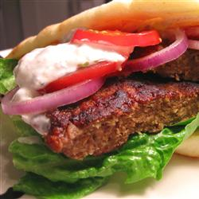
GYROS BURGERS
INGREDIENTS
• 1/2 pound lean ground beef
• 1/2 pound lean ground lamb
• 1/2 onion, grated
• 2 cloves garlic, pressed
• 1 slice bread, toasted and crumbled
• 1/2 teaspoon dried savory
• 1/2 teaspoon ground allspice
• 1/2 teaspoon ground coriander
• 1/2 teaspoon salt
• 1/2 teaspoon ground black pepper
• 1 dash ground cumin
DIRECTIONS
Preheat an outdoor grill for medium-high heat, and lightly oil grate.
In large bowl, combine ground beef, ground lamb, onion, garlic and bread crumbs. Season with savory, allspice, coriander, salt, pepper and cumin. Knead until mixture is stiff. Shape into 4 very thin patties (1/8 inch to 1/4 inch thick).
Cook patties for 5 to 7 minutes on each side, or until cooked through.
• PREP 10 mins
• COOK 15 mins
• READY IN 25 mins

Slide 7
POLISH CUISINE

Slide 8
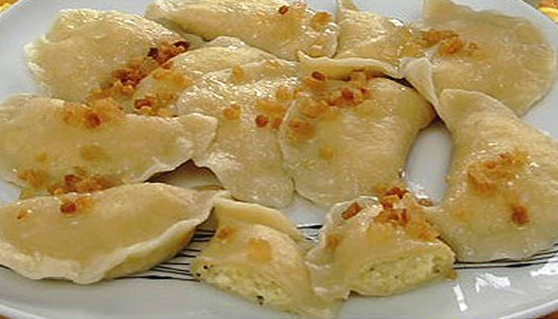
PIEROGI
INGREDIENTS
• 12 Yukon Gold potatoes, peeled and quartered
• 3 eggs
• 3 tablespoons cream cheese, divided
• 3 teaspoons milk, divided
• 2 cups all-purpose flour, divided
• 2 1/2 (8 ounce) containers cottage cheese
• salt to taste
• 2 tablespoons butter
• oil for frying
DIRECTIONS
Bring a large pot of salted water to a boil. Add potatoes and cook until tender but still firm, about 15 minutes. Drain and cool.
Meanwhile, prepare dough by combining 1 egg, 1 tablespoon cream cheese, 1 teaspoon milk and 1/2 cup flour. Once all the flour has been worked in, add another 1/2 cup flour, 1 tablespoon cream cheese and 1 teaspoon milk. When the dough is well blended, add 1 egg, 1 tablespoon cream cheese and another 1/2 cup flour; mix well. Finally, add the remaining egg, 1 teaspoon milk and 1/2 cup flour. If dough is too dry, add a little more milk; if too wet, add more flour.
On a well floured surface, roll out 1/4 of the dough to 1/4 inch thickness. Using a glass, muffin cutter, or any rounded surface, cut out circles of dough. Flour both sides of the circle and set aside in a single layer on wax paper. Repeat process with remaining dough.
Mash the potatoes with the cottage cheese, salt and butter. Place a spoonful of the filling slightly below the center of a circle of dough. Fold the dough over and seal edges with fingertips. Use enough filling so that you have to stretch the dough over it, but not so much that it squeezes out when sealed.
Bring a large pot of salted water to a boil. Drop in pierogis, a few at a time. Cook for 1 to 2 minutes, or until they float to the top; drain.
Heat oil in a large skillet over medium-high heat. Fry boiled pierogis in hot oil until crispy.
• PREP 1 hr
• COOK 30 mins
• READY IN 1 hr 30 min

Slide 9
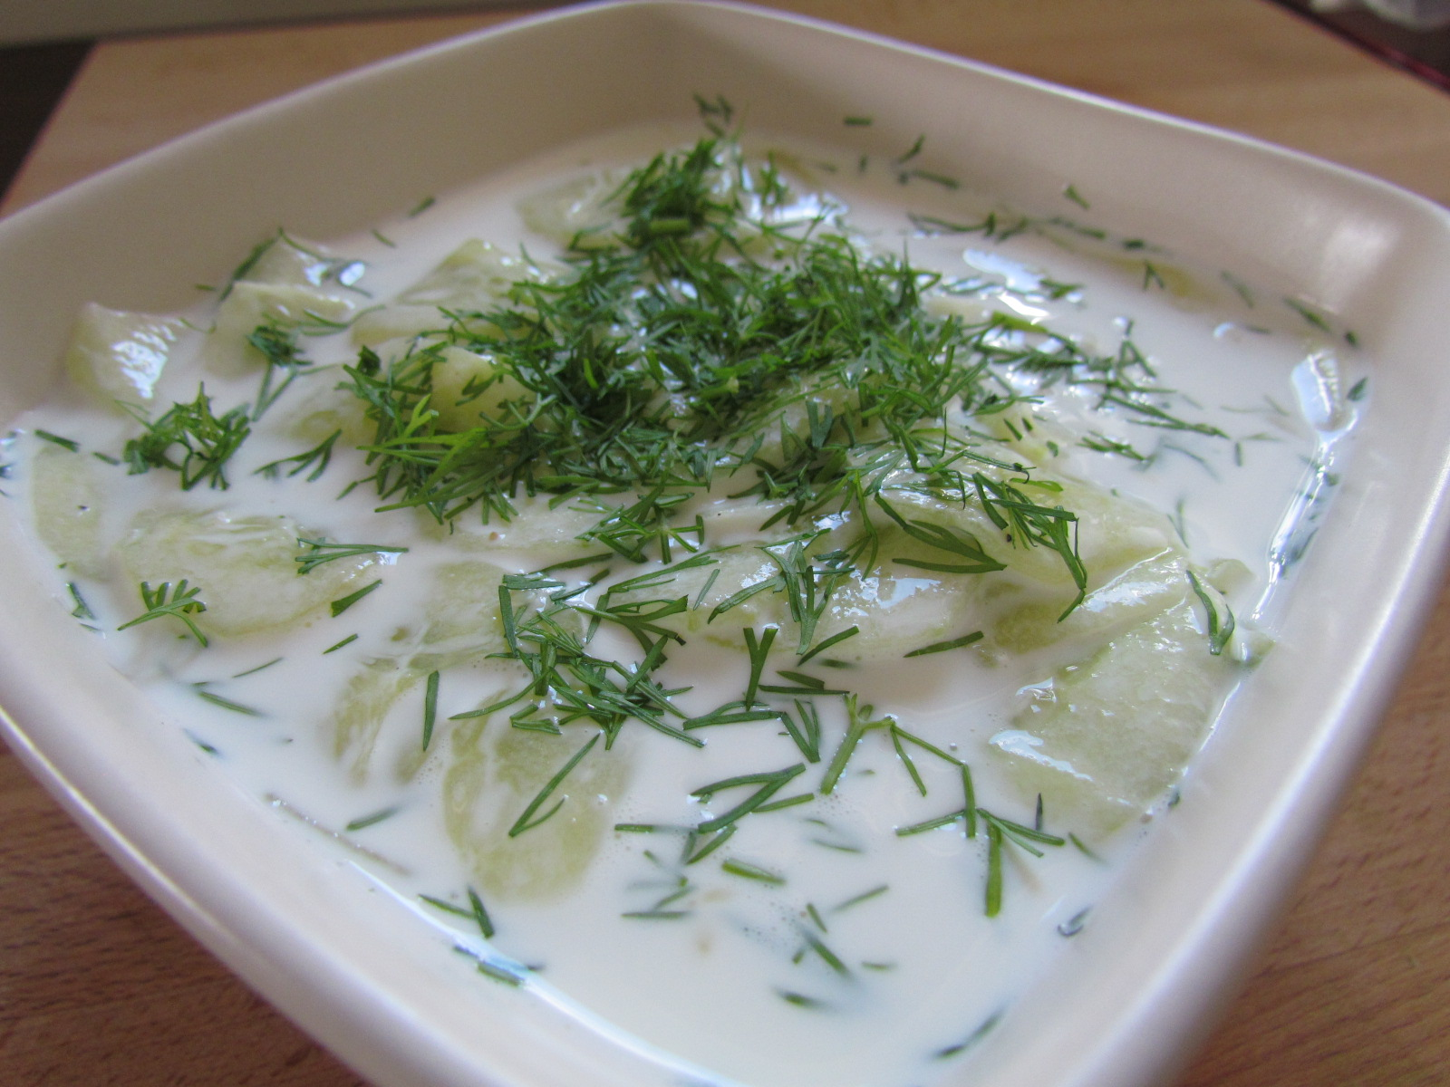
MIZERIA
INGREDIENTS
• 1 pound small cucumbers, peeled and thinly sliced
• salt to taste
• 1 bunch dill, chopped
• 2 1/2 tablespoons sour cream
• 1 teaspoon lemon juice
• 1 pinch white sugar
ground black pepper to taste
DIRECTIONS
Sprinkle salt over cucumbers in a bowl. Let stand until cucumbers are soft, about 5 minutes. Squeeze liquid from cucumbers and discard. Add dill to cucumbers.
Mix sour cream, lemon juice, and sugar in a bowl; add to cucumbers and toss to coat. Season with black pepper. Chill completely before serving, at least 30 minutes.
• PREP 10 mins
• READY IN 45 mins

Slide 10
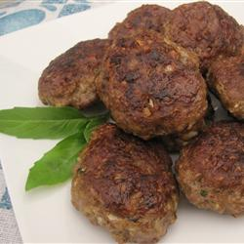
KOTLETY
INGREDIENTS
• 1 1/3 pounds lean ground beef
• 2/3 cup milk cracker crumbs
• 1 small sweet yellow onion, minced
• 1 egg, well beaten
• 1 tablespoon milk
• 1 clove garlic, minced (optional)
• 1 1/4 teaspoons kosher salt
• 1/2 teaspoon freshly ground black pepper
• 1/2 cup vegetable shortening for frying
DIRECTIONS
Mix ground beef, cracker crumbs, onion, egg, milk, garlic, kosher salt, and black pepper in a large bowl until evenly blended. Shape meat mixture into twelve 3-inch patties about 1 1/4-inch thick.
Heat vegetable shortening in a large skillet over medium-high heat. Sear patties until golden brown, about 2 minutes per side. Reduce heat to low and continue cooking, uncovered, until patties are no longer pink in the center, about 20 minutes more. Remove patties from skillet and drain on paper towels until ready to serve.
• PREP 15 mins
• COOK 25 mins
• READY IN 40 mins

Slide 11
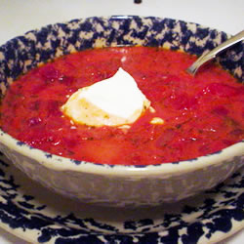
BORSCHT
INGREDIENTS
• 6 cups water
• 3/4 tablespoon salt
• 1/2 cup finely chopped carrots
• 1/4 cup chopped green bell pepper, divided
• 1/2 stalk celery, chopped
• 1 medium beet
• 1/2 cup canned peeled and diced tomatoes
• 3 potatoes, quartered
• 1/3 cup butter
• 1/2 cup chopped onion
• 1 1/2 cups canned tomatoes
• 3 cups finely shredded cabbage, divided
• 1/4 cup heavy cream
• 3/4 cup diced potatoes
• 1 tablespoon dried dill weed
• 1/4 teaspoon ground black pepper to taste
• salt and freshly ground black pepper to taste
DIRECTIONS
Place water, salt, carrots, 1/2 of the bell pepper, celery, beet, tomatoes, and quartered potatoes in a large stock pot over high heat. Bring to a boil.
Melt 1/3 cup butter in a separate skillet over medium heat. Sauté onions in butter until tender, approximately 5 minutes. Stir in tomatoes, reduce heat to medium low, and simmer for 15 minutes. Remove 1/2 cup of sauce from skillet, and set aside. Stir half of the cabbage into the skillet with remaining sauce, and continue simmering 5 minutes more, or until tender.
Remove beet from boiling liquid and discard. Remove potatoes with a slotted spoon or tongs, and place in a bowl with remaining 1 tablespoon of butter and the cream. Mash together until smooth.
Return the 1/2 cup of reserved onion-tomato sauce to the stock pot. Stir in diced potatoes, and simmer until just tender but still firm, approximately 5 minutes. Increase heat to a low boil, and stir in remaining cabbage, tomato sauce, and mashed potatoes. Reduce heat and simmer a few minutes more. Stir in remaining bell pepper, season with black pepper, and serve.
• PREP 25 mins
• COOK 1 hr
• READY IN 1 hr 25 mins

Slide 12
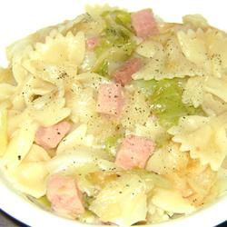
CABBAGE AND NOODLES
INGREDIENTS
• 1/4 cup butter
• 1 head cabbage, cored and chopped
• 1 large onion, diced
• 1 (12 ounce) package farfalle (bow tie) pasta
• 2 tablespoons water
• 1 1/2 cups cooked ham, cut into bite-size pieces
• 2 pinches white sugar, or to taste
DIRECTIONS
Melt butter in a large skillet over medium-low heat; cook and stir cabbage and onion until very tender, about 30 minutes.
Fill a large pot with lightly salted water and bring to a rolling boil. Stir in bow tie pasta and return to a boil. Cook pasta until tender but still slightly firm, about 12 minutes. Drain well and set aside.
Stir water and cooked ham into cabbage mixture; heat through. Thoroughly mix in sugar.
Gently stir bow tie pasta into the ham and cabbage and heat through.
• PREP 15 mins
• COOK 30 mins
• READY IN 45 mins

