Slide 1
Tomasz Żołnierczuk
WELCOME
Ulotka na temat Nieledwi

Slide 2
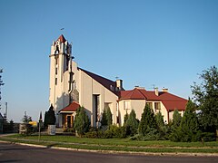
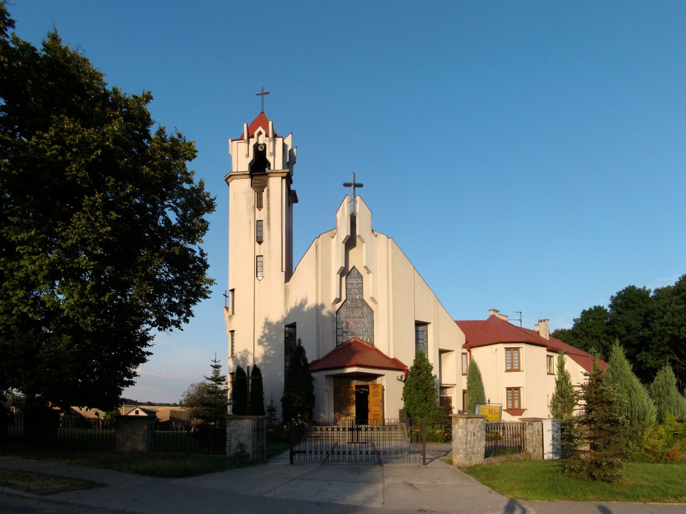
Church in Nieledew
It's a place where the priest leads a mass.

Slide 3
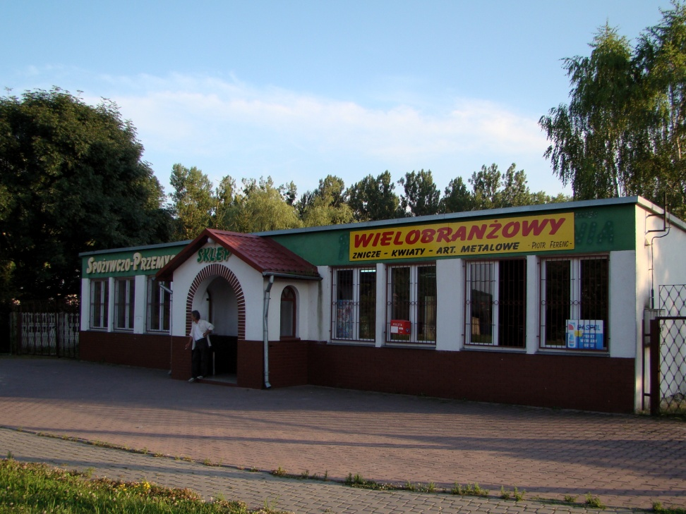
shop in Nieledew
This is the place where you can buy groceries.
There is a church next to this shop.

Slide 4
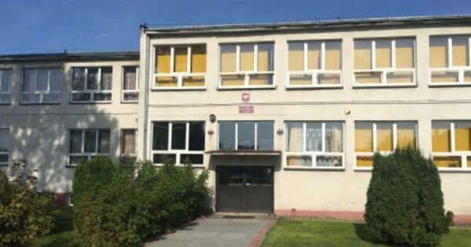

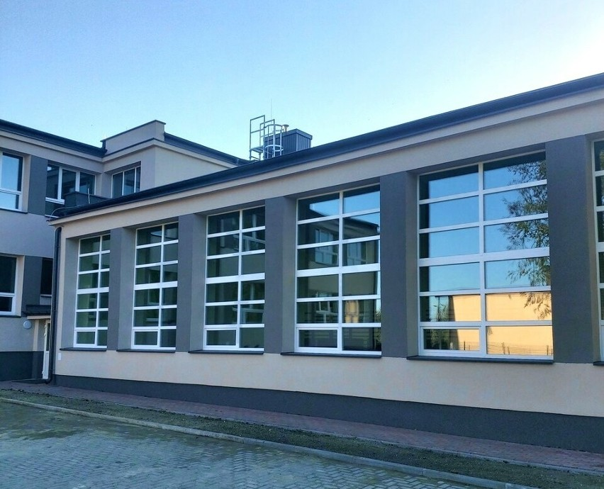
School in Nieledew
Here, children learn, perform and have fun together.

Slide 5
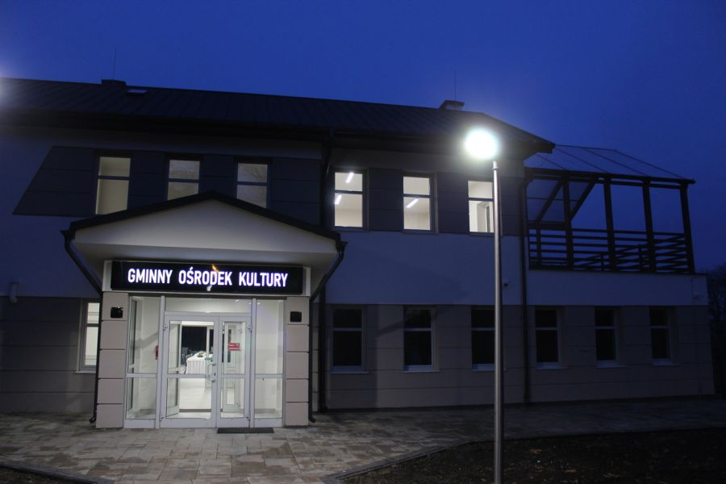

There are many interesting places in Nieledew, one of them is the community center.

