Slide 1
Christmas Day in United Kingdom

Slide 2
Kids open presents in the morning

Slide 3
Royal family attending church

Slide 4
Christmas crackers

Slide 5
What do you call a boomerang that doesn’t come back?
- a stick!

Slide 6
What part of the clock is always old?
- The second hand!

Slide 7
Chrismas cracker joke
How do you get warm in a cold room?
Go to the corner because it’s 90 degrees.

Slide 8
Traditional christmas lunch

Slide 9
Christmas pudding

Slide 10
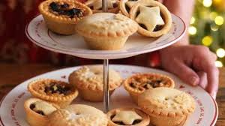
Mince pie
It’s filled with a mixture of dried fruits and spices called "mincemeat".

Slide 11
Mulled wine
It’s a warmed up red wine with spices like cinnamon, orange, sugar, ginger, bay leaf and berries.

Slide 12
Quens speach on Christmas
At 3 pm the Queen gives a speech to the nation on BBC.

