Slide 1

Prezentacja o Wielkiej Brytani

Slide 2


Wielka
Brytania

Slide 3
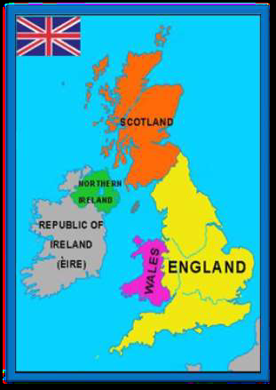
Location
United Kingdom of Great Britain and Northern Ireland covers the island of Great Britain, the northeast of the island Ireland and many smaller islands.
It is divided into 4 historical areas:
England, Wales, Scotland and Northern Ireland.
The official language is:
English.

Slide 4
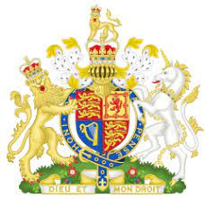
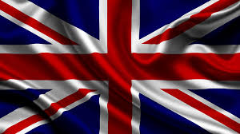
Flag and Coat of Arms of Great Britain

Slide 5

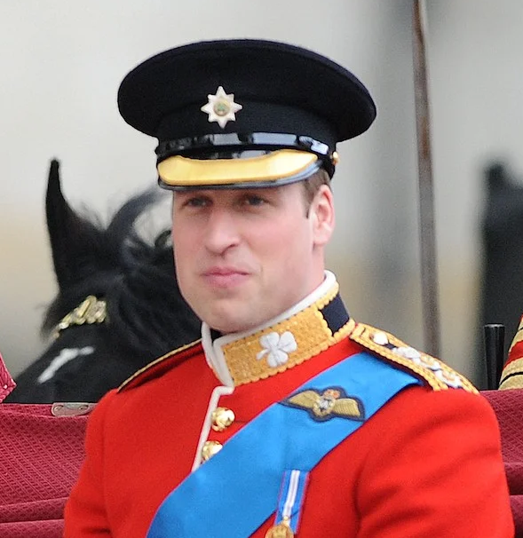
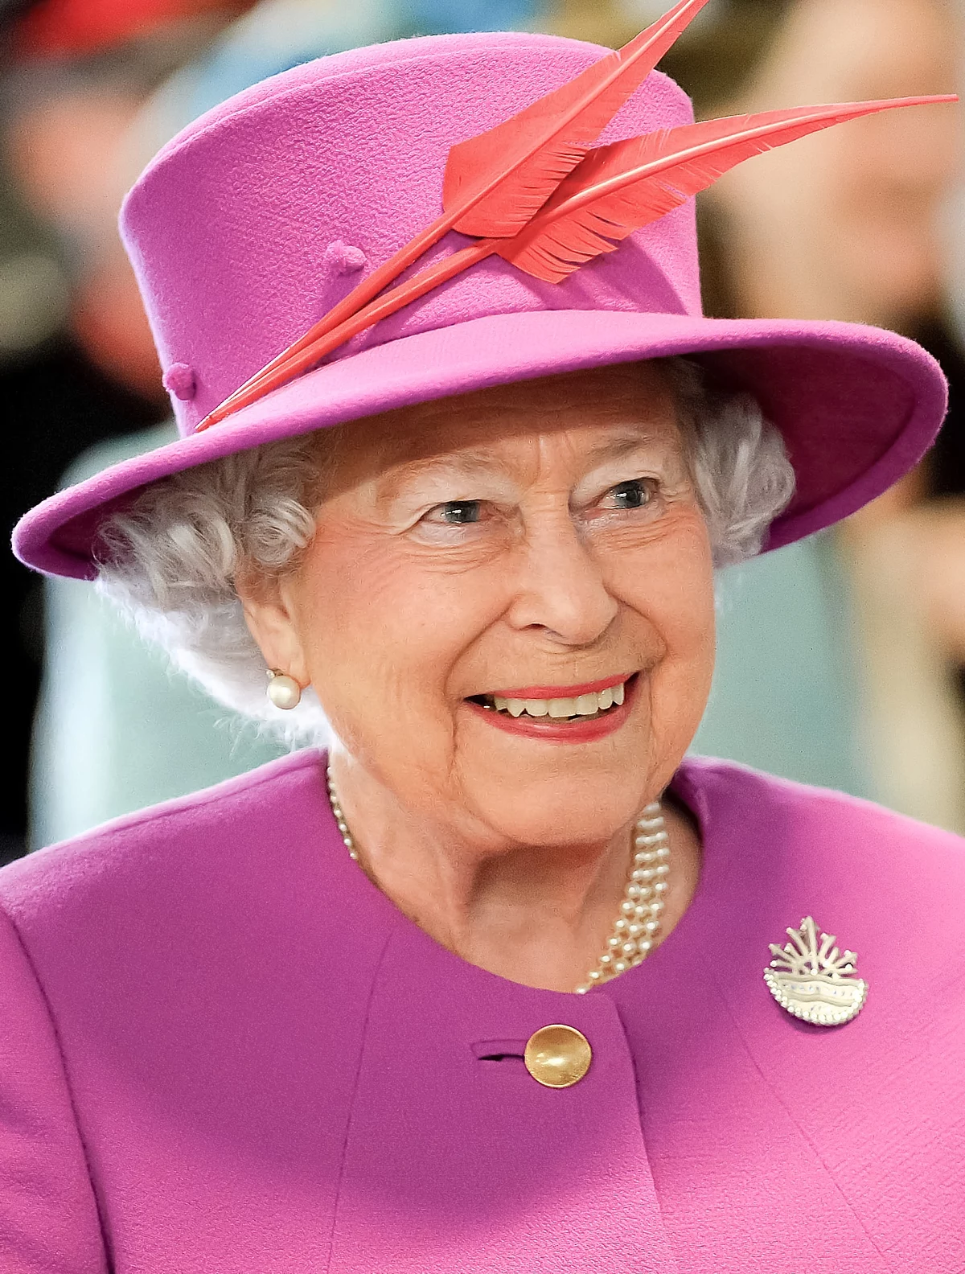
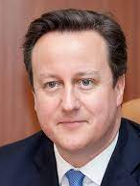
Area244,820km Capital city: London
The United Kingdom is a parliamentary monarchy with a government accountable to Parliament.
Head of State: Queen Elizabeth II.
Heir to the throne: Prince William
Prime Minister: David Cameron

Slide 6
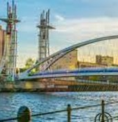
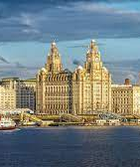
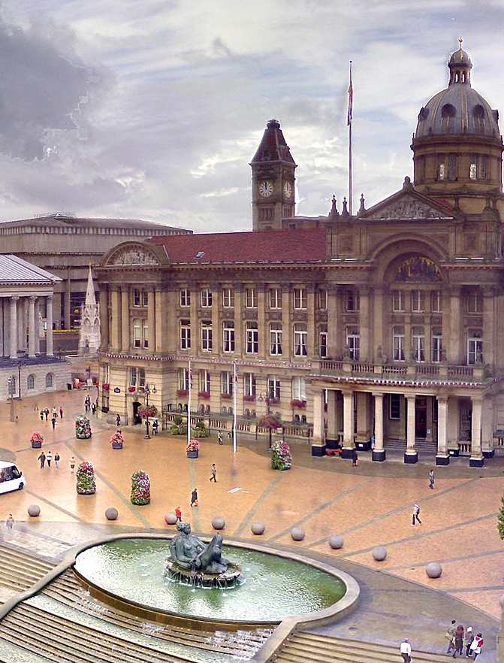
Large cities
Manchester
Liverpool
Ones of the largest cities are:
Birmingham,
Manchester,
Leeds,
Glasgow,
Liverpool
Birimingham

Slide 7
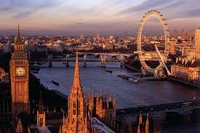
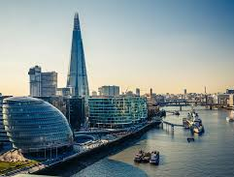
LONDON
London - the capital of Great Britain, is located in
South England on the Thames. In terms of The population of London is one of the largest
urban agglomerations of the world. The city is full
Monuments and museums attract 30 million annually
Tourists.

Slide 8
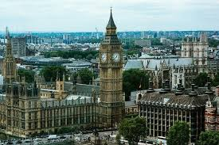
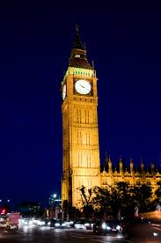
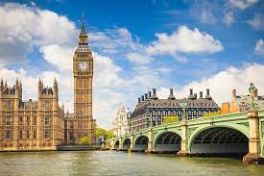
Big Ben
Big Ben is the name of a 14-ton bell
is located on a 106 metre high tower. This bell hangs from one of the towers of the London Parliament.

Slide 9
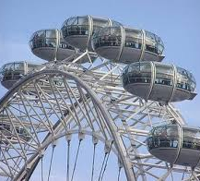
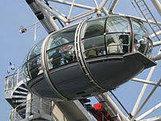
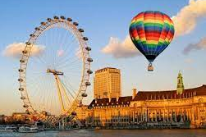
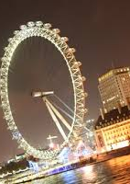
THE LONDON EYE
The London Millennium Eye. I am located in the District of Lambeth, on the South Bank of the Thames. The wheel has a height of 135 meters and its voll rotation takes 40 mines. There are 32 shepherd’s caps on the bike.

Slide 10
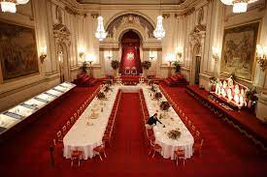
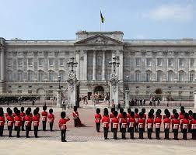
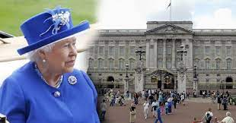
Palace Buckingham
The first inhabitant of the palace was Queen Victoria.Before Palace tourists can visit the world famous The Changing of the Guard Ceremony.

Slide 11
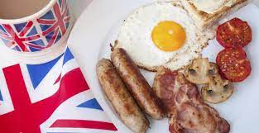
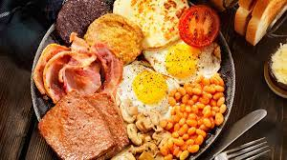
British cuisine
English food is not considered too exquisite
and healthy. Nevertheless, there are some dishes that are worth it
to try.
English breakfast :
This meal consists mainly of
fried a few slices
Bacon, eggs, toast, beans and
Tomatoes. To drink I give myself
Fruit juices, or coffee and tea.

Slide 12

Top 10 Places to Visit in United Kingdom
1. Muzeum Brytyjskie
2 London Eye
3 Tower of London
4 Zamek Windsor
5 Stonehenge
6 Eden Project
7 Big Pit: National Coal Museum
8 Zamek w Edynburgu
9 Roman Baths
10 Titanic Belfast

Slide 13
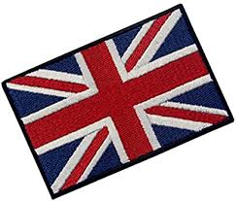
Thanks for watching
Wiktoria Kożuch kl.7B

