Slide 1
Johan Paul II
(18.05.1920-02.04.2005)

Slide 2
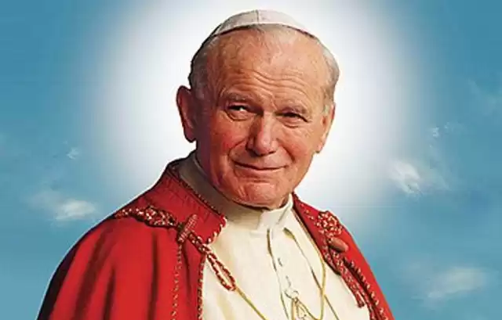

Slide 3

This is Polish Pope. He was born in 1920 in Wadowice, as Karol Wojtyła. He is my role model.
He studied Polish philology in Krakow, where he was preparing for the priesthood in a clandestine seminary.

Slide 4
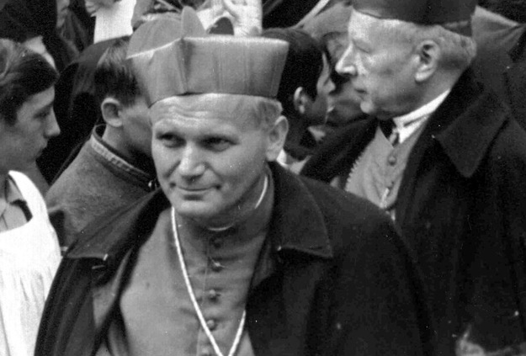
He was ordained a priest in 1946, then also went to study in Rome. After his return he taught at the Jagiellonian University and at the Catholic University of Lublin.In 1958 he became bishop in 1963 Archbishop of Krakow, four years later- a cardinal.

Slide 5
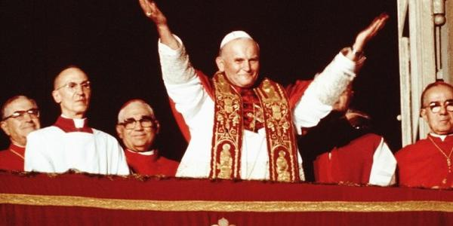
I
In 1978, to the surprise of the world, the head of the Roman Catholic Church was elected.

Slide 6
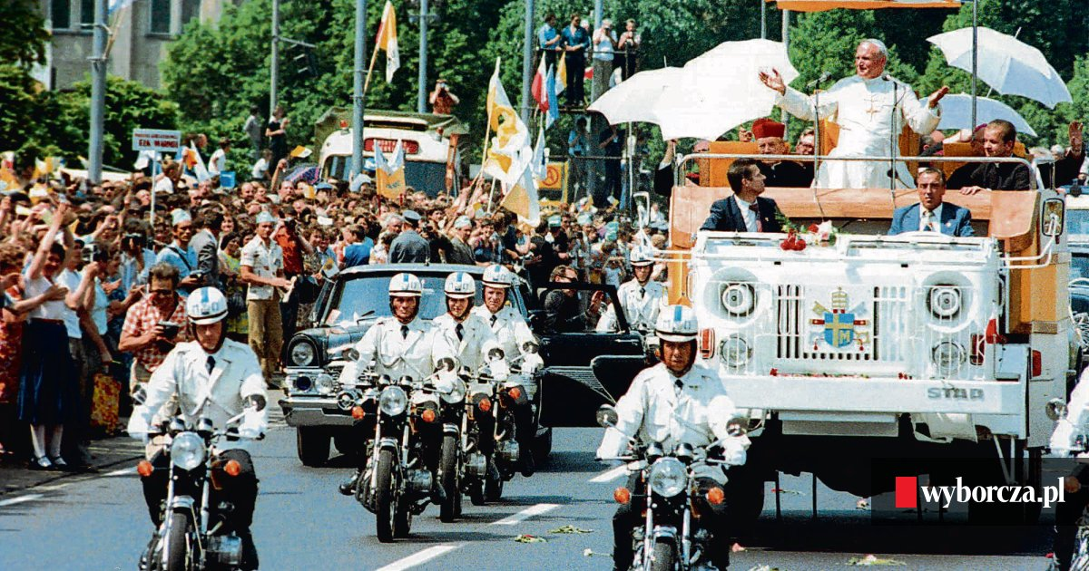
After 27 years of his pontificate, abounding in a meeting with the faithful the tireless pilgrimage to all corners of the globe, and in fostering ecumenism, april 2, 2005 Pope John Paul II, died at the Vatican.

Slide 7
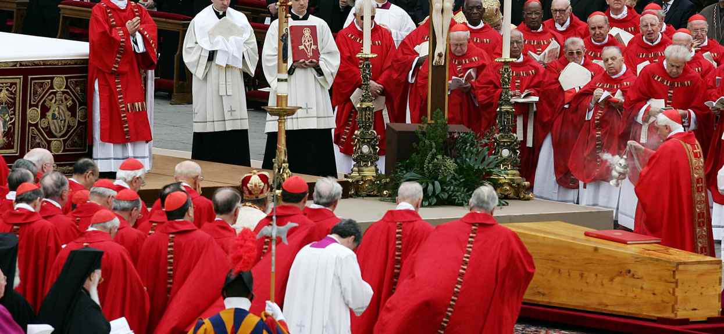
The Holy Father was buried on April 2, 2005 in St. Peter’s Basilica.

Slide 8
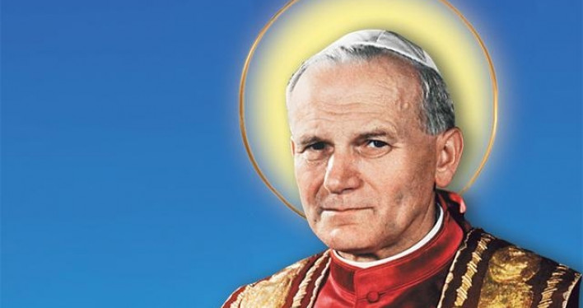
On April 27, John Paul II was Canonized. He was a great man who attracted crowds of people.

Slide 9
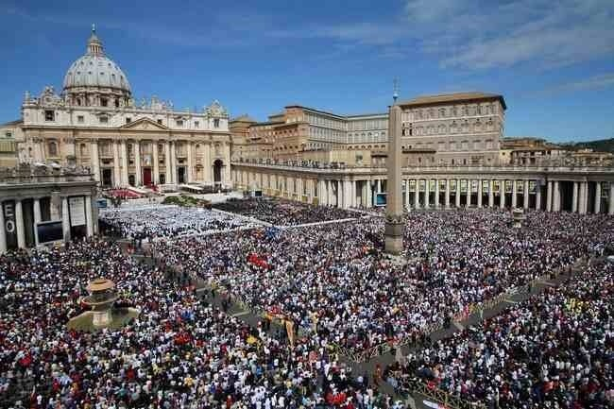
Johan Paul II is a saint who lived among us and our affairs, a role model. He attracted crowds of people.

Slide 10
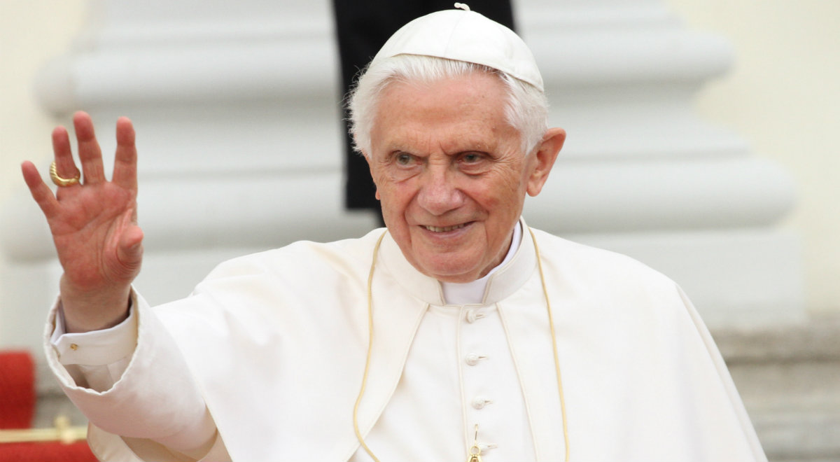
Benedict XVI became the successor of John Paul II

Slide 12
Prezentację przygotował:
Hubert Sawka

