Slide 1

My school
Primary School im. Stefana Żeromskiego in Chmielnik
Katarzyna Tetela kl.6 „c”

Slide 2
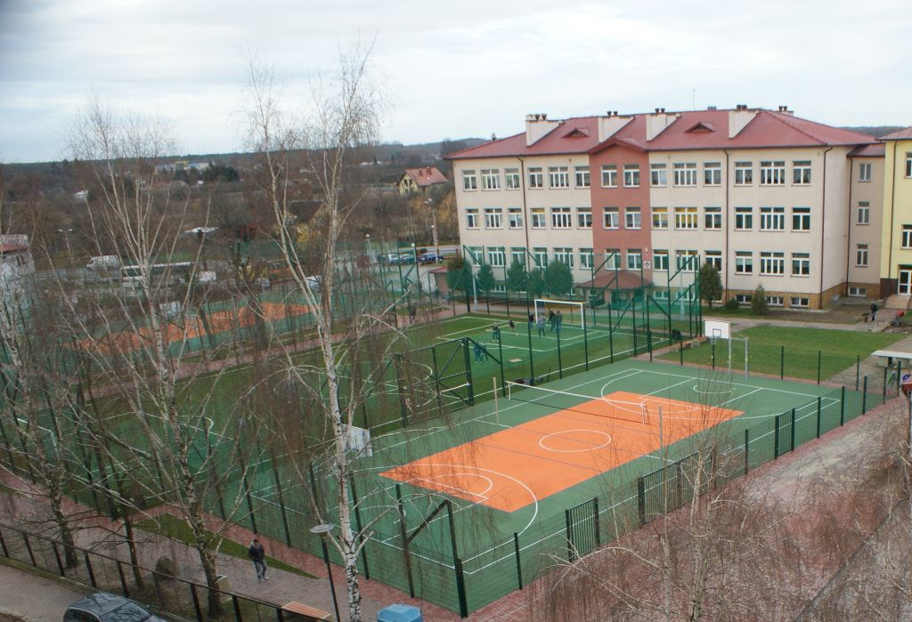

Slide 3
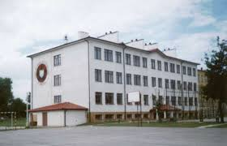
History of our school
The history of the modern Primary School in Chmielnik starts right after The II World War . In February 1945 in the school building at Railway Street (later Mielczarski) held the records for the school (the children of Chmielnik, Suchowola, Dezyderów and Andrzejówka). The building of the pre-war school No. 1 is not suitable, however, for learning due to the destruction of the war. It was started on the renovation, and soon after his graduation from the children began.

Slide 4
On 20-23 September 1951 took place in the school of the famous strike of children, which was a response to the release. Edward Materski (later Bishop). He was also a response to the lack of teaching religion at school. Restored teachings of religion. Pre-war classrooms were not able to secure all of your educational needs therefore, in 1963, part of the premises of the School organized a second primary school and it has eight classes of instruction. In 1973/74 combines both schools, creating a Communal School Chmielnik in Bulk. May 27, 1979,
the school received the name of Stefan Żeromski.

Slide 5
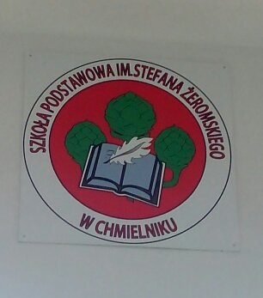
The coat of arms of our school

Slide 6
National anthem of our school
Work today, our science,
After reaching high expertise
in zeal,
be smart work conscientiously,
and learn, learn perseverance
in life it will be for you,
without your knowledge and
without profession.
Wise needed is everywhere, it is the future of the nation.
Wise needed is everywhere, it is the future of the nation.

Slide 7
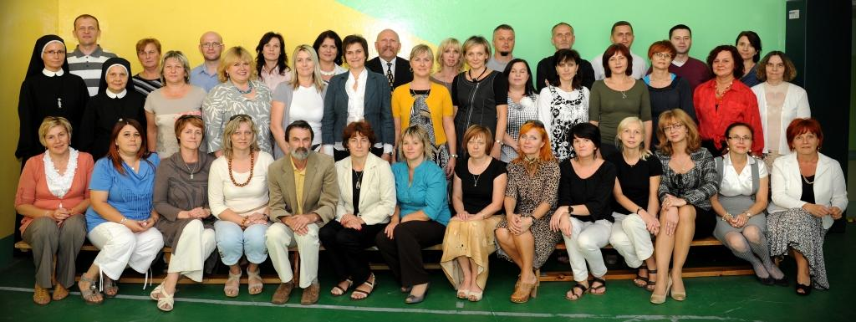
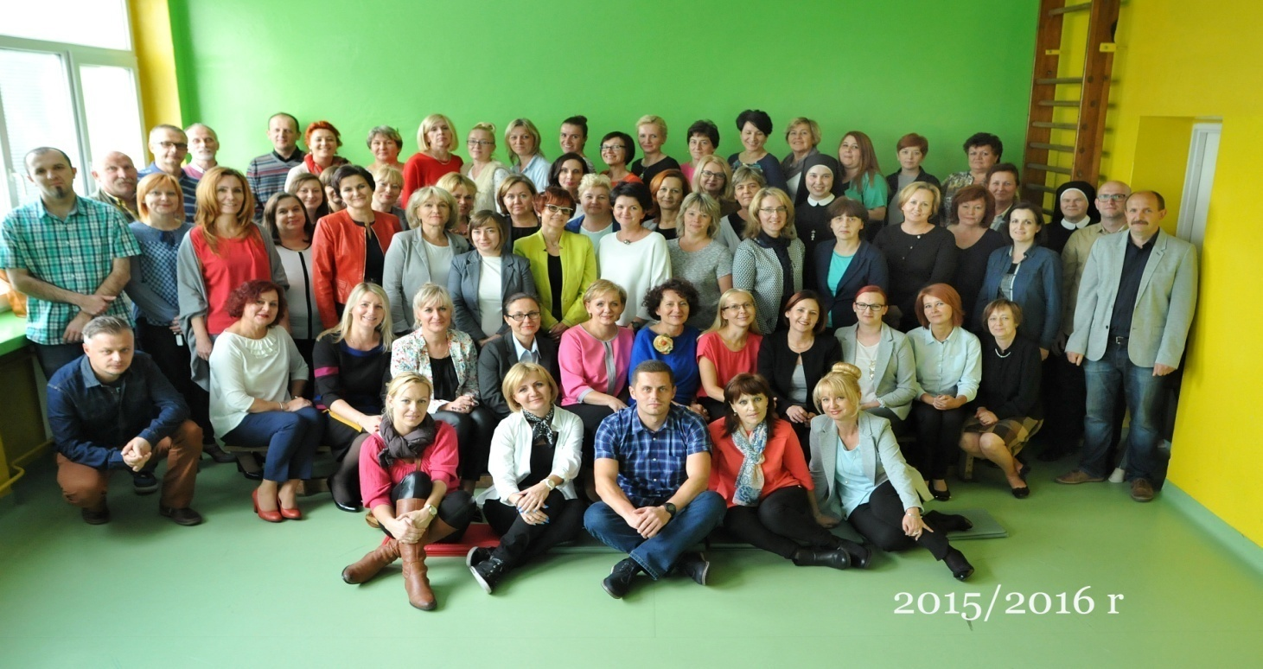
The teachers of our school

Slide 8
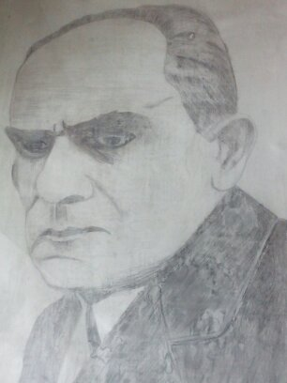
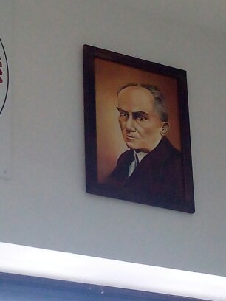
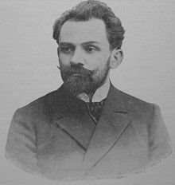
Patron of our school
Stefan Żeromski

Slide 9
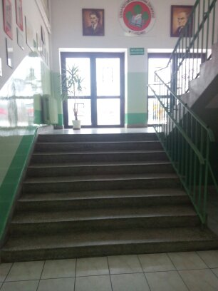
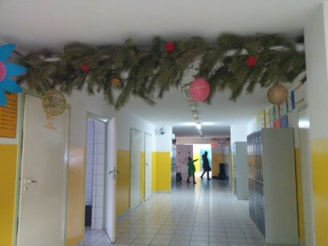
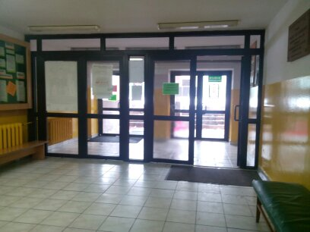
School corridors

Slide 10
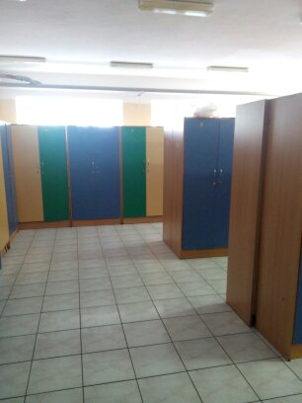
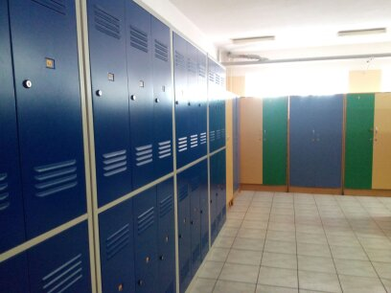
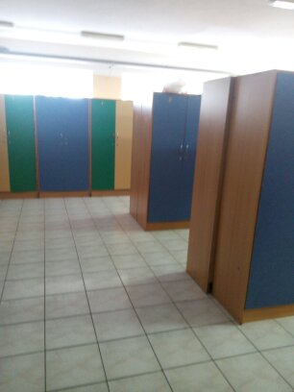
The school changing rooms

Slide 11
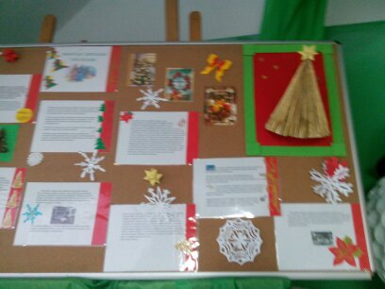
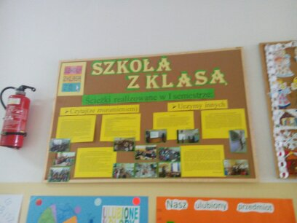
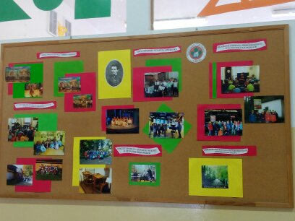
Newspaper made by students of our school

Slide 12
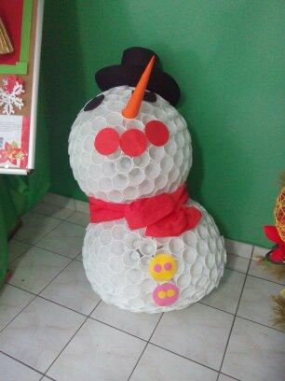
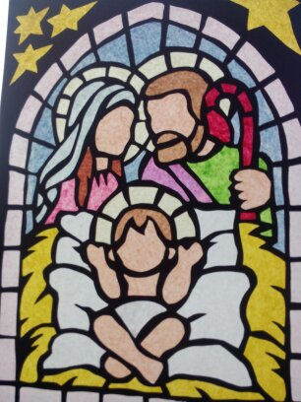
Art works of students of our school

Slide 13

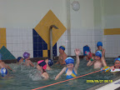
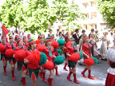
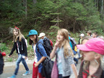
Sports Pupils of our school and take an active part in sports competitions. They stimulate social development and personal child, are a source of fun and success, allow for the acquisition and improvement of ambition and shape appropriate attitudes of sports: Mastering, discipline, tolerance and respect for others.

Slide 14
THE END
Thank you for your attention!

