Slide 1
Christmas in
Poland
Kinga Wiśniewska presentation

Slide 2
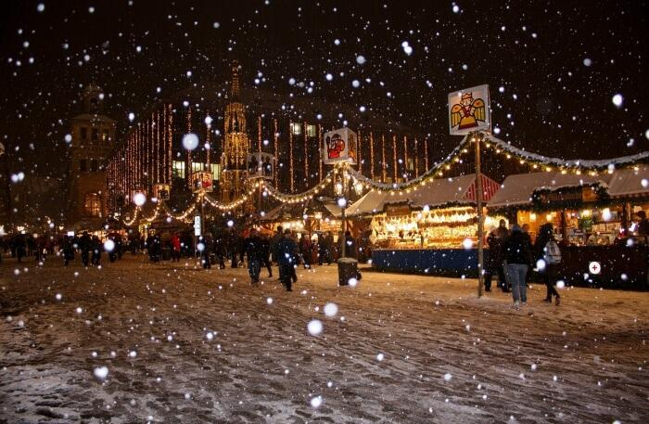
There are always 12 meals on the Christmas Eve table in Poland. The week before, all families decorate the Christmas tree, buy presents and get ready for the new year.

Slide 3
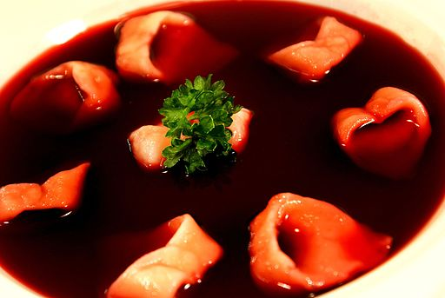
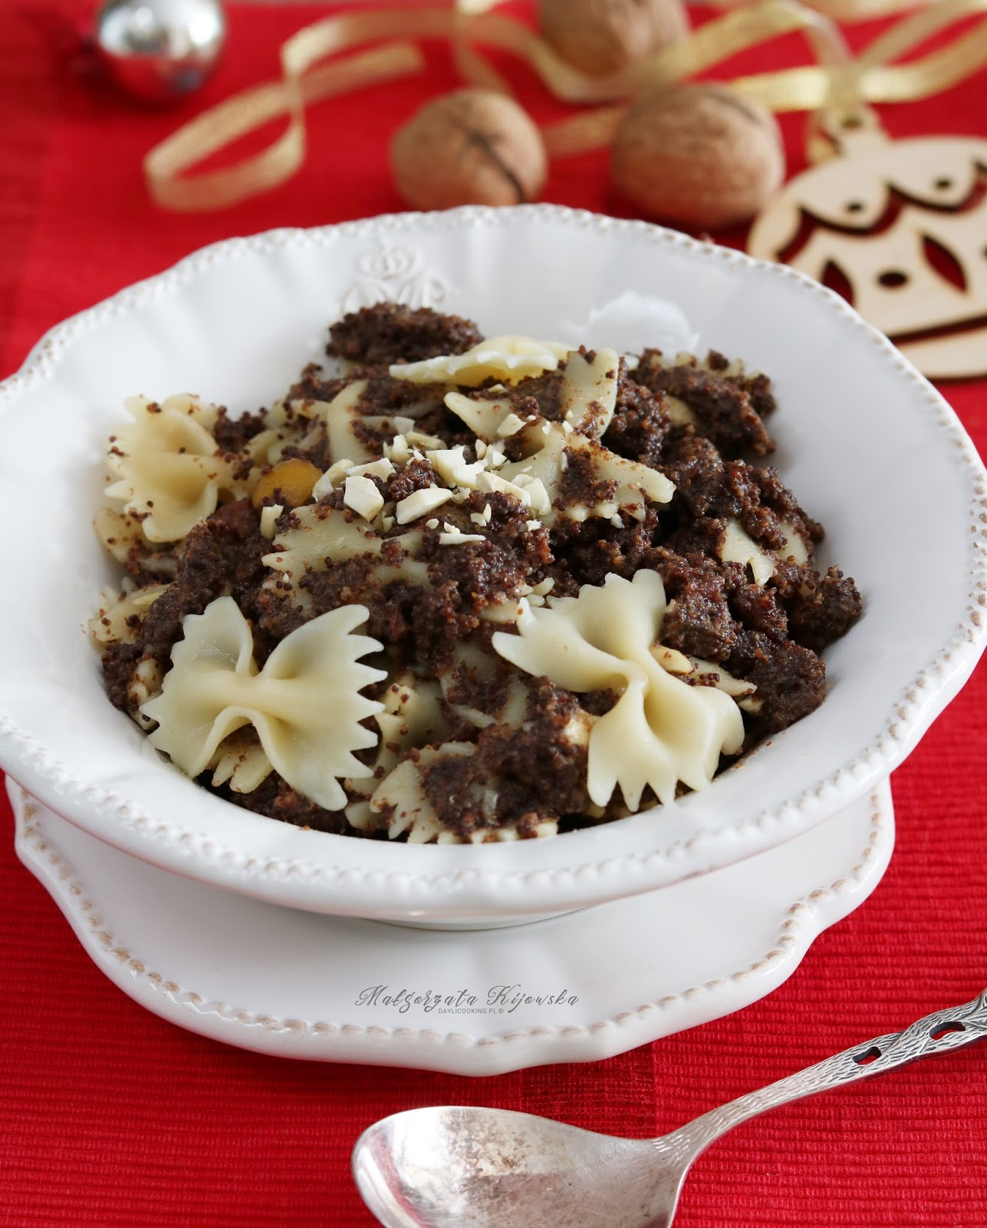
The most popular Christmas Eve food in Poland are:
Pasta with poppy seeds and dried fruits
Borsch with ravioli

Slide 4
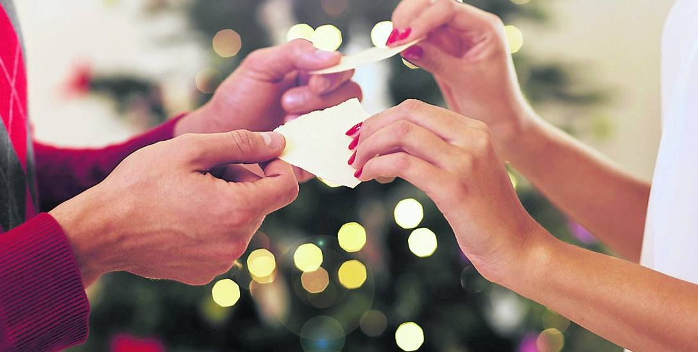
Sharing the wafer

Slide 5

What is it about?
in Poland, sharing the wafer is very important.
When sharing the wafer, we express our best wishes.

Slide 6

Christmas Eve is the most beautiful holiday in this country. On this amazing evening, everyone is together, everyone is in harmony.

Slide 7
What's first ...?
First, all the household members share the wafer, then they sit down at the table and sing Christmas carols. They start to eat a bit of each of the 12 dishes and finally the kids open gifts from Santa Claus :)

Slide 8

Thank you for your attention

