Slide 1
Christmas in the world
Nikola Kałużna, Zuzia Gramala , Dawid Pływaczyk, Michał Pływaczyk

Slide 2
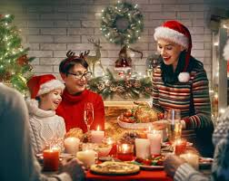
Christmas in Poland
Christmas, Christmas - in the Christian tradition - a holiday commemorating the birth of Jesus Christ. In Poland, it is celebrated on December 24

Slide 3
Traditions in Poland
Christmas traditions - Christmas and Christmas Eve customs in Poland include singing Christmas carols, putting hay under the tablecloth, preparing 12 dishes for the Christmas table. What are other Christmas traditions in Poland and what Christmas and Christmas Eve customs can be found in different parts of our country?

Slide 4
Curiosities that are in Poland
1. It is a tradition to hang mistletoe from the ceiling and kiss under it. It is said that a kiss under the mistletoe brings good luck for another year.
2. The most popular Christmas carol is "Silent Night", which is known all over the world. There is a translation in over 300 languages.
3. Decorating the Christmas tree is one of the youngest traditions. The lights are a symbol of Jesus' coming into the world and the green color symbolizes hope and eternal green.

Slide 5
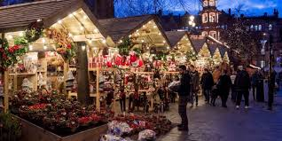
Christmas in England
It is derived from Old English and means the Mass of Christ. Christmas in England begins on December 25. The English do not celebrate Christmas Eve, but they do celebrate Boxing Day, which falls on December 26.

Slide 6
Traditions in England
Over the centuries, most of the rituals have disappeared and today the customs of Christmas are very similar to those celebrated in other parts of the world. However, the English have a lot of their own small and nowhere else unique traditions In the islands, Christmas starts very early and the English love this period of preparation and waiting. Already in October, shops are filled with goods decorated with the figures of a chubby Santa squeezed into a slightly too small sleigh. There are decorations on houses, sometimes with thousands of blinking lights. Everyone buys gifts. In factories, so-called Secret Santa, i.e. mutual giving of inexpensive gifts, is organized.

Slide 7
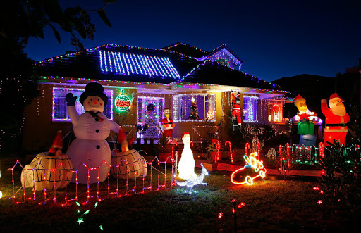
Christmas in Australia
Christmas in Australia is celebrated on December 25 and 26. ... 25.12 - Christmas Day is the day when children find presents under the tree in the morning. Santa comes to them at night when the children are asleep.

Slide 8
Traditions in Australia
On this continent, Christmas Eve is not celebrated, its tradition does not exist - of course, it is a country so multicultural that, to a large extent, this tradition is individual for each family. "Carols by candellight" is the custom of gathering in parks or on beaches in the evening and singing Christmas carols and candlelight songs. This is a chance for people living in the same neighborhood to get closer to each other. It was invented and popularized in 1937 by the Australian radio journalist - Norman Banks. It often happens that whole families spend Christmas time on the beach, for example at a barbecue. Houses are eagerly decorated with occasional ornaments, therefore competitions for the most beautiful decorations are often organized.

Slide 9
Interesting facts from Austria
1. Christmas is celebrated in the middle of the Australian summer, which lasts from December to February. Outside, 30 degrees, the beaches fill up with holidaymakers, and it's also a long vacation period. The kids are free from school, many companies close their activities for this time and go for the long-desired rest. There are a lot of people everywhere and more expensive than usual.
Santa comes to Australian kids on a surfboard (instead of a sleigh), and has dolphins or kangaroos (not reindeer) in the harness, and he wears shorts, a T-shirt and obligatory flip-flops! ... who would wear a 30-degree sheepskin temperature.

Slide 10
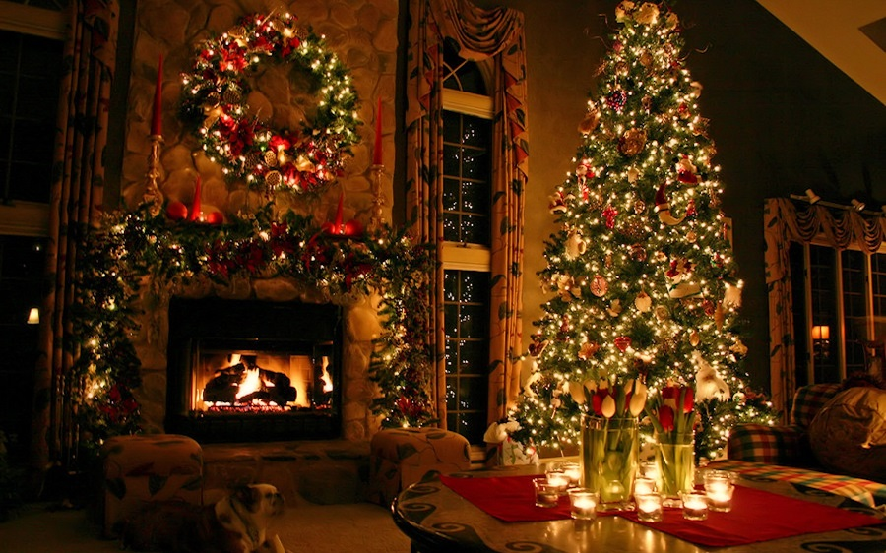
Christmas in Great Britain
On December 25, Christmas Day is a day off for everyone in Great Britain. Christmas celebrations begin right after waking up - usually children are the first to go to the Christmas tree in search of gifts that Santa Claus left there at night.

Slide 11
Traditions in Great Britain
Great Britain is becoming a multicultural country, welcoming immigrants from all over the world, and with them also their customs and traditions. The visitors enrich the already existing Christmas customs, but most of all they assimilate by adopting British traditions and cultivating them in their homes. In Britain, Christmas is the most family-oriented of all. Relatives and friends send greetings cards to each other, which they later place in a visible place, e.g. by hanging on the fireplace. In many workplaces, Christmas parties are held on December 24, and in schools, children play a nativity play. On Christmas Eve, usually all preparations for Christmas are finished - the Christmas tree is decorated and in the evening the families go to Midnight Mass.

Slide 12
The first Christmas tree
Prince Albert, spouse of the then reigning consort of Queen Victoria, is considered to be the person who in 1840 initiated the custom of placing and decorating a Christmas tree in Great Britain. But in fact, forty years earlier, the first Christmas tree was set up at Queen's Lodge, Winsdor, and it was initiated by Queen Charlotte, German descent, wife of Georg III.

Slide 13
Curiosities in Great Britain about Christmas
For Christmas dinner, the English eat turkey, served with potatoes and vegetables. With Brussels sprouts wrapped in breadcrumbs. And for dessert, it's Christmas pudding - sweet pudding with alcohol. According to some recipes, its preparation takes up to two months.
Instead of posting or e-mailing letters to Santa, British children are throwing them into the fire. They believe that their dreams will reach the North Pole with smoke.

Slide 14
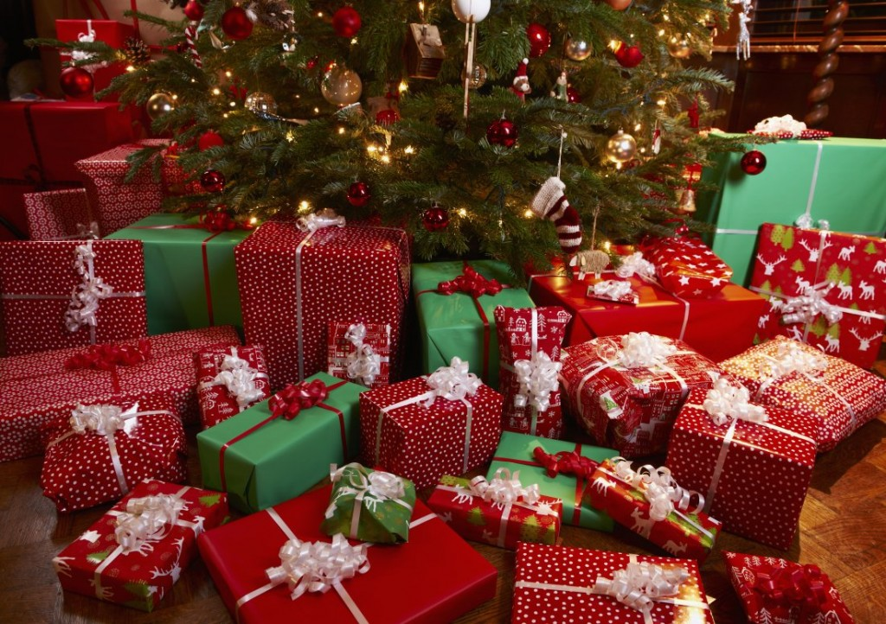
Christmas in Germany
W Niemczech Boże Narodzenie obejmuje trzy dni: 24 grudnia -Wigilię, pierwszy dzień Świąt Bożego Narodzenia i drugi dzień Świąt Bożego Narodzenia. ... W kraju tym nie ma zwyczaju łamania się oplatkiem, a świąteczne prezenty Niemcy układają na stole.

Slide 15
Traditions in Germany
On Christmas Eve, each guest has a coin hidden under the plate, which is to bring good luck in the new year. Although the celebrations of the holidays begin on December 24, the Christmas Eve dinner is not as sumptuous as in Poland. Gifts are given out on December 25th - in Germany they are also brought by Santa Claus. Our western neighbors are also famous for their wonderful Christmas fairs, where you can buy, among other things, decorations, decorations, lights, as well as sweets, Christmas dishes or mulled wine.

Slide 16
Interesting facts in Germany
Our western neighbors do not have the habit of breaking the wafer during Christmas Eve. This tradition is valid only in Poland and Lithuania. In Germany, there has never been any fasting, and during Christmas Eve dinner, most often people eat potato salad, sausages or sausages. The tradition of decorating the Christmas tree, which dates back to the 15th century, comes from Germany. The tree was considered a gift from Jesus. In Poland, Christmas is a typical family holiday, while Germans also spend it with their closest friends.

Slide 17
THE END
We thank you for your attention

